Slide 1
Chapter 9 Daily Life in Ancient Egypt

Slide 2
How did social class affect daily life in ancient Egypt?

Slide 3
Ancient Egypt’s Social Pyramid

Slide 4
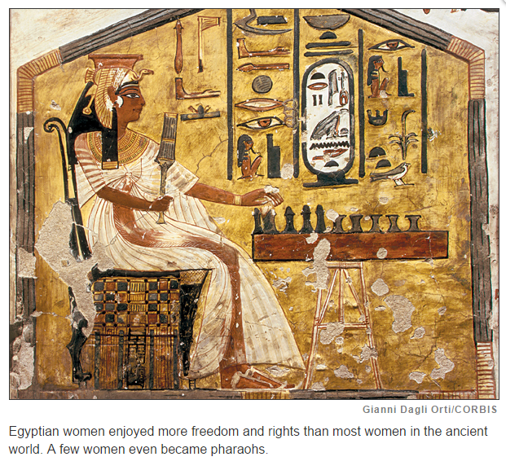
How did social class affect daily life in ancient Egypt?
Egyptian society was structured like a pyramid. At very top of this social pyramid was the pharaoh, Egypt’s supreme ruler. Egyptian religion strengthened the pharaoh’s authority. Pharaohs were believed to be gods, and their word was law.

Slide 5
How did social class affect daily life in ancient Egypt?
Egypt’s social pyramid was fairly rigid. Most people belonged to the same social class as their parents. There was little chance of moving to a higher class. Members of different classes may have had some things in common, but, in general, their lives were quite different.
Egyptians in all social classes cherished family life. Most Egyptians married within their social group. Children were highly valued.
Men and women had different roles within the family. Men were the heads of their households. They worked to support the family. Fathers often began to train their sons at a young age to take on their line of work. Women typically managed the home and raised the children. Upper-class women had servants or slaves to help them. Lower-class women did the work themselves.

Slide 6
How did social class affect daily life in ancient Egypt?
Men were in charge of Egyptian society, but women enjoyed more freedom and rights than most women in the ancient world. They could own land and run businesses. They could also ask for divorces and represent themselves in legal matters. Some women in the middle and upper classes worked as doctors, government officials, or priestesses. Both women and men enjoyed a better quality of life the higher they were on the social pyramid.
The Egyptians believed that their class system created a stable, well-ordered society. Each group had its own role to play.

Slide 7
Government Officials: Vizier, Chief Treasurer, & Military General

Slide 8
Lives of Luxury

Slide 9
Priests were powerful and highly respected in society. Priests advised the pharaoh, oversaw religious ceremonies, take care of the temple and take care of the burial practices.

Slide 10
The Priests’ Role in Burial Practices

Slide 11
Scribes were Egypt’s official writers and record keepers.

Slide 12
The Work of Scribes

Slide 13
Artisans were highly skilled laborers who created some of the most beautiful art objects in the ancient world.

Slide 14
The Daily Life and Work of Artisans

Slide 15
Peasants made up the lowest and largest class in Egypt. Peasants were unskilled farmers and monument builders.

Slide 16
The Daily Lives of Peasants

Slide 17
Summary

