Slide 1
4th Grade
Enrichment Clusters
Ridgecrest Elementary
Fall 2014

Slide 2
Enrichment Cluster Choices
Be a Hero, Make a Difference | Crafty Recreations
Soccer Anyone? | Dream Makers
Say What?! Code Talkers | Ori-Kami? Origami!
Business Matters | Stomp
Game Theory | Knitting! A Life Long Fun Skill

Slide 3
BE A HERO! Make a Difference!
Do you want to be a HERO to those who can't help themselves? Do you dream about CHANGING THE WORLD? Join this cluster to make the difference that only YOU can!
Think of a problem in the world that people should know more about. Is there a school-wide, social or environmental problem that you want people to think deeper about? Complete a project on this problem to make people more aware of it. Be the difference to the world, or another human being, animal…

Slide 4

SOCCER Anyone?
Do you like to watch the game of soccer? Do you play soccer yourself? Do you want to explore the fundamentals of this exciting international sport? There is more to the sport of soccer than just playing the game. There are rules and statistics that go along with this heart-pounding, thrilling game. Sign up to explore basic soccer skills, techniques, rules, keeping a scorebook, and fundamentals that will not only help you understand the game, but allow you to step out and have some fun too.

Slide 5

SAY What?!!! Code Talkers
Do you find yourself dazed and confused with certain comments that people make? Do you feel like the English language has hidden and unwritten rules? Does talking in code interest you? Improve your understanding and writing as we unravel these mysteries.

Slide 6
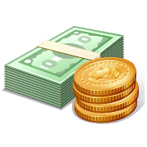
Dream Makers
What is in your future? Do you know what you want to be when you grow up? Do you have a plan on how to get there? Explore your strengths, weaknesses, and obstacles that will keep you from reaching your dreams. Set your career goals, map out your plan, and begin to make it happen. Your future starts today!

Slide 7
Crafty
Recreations
Are you creative? Do you hate to throw things away because you see the potential for new products from everything you use? Then this enrichment cluster was meant for you! Reusing, recycling, repurposing EVERYTHING is the name of the game. You can create NEW products from old trash like old torn books, magazines, water bottles, cereal boxes, newspaper, cans, boxes, etc. You can make products that are useful and practical or solve REAL problems you see around your school or in your neighborhood. You can study the history of recycling and its impact on the environment. You can create clothes or music from recycled items. It’s up to YOU. Become a creator and join us!

Slide 8
Ori-Kami? Origami!
Do you like to make things with your hands? Do you like creating art? Beautify the world by doing origami, the Japanese art of paper folding. Check out the work of Robert Lang, one of the foremost origami artists. Then try this art form yourself, both with patterns and without. You can make an origami menagerie (collection of animals), create a flower garden, or come up with an idea of your own. Your hands and your imagination will be your masters! Make your own folds! Become part of the history of origami.

Slide 9
Business Matters
Have you ever thought about starting your own business? You will conduct research about businesses that have been around for a long time, such as McDonald’s and Fisher-Price. Then consider developing a business proposal for a possible new business of your own, and look at ways to advertise the business, such as a television ads, informational brochures, or business cards. Take a leap and actually start your own business!

Slide 10

Stomp
Do you see the world around you as one big musical instrument? Do you find yourself tapping or drumming on anything? Well STOMP is the place for you! Think of it as a chance to make music with ordinary things that surround you every day. Things like brooms, trash cans, paper, buckets, spoons, pipes or anything else you can think of. If you want to turn those ordinary things into amazing instruments this is for you!

Slide 11
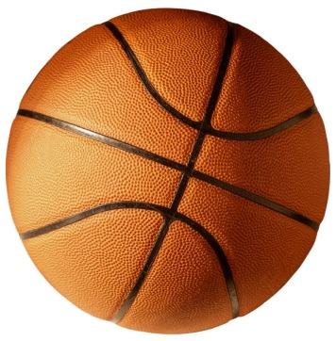

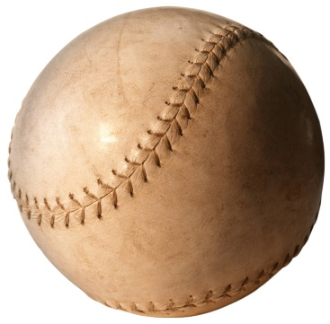
Game Theory
Game on! Do you have what it takes to create a new sport? Given a random pieces of sports equipment, you will work with a team to create a new game, complete with rules, strategies, penalties, boundaries, and surface dimensions. You and your team will scrimmage each other until you have perfected your new sport, then decide how you will share this sport with the rest of the school.

Slide 12
Knitting! A Life Long Fun Skill
Have you ever wanted to knit? Do you want to design a beautiful scarf? You will start by making a small practice project and then continue on with a scarf. You will also explore quick easy techniques, different color patterns, and types of yarn. Your projects can be used as gifts or you can use them yourself. Once you've finished your scarf, there are so many projects you can continue to make. Knitting opens doors to an endless world of creativity!

Slide 13
Enrichment Cluster Topics
On an index card, please, write: 1.) Your first and last name 2.) Your homeroom teacher’s name 3.) Three topics that interest you
Be a Hero, Make a Difference | Crafty Recreations
Soccer Anyone? | Dream Makers
Say What?! Code Talkers | Ori-Kami? Origami!
Business Matters | Stomp
Game Theory | Knitting! A Life Long Fun Skill

Slide 14
Enrichment Clusters begin November 7th
SEM Clusters will be held on the
1st & 2nd Friday in Nov., Dec., and Jan.

