Slide 1
Tips and steps to complete:
Free Application for Federal Student Aid
Application for grants, loans and work study funds provided by the federal government.

Slide 2
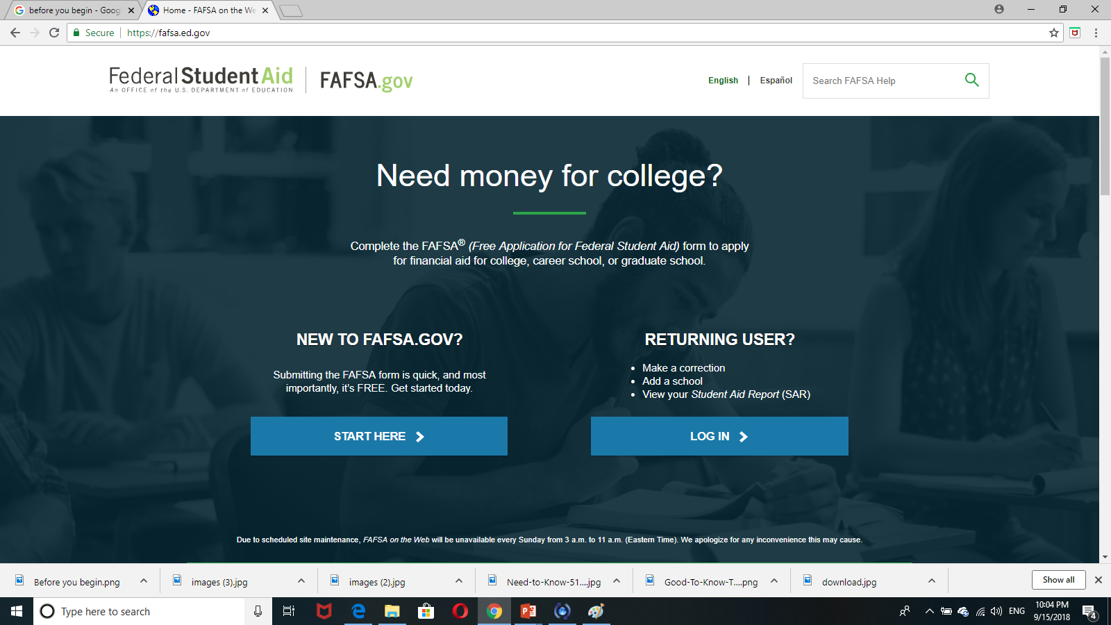
Go to the correct website
WWW.FAFSA.GOV
CLICK HERE

Slide 3
PREPARE YOUR DOCUMENTS
CREAT
YOUR
FSA ID
Your Social Security Number
Your permanent resident card (if you have one)
Any W2 Forms or records of earnings from the tax year requested.
Tax records/some examples 1040; 1040 EZ
2017 tax information should be used when completing the 2019/2020 FAFSA application.
You will need the same information for your parents if you are a dependent student.
Your electronic signature to your FAFSA.
Your access to the federal student aid website.
Your parents will need their own FSA ID to complete your application.

Slide 4
LOG IN PAGE
Enter your FSA ID and password on the next screen.
Remember: Do not share your FSA ID with anyone. It is considered your signature.

Slide 5
Disclaimer
Next screen you will see a disclaimer that says that you should use this application and funds for education purposes only.
Read, then click accept.

Slide 6
Choose the correct school year
For example, if you are going to enter college in the fall of 2019 you will click on
START 2019/2020 FAFSA

Slide 7
SAVE KEY
At this point, you will be asked to create a SAVE KEY.
It is anything between 4 and 8 characters.
This is your best way to save your application and finish it later if you need to stop.
Your parent will need this SAVE KEY to log in to the application and put their information.

Slide 8
Student Demographic information
Fill out your demographic information such as, your name, date of birth, mailing address etc.…
Notice that there is a help and hints button on the right side of the screen. If you have any questions, it is a good way to find an answer. FAFSA help line:
1-800-433-3243

Slide 9
Eligibility Question
For males between 18 and 25, it is required that you register with the selective service.
Select (never attended college 1st yr) even if you did AP or IB or duel enrollment.
Press yes if you wish to be considered in work study

Slide 10
To be eligible to receive federal student aid, you must:
1) Be a citizen or eligible noncitizen of the United States.
7) Register (or already be registered) with the Selective Service System,
2) Have a valid Social Security Number.
3) Have a high school diploma or a General Education Development (GED) certificate.
4) Be enrolled in an eligible program as a regular student.
8) Not have a conviction for the possession or sale of illegal drugs for an offense that occurred while you were receiving federal student aid (such as grants, work-study, or loans).
5) Maintain satisfactory academic progress.
6) Not owe a refund on a federal student grant or be in default on a federal student loan.

Slide 11
After the eligibility question you will be asked to select schools
Now enter the colleges or schools you wish to attend.
You may enter up to 10 colleges.
PTC Clearwater-005605
PTC St. Petersburg-013917
Housing Plans …
Then you will be asked to enter your housing plans, this helps the school know what your cost of attendance will be.

Slide 12
Dependency questions
These questions will determine if you need to report your parent information or not.
If you answered yes to any of these questions, you may be considered as an independent and your parent information may not be required.

Slide 13
Dependency Status Results
Once you get to this page, select “I will provide parental information.”
NOTE! The color of the banner on the left side will change in the next page, and the word PARENT will replace STUDENT.
This is your parents’ turn to enter the application and put their information.

Slide 14
Parent Demographics Information
Here your parents will enter their demographic information, such as their name, social security, mailing address…etc.

Slide 15
Continue…
Parent Demographics Information
In the next page, they will be asked to enter their marital status and the household size.
The household size is the number of people that live with you, supported by your parents.

Slide 16
Parent tax information
Next, your parents will enter their tax information.

Slide 17
IRS Data Retrieval tool
Using the Link to IRS (data retrieval tool) will save time and help with the accuracy of tax information needed. This tool also helps in the verification process, and limits the additional need to request transcripts after the application has been completed.
If this tool in not working, you will need a hard copy of your tax return. You will need to enter certain data which can be found on lines of your tax form.

Slide 18
Student Tax information
You can also use the IRS link.
NOTICE!
We are back to
student Banner

Slide 19
Sign and submit
After you review all information and verify everything is correct, hit the Agree button and press
SUBMIT MY FAFSA NOW

Slide 20
Wait for this confirmation page!
You should see your confirmation number, eligibility information and
your EFC…

Slide 21
You should contact the financial aid office at the college you plan to attend, to find out if there are additional requirements, or verification documents needed.

Slide 22
Financial aid award letter
After you have completed the college’s application requirements and the college has determined your eligibility, the college will create a financial aid award letter for you.
This letter will detail the costs of attending the college for an academic year, as well as any grants, scholarships, work-study, or loans you are eligible to receive.

Slide 23
Questions ?
We are here to help you!

Slide 25
THANK YOU!

