Slide 1
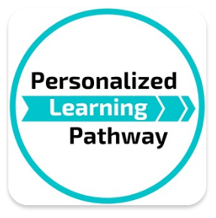
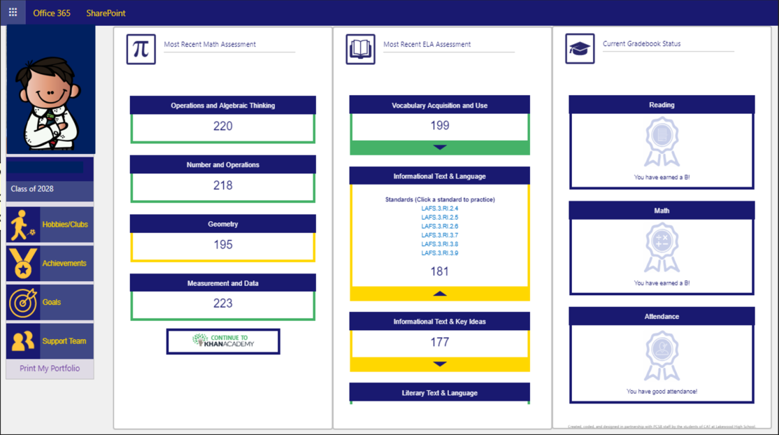
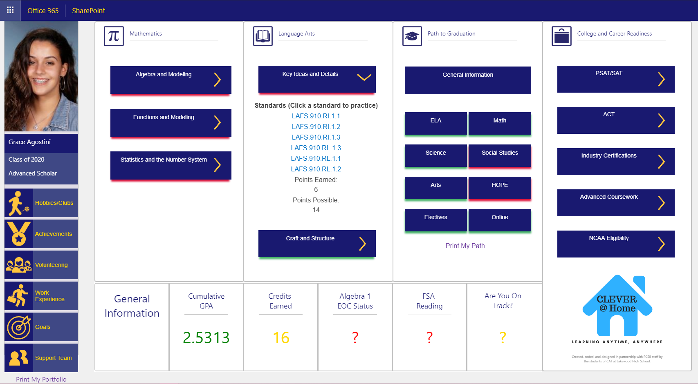

The Personalized Learning Pathway (PLP) is a new online platform that provides a dashboard of information about how a student is doing in school and on state/ district assessments. Student in grades 3-12 can keep track of clubs and volunteer activities as well as access online lessons for the areas they need more work on.
Students get to PLP through their Clever dashboard.
Log into Clever
Click on the Personalized Learning Pathway app
Enter their school email – username@pcsb.org (Ex. r2.d2@pcsb.org)
Elementary PLP
(3-5 only)
MS & HS PLP

Slide 2
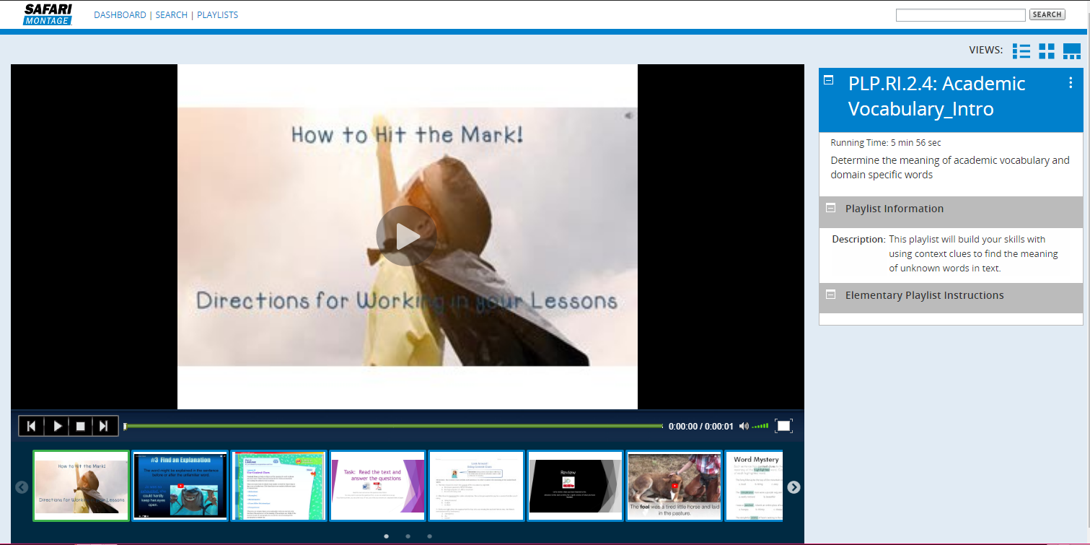
When the student clicks on one of the links for an area they need more work on, it takes them to an online lesson!
Elementary Lesson Example
Each online lesson will include an item the students can hand in to their teacher at school.

Slide 3
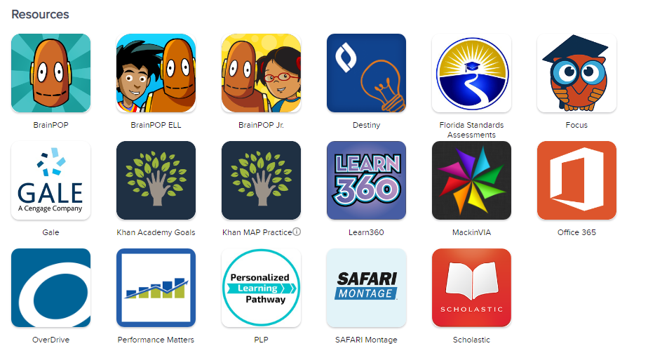
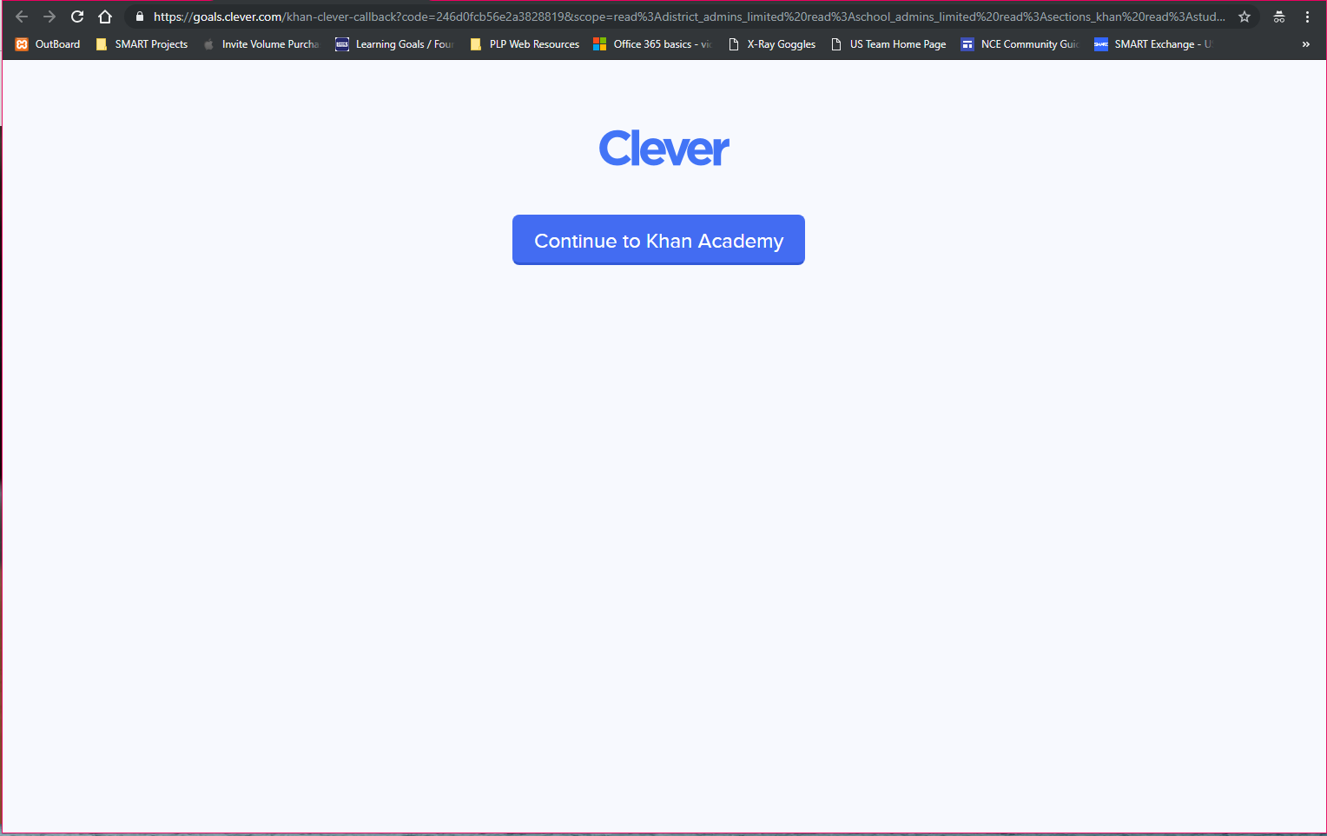
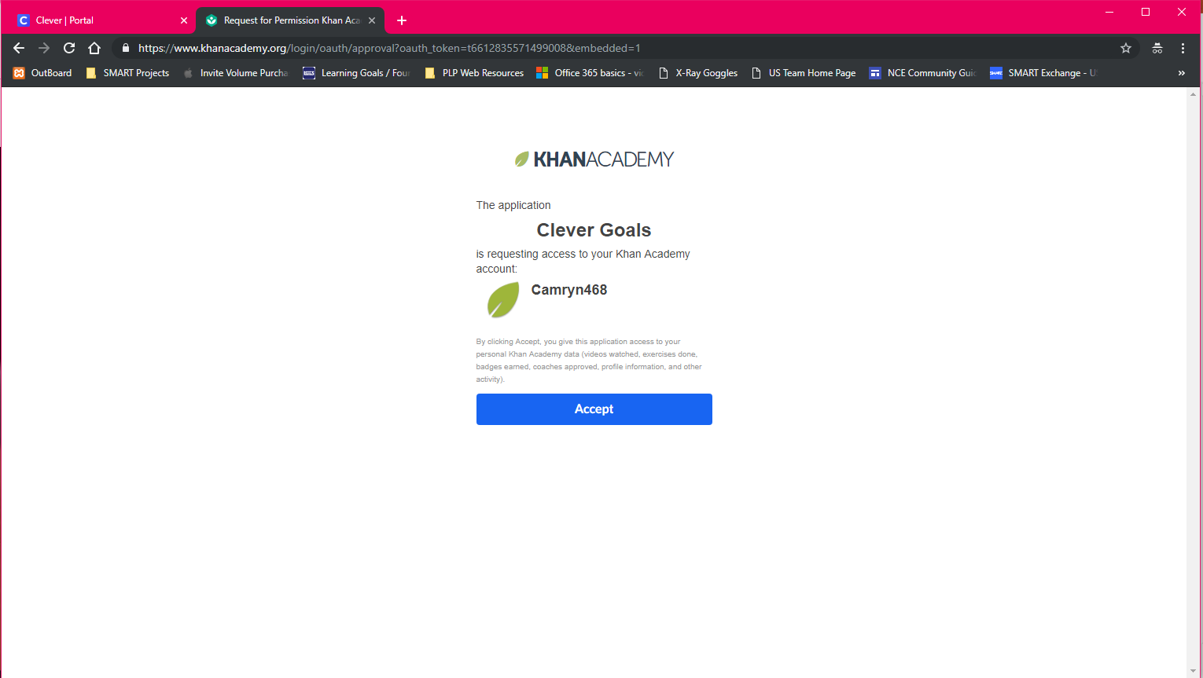
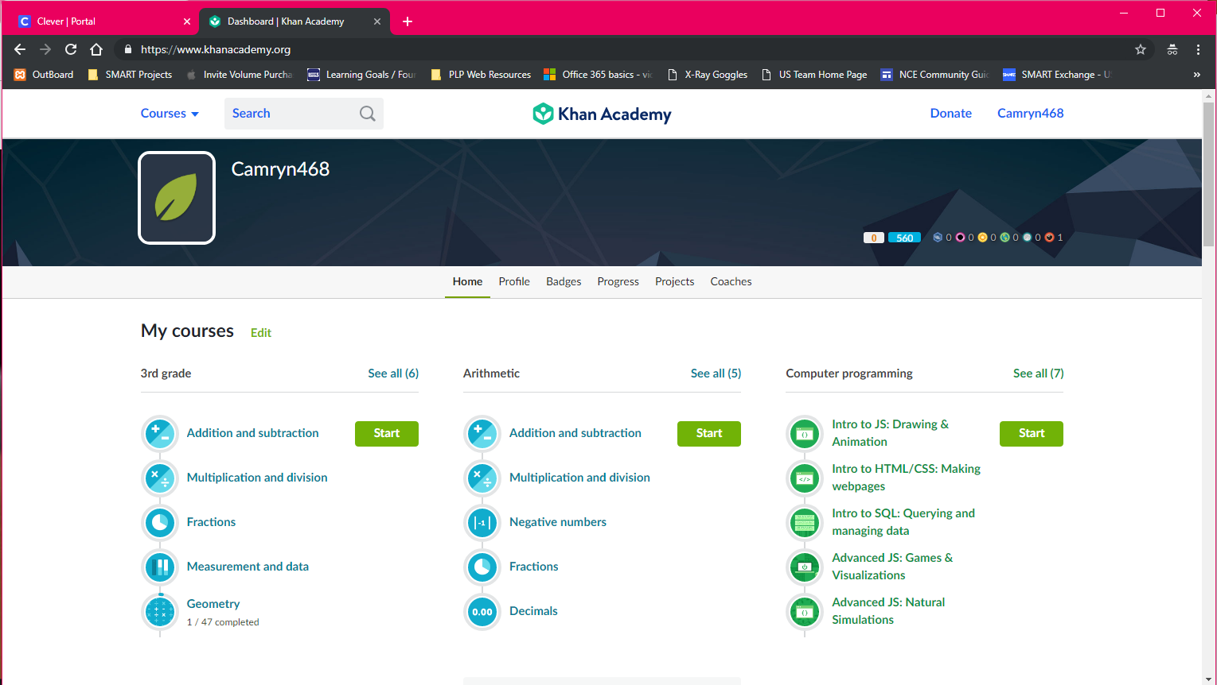
The Personalized Learning Pathway (PLP) has also partnered with Khan Academy to provide lessons for math practice in grades 3-5.
How will students get to those after they log into Clever?
Click on the Khan Academy Goals app
Click on the Continue to Khan Academy button
Accept the Clever Goals message.
You will now see the main Khan Academy page, leave this tab open.

Slide 4
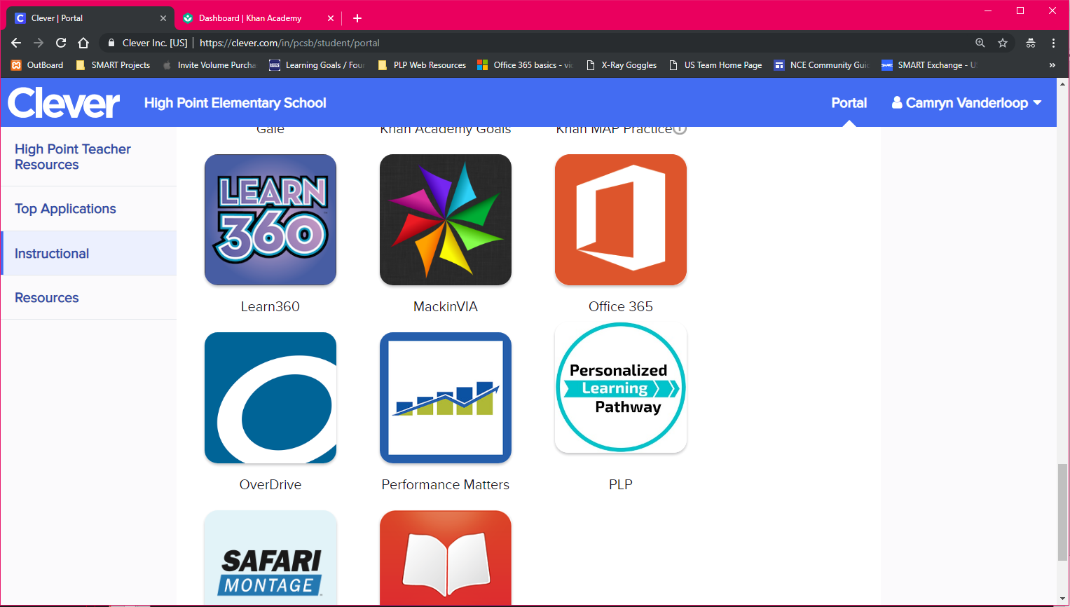
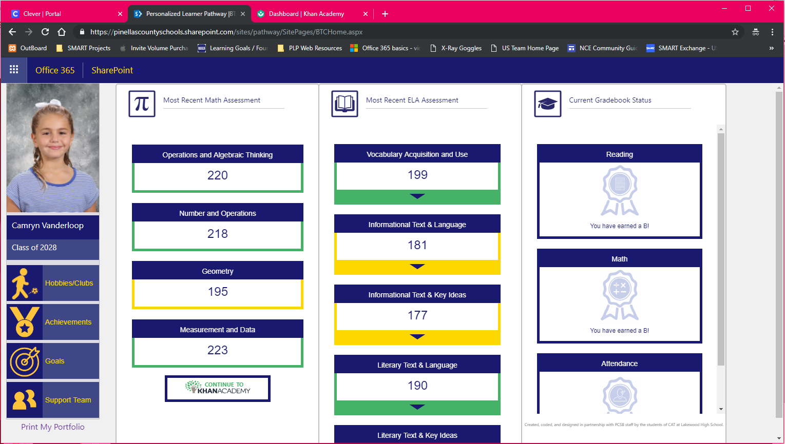

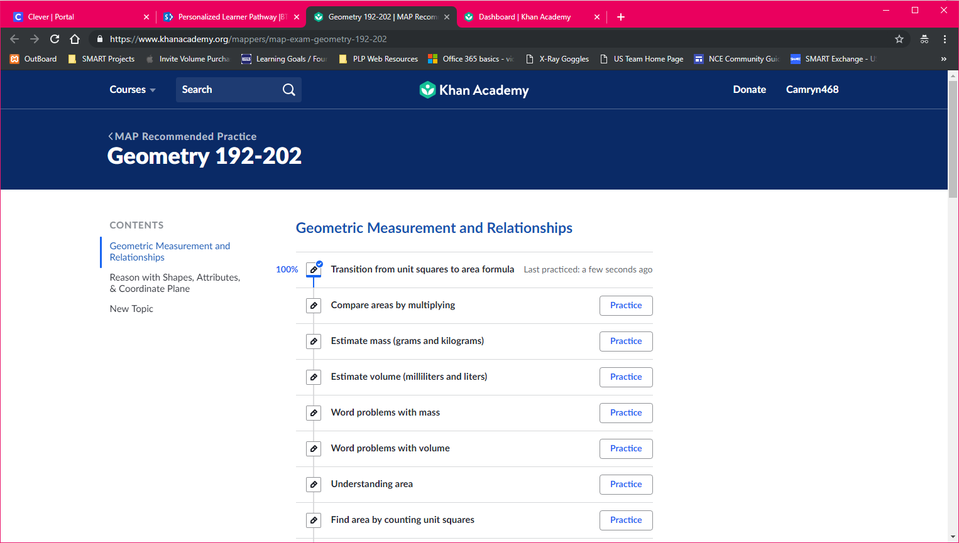
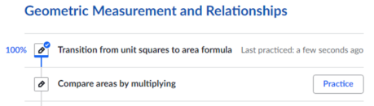
The Personalized Learning Pathway (PLP) has also partnered with Khan Academy to provide lessons for math practice in grades 3-5.
4. Go back to the Clever tab you left open.
5. Click on the PLP app
6. Click on the math topic you would like to work on.
7. Khan will open up to that topic & track your progress too!

