Slide 1
AP SEMINAR
& why YOU should take it

Slide 2
AP CAPSTONE
It is a flexible, college-level program with two required courses – AP Seminar and AP Research. These courses complement the skills and knowledge acquired in other AP courses. Skills to be developed in this two-course sequence include the following:
Thinking independently
Writing effectively
Conducting research
Collaborating with others
Learning across disciplines

Slide 3
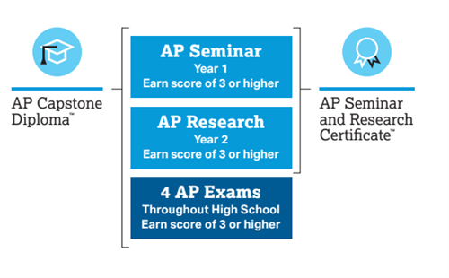
AP Seminar → AP Capstone

Slide 4
WHAT IS AP Seminar?
Cross-Curricular Conversations
Collaboration
College Credit
Information/articles pulled from all academic disciplines → not JUST English!
Working with others in teams to create collaborative projects.
AP Seminar is a 5-point class that earns you college credit
Academic and Real-World Topics
Applicable Skills
Accessible to All!
Perfect for goal-oriented, academically-motivated students who are ready to research!
No prerequisite → great place to start if you haven’t taken an AP before!
Develop practical, real-world critical thinking skills while researching high-interest topics, both individually and with a team

Slide 5
REASONS TO TAKE AP SEMINAR
01
02
STAND OUT IN COLLEGE APPS
EARN COLLEGE CREDITS
Taking an AP class helps demonstrate that you have what it takes to succeed in an undergraduate environment.
By taking an AP course & scoring successfully on the AP Exam, you can qualify for college credit.
03
04
BUILD COLLEGE SKILLS
FAKE NEWS? NOT HERE
AP Courses let you know what to expect during the next phase of your educational journey.
AP Seminar allows you to learn critical thinking and research skills, a priceless skill in the digital era.
Notes:
Build College Skills
Taking an AP course builds the skills you'll need throughout your college years. You give your mind a rigorous workout while polishing up your time management and study skills. You also get better at handling challenging issues and problems, with the support of your AP teachers. AP courses let you know what to expect during the next phase of your educational journey, and help you build the confidence to succeed.

Slide 6
HOW AP SEMINAR WILL HELP FUTURE YOU
Expands your knowledge of current issues
Expands your knowledge in different fields
Allows you to develop skills in research, critical thinking, and public speaking
Can introduce you to your future major/field of study
Allows you to make friends/collaborate effectively in groups

Slide 7
AP SEMINAR CLASS FORMAT
PT1
PT2
EOC
PERFORMANCE TASK 1
PERFORMANCE TASK 2
END-OF-COURSE EXAM (AP EXAM)
Team research project on a real-world problem/issue
Individual research report & presentation on a thematic issue
Critical Thinking/ Argumentative Analysis

Slide 8
COLLABORATION & COMMUNITY
Collaboration
Learn to work with diverse groups of people in a collaborative environment.
Community
Make new friends and have rich discussions with a variety of differing opinions.

Slide 9
DON’T BELIEVE US?
Here are some Words of Wisdom
From a former AP Capstone student:

Slide 10
“I just wanted to update you on how thankful I am that I took AP Capstone! I am writing my first college research paper and this is the easiest assignment of my life. Everyone in the class group chat is going crazy because they don't know what a scholarly source is. All I had to do was pull up Gale and get to work.
Learning how to read scholarly articles in AP Capstone was so incredibly helpful. I am in a class on the effects of trade. The professor assigns two lengthy scholarly articles a week for us to read to understand the advanced material. These articles can be about 80 pages each of really dense literature and analysis. But thankfully, I learned how to read these in your classes. My class is filled with juniors and seniors who are just now learning to read these types of articles. These articles are very easy for me to process due to AP Capstone. If I hadn't taken AP Capstone in high school I probably would've had to drop this class. I am one of the youngest students in the class, and I have one of the highest grades.
Finally, I am applying to internships with offices in the Florida House of Representatives. Many of these positions ask for applicants who would be able to conduct research on policy proposals, public support, and legislative analysis. I went to the Career Center on campus and my advisor was very excited to see my paper from AP Research and had me put a section about it on my resume.
Feel free to share this with your students because I am so incredibly thankful that I took AP Capstone! Miss you guys tons and I hope your classes are going well this year!” - Shelby Wright, class of 2021

Slide 11
INTERESTED IN JOINING THE AP CAPSTONE PROGRAM?
Email Mrs. Munson with any other questions at munsond@pcsb.org OR let your counselor know that you’d like to take AP Seminar!

Slide 12
THANK YOU!
And see you soon!

