Slide 1
SENIOR CLASS ASSEMBLY
January 29, 2020

Slide 2
SENIOR CLASS SPONSORS
Ms. Parks
parksk@pcsb.org
Rm – 2-110
Mrs. Kessler
kesslerp@pcsb.org
Rm – 2-106

Slide 3
GRADUATION FEES
Graduation Fees - $90 due April 1st
Payments accepted via cash or check made out to Largo High with student name and “graduation fees” written in the memo.
Pay Monday – Friday during lunch and before school ONLY!!

Slide 4
GRADUATION
Largo High School’s
2020 Graduation Ceremony
Saturday, May 23rd, 2019
Tropicana Field
4:15 pm

Slide 5
REMIND & SOCIAL MEDIA
Follow your senior council for updates…
Instagram: Largo2020
Remind: @b6bh2d
@b6bh2d

Slide 6
GRAD BASH – FRIDAY, 4/03/20
Grad Bash tickets are still on sale!!!
First come first serve basis
Must have fees and permission slip
Cost is $135
Pay in room 2-110
Final date to pay is February 14th!!!

Slide 7
SENIOR COOKOUT & OLYMPICS: THURSDAY, MARCH 12TH
During 7th period @ the Football Field (ONLY)
Wait for the all call to be dismissed
During lunch get a WRISTBAND: won’t be allowed in without one
Senior Olympics to follow after school
BYOB: flag football, kickball and corn-hole with music
One free meal includes: Hamburger, black bean burger OR hotdog, chips and water with a soda
Additional food or drinks, you will have to purchased: Hotdogs, hamburgers & water: $1 Chips & soda: $0.50

Slide 8
MR. & MISS LARGO PACKER GAMES
Competing for the title of Mr. & Miss Largo
Winners are allowed to wear crown & sash @ Prom
Prize: Free admission to Senior Brunch
Homecoming Queen & King are not allowed to run
Winners are not allowed to run for Prom Queen & King

Slide 9
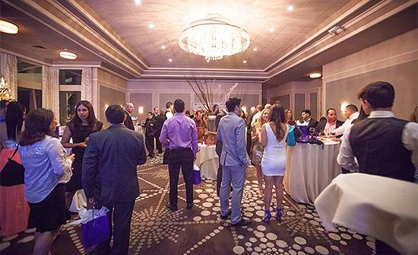
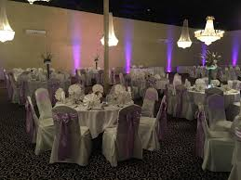
SENIOR BRUNCH

Slide 10
Senior Brunch
April 28th from 11:00 am - 1:00 pm
$25
Superlatives awarded certificate
Photo opp
Raffle, games & prizes
Talent show: entertainment
Slideshow: submit photos to LargoHighSeniorCouncil@gmail.co
Grad rehearsal will be held in the auditorium 1st and 2nd period this day.

Slide 11
JUNIOR COUNCIL INFO
Council President & Vice President

Slide 12
YEARBOOK UPDATES MS. HICKS 1-234

Slide 13
Order online
- ybpay.lifetouch.com
- ID CODE: 13268420
Bring cash, check, or money order to
Ms. Hicks’ room (1-234)
BUY A YEARBOOK!!!

Slide 14
SENIOR PAGE RATES
Quarter Page $90.00 1-2 Photos
½ Page $125.00 5 Photos
Full Page $250.00 10 Photos
Last day to buy a senior dedication page is February 21st

Slide 15
CAP AND GOWN
Last day on campus to take cap and gown photos is February 5th in the auditorium.
It is NOT a retake day for seniors who have not been photographed. We encourage those who did not take senior photos to take a picture on this day.
There will be a sign up sheet outside on Ms. Hicks’ door starting TODAY, first come first serve.

Slide 16
SENIOR QUOTES
Quote slips will be available for pickup at lunch TODAY ONLY
Quote Submission- On Friday January 31st in Ms. Hicks’ room 1-234 all day long
If there are more than 3 inappropriate quotes Ms. Hicks will delete them all.
If you submit an inappropriate quote, it will be reported.
All quotes must be limited to 64 characters/spaces total.
Yes, spaces between words count and need to be included.
NO profanity. NO acronyms. NO gang-affiliated words or phrases. NO drug or alcohol references.
NO derogatory comments about other students or staff members.

Slide 17
SENIOR IDs
Senior IDS will be available for pick up on friday when you hand in your senior quote slip
You’ll only have a senior ID if you took your senior portrait already

Slide 18
SENIOR PANORAMIC
Senior panoramic picture will be on Friday, February 7th in the gym.
Time TBA

Slide 19
SUPERLATIVE PHOTOS
There will be 3 separate days to take pictures of the superlative winners during 4th period only in Ms. Hicks room 1-234
The days are February 6th, 11th, and 13th.

Slide 20
QUESTIONS?
Please come see Ms. Hicks’ before school, during lunch, or after school.
Email: hickska@pcsb.org

Slide 21
SENIOR SUPERLATIVES!

Slide 22
Best Dressed: Khaishef Edwards + Leonela Gonzalez
Senior Snack: Carlos Franklin + Brielle Bender
Beauty&Brains: Teo Couedelo + Katerina Nasto
Most Changed: John Ozack + Amaziah Gilbert
Best Couple that Never Dated: Skylar McPherson + Madison Geary

Slide 23
Most likely to be Famous: Skylar McPherson + Sam Lopez
Bromance: Zuri McClary + Jayden Hayes
Sismance: Angelica Alvarez + Melissa Pena
Worst Driver: Justin Driver + Rachel Silverboard
Power Couple: Riley Rawe + Brianna James
Worst Case of Senioritis: Eli Chihani + Pulonga Maafu

Slide 24
Most Athletic: Quavon Matthews + Julia Violante
Biggest Flirt: Dee Jean-Pierre + Lucy Cantrell
Best Smile: Dorantaye Merrill + Janiyah Jones
Class Clown: Jayden Hayes + Hailey Winder
Most Likely to be LATE Graduation: Corey Robinson + Riley Moore

Slide 25
Most Unforgettable: Jayion McCluster + Ashanti Crawford
Most Likely to be President: Josh Mott + Elena Villamagna
Best Laugh: Zachary Dermody + Kylah Faye
Social Butterfly: Kamari Battle + Maria Olivera
Most Likely to be Successful: Jacob Harrison + Besarba Myrtaj

Slide 26
TO PAY FOR FEES PLEASE VISIT ONE OF THE TABLES
THANK YOU FOR YOUR ATTENTION!

