Slide 1
NORTHEAST HIGH SCHOOL
CLASS OF 2025

Slide 2
Day of graduation information
Date: May 29, 2025
Time: 11:30 a.m.
Location: The Sound
255 Drew Street
Clearwater, FL 33755
Students arrive: 10:30 a.m.
Student entrance: Southside of Clearwater Library

Slide 3
Dress code
Men should wear a dress shirt with a collar, socks, dress shoes and dark or khaki trousers.
Women should wear appropriate business attire, comfortable dress shoes or sandals with a strap. High- heeled shoes or wedges are NOT recommended since students will be doing a lot of walking over various surfaces as well as going up and down stairs!!!!
All should be aware that the red gowns will run if they get wet, so be careful about wearing white and sweating!

Slide 4
Dress code – PROHIBITED!!!!
Each student will be checked for appropriate clothing attire.
The following clothing items are prohibited:
Shorts (this includes rompers)
Flip flops, tennis shoes or Crocs
Flowers, flags, sashes and jewelry are NOT to be worn ON graduation gowns
Decorated caps or gowns are not allowed. COUNTY POLICY!!
No chewing gum, food, drink or other objects allowed inside.

Slide 5
Dress code – PROHIBITED!!!!
All electronic devices are prohibited from being used during the ceremony.
It is recommended that graduates leave purses and electronic devices with a family member.
Electronic devices will be confiscated until the end of the ceremony.
Students not following the dress code will not be allowed to participate in the ceremony.

Slide 6
Prohibited Items
Full list of prohibited items on the website
Paperless venue
No posters
No bigheads
No water bottles
No balloons
No umbrellas

Slide 7
Parent Information
Guest can enter the sound at 10:30 a.m.
Parking fees: Standard Rates Apply
Parking lots are available near the venue.
PCSB Bus Transportation
Rideshare drop off near the stadium
Handicapped lots available. (see map)
Paperless Venue

Slide 8
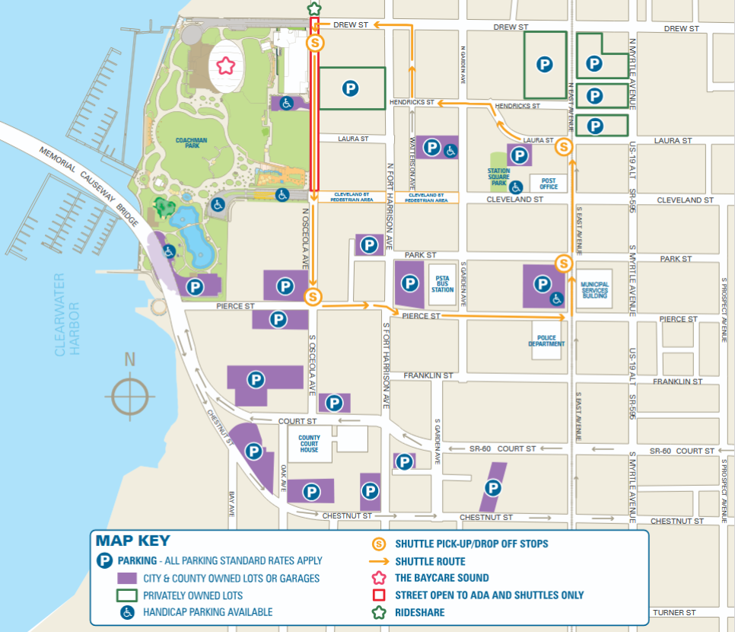
Parking MAP

Slide 9
Arrival & entrance info
Students will enter through the South Entrance of the Media Center
Students can enter the gate starting at 10:30 a.m.
Electronic devices & bags must be left with a family member.
ADMIN WILL CHECK FOR THIS!!!

Slide 10
Arrival & entrance info
FIRST: Go to the check-in table in the Clearwater Library with the alpha of your last name to receive your reader card
1
SECOND: Locate your numbered group and get in numerical/alpha order
2
THIRD: Designated teachers will ensure you are in order & properly dressed.
3

Slide 11
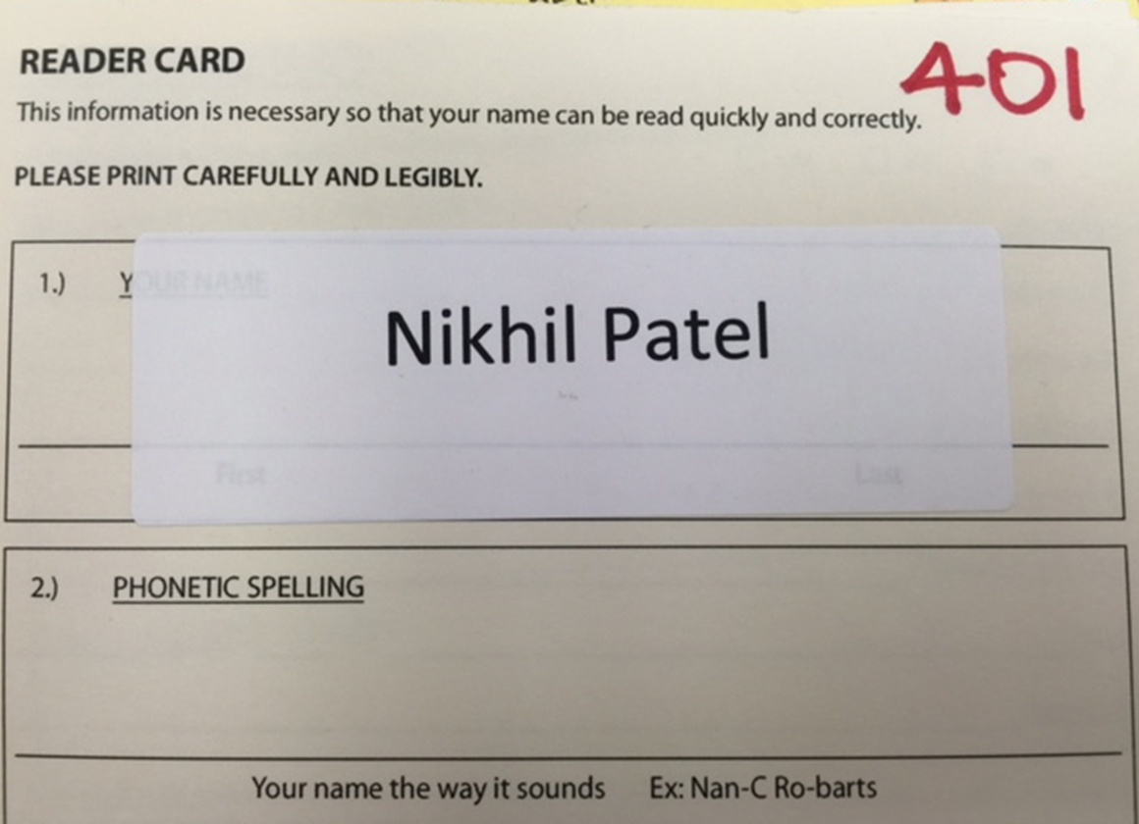
READER CARD

Slide 12
Ceremony info
The ceremony will be livestreamed. Link to come later.
Students will hear when it is time for the ceremony to start.
Ensure gown is zipped prior to walking onto the field. Tassel is worn on the right side.
Medallions, stoles, honors cords.
NEHI/PCSB issued items only
Students will enter onto the field in two lines.
Line leaders will seat the students. Remain standing until announced to be seated.

Slide 13
Ceremony info
Students are to remain seated until called by their row to enter on stage to receive their diploma cover.
Students will have a professional graduation picture taken behind the stage.
Students will enter the stage, hand their reader card to one of the name readers then proceed towards Principal Hernandez, receive their diploma cover and take another picture with Principal Hernandez.
Students will exit stage left and immediately return to their seat for the duration of the ceremony.
Do not throw caps in the air.

Slide 14
Final information
Issues with caps/gowns and orders must be handled with Herff-Jones at (727) 381-7714
Students must satisfy grad fees and have the current cap & gown to participate in the ceremony.
Pay all financial obligations before graduation in order to be able to participate. (Pick up diploma at school)
For an ASL interpreter or a graduate who needs assistance due to a disability, please see Mr. Cady at Cadyj@pcsb.org after!!!

Slide 15
Walking Across the stage

Slide 16
CONGRATULATIONS!
GRADUATION DAY
29 DAYS AWAY

