Slide 1
Math

Slide 2
Statistics
Mr. Trunk

Slide 3
AP Statistics
Students learn about the major concepts and tools for collecting, analyzing and drawing conclusions from data.
AP Statistics can prepare students for dozens of college majors beyond statistics, including criminal justice, aerospace engineering and environmental studies, just to name a few.
Additionally, concepts you learn in AP Statistics are applicable in scores of career fields, including advertising and marketing, social work and engineering.

Slide 5
Probability and Statistics Honors
Statistics is one of the most widely used math subjects, and many career fields require a background in it.
A great choice for honors level student who wants to try something different than Analysis of Functions or Pre-Calculus.
Good preparation for Intro to Statistics courses in college.

Slide 6
AP Calculus AB
Mr. Tarrou
Aka: ProfRobBob

Slide 7
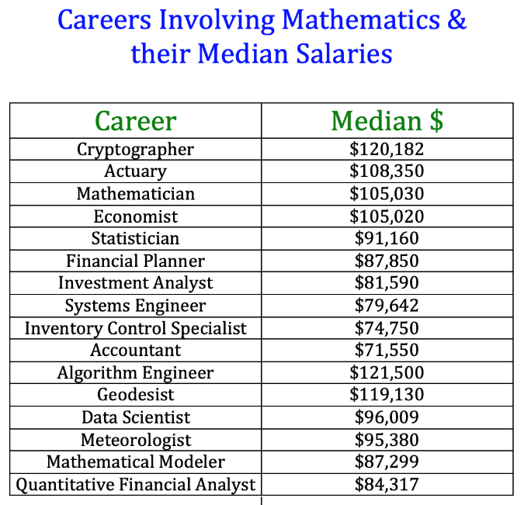

Slide 8
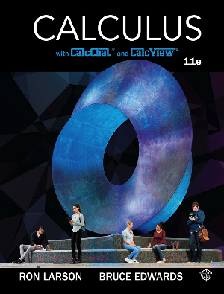
With 25 years of experience I will help you earn a
5 on your AP Exam with:
In-depth lessons with many examples and opportunities for collaborative work for every topic in the AP syllabus
After school tutoring available Monday-Thursday
Solutions for odd problems on www.CalcChat.com
Hundreds of videos I have created and posted at www.YouTube.com/ProfRobBob and www.ProfRobBob.com

Slide 10
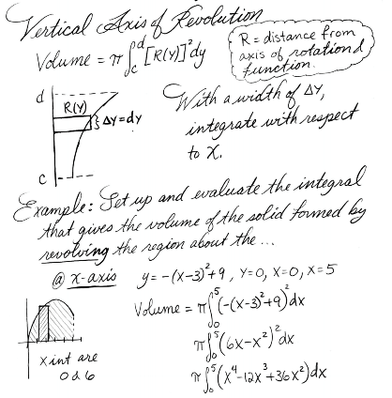
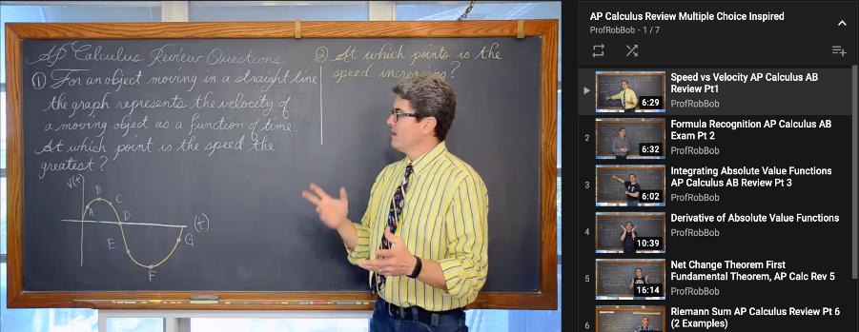
Whether you need more examples, missed a class, or just need a refresher, you will have access to my full set of notes and my lessons 24/7.

Slide 11
Get your name on the Wall of 5’s
and set yourself up for success in your college math classes!

Slide 12
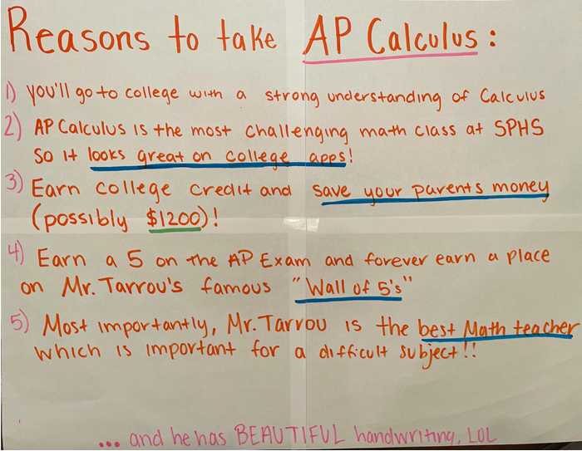

Slide 13
