Slide 1
Science

Slide 2
AP CHEMISTRY BRIEF COURSE DESCRIPTION
St. PETERSBURG HIGH SCHOOL

Slide 3
COURSE DESCRIPTION
The AP Chemistry course is designed to be the equivalent of the general chemistry course usually taken during the first college year.
For some students, this course enables them to undertake, in their freshman year, second-year work in the chemistry sequence at their institution or to register in courses in other fields where general chemistry is a prerequisite.
For other students, the AP Chemistry course fulfills the laboratory science requirement and frees time for other courses.”

Slide 4
WHY SHOULD I TAKE AP CHEMISTRY?
AP Chemistry is open to all students that have completed a year of chemistry honors who wish to take part in a rigorous and academically challenging course. AP Chemistry is not a course to take simply to ‘take an AP course’.
Students who are planning a career in anything related to the medical field should definitely take AP Chemistry before they graduate.
AP Chemistry requires a significant amount of study and work outside of the classroom. Students will truly be engaged in a college level course.
Even if a student does not receive a “qualifying score” of 3+, valuable knowledge will be attained that allows the student to be successful in their entry level college chemistry class..

Slide 5
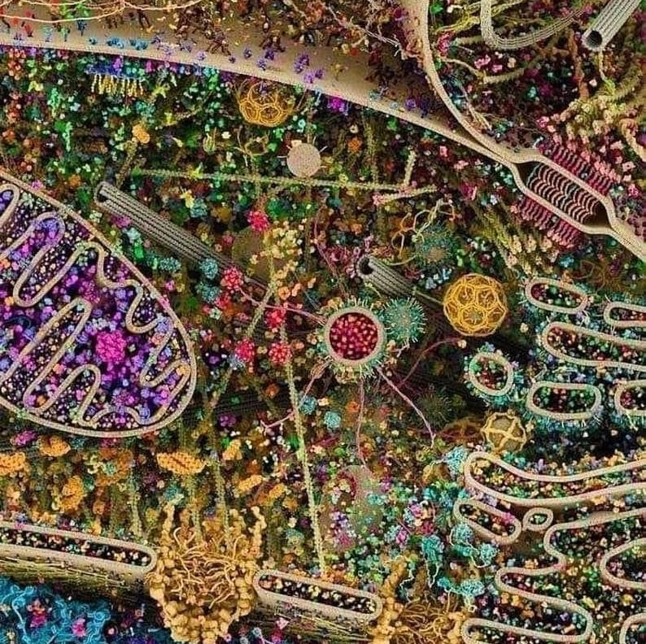
AP Biology
An introductory college-level biology course. Students cultivate their understanding of biology through inquiry based and hands on investigations as they explore the following topics: evolution, cellular processes-energy, communication, genetics, information transfer, ecology, and interactions. 25% of coursework is laboratory based

Slide 6
Who Should take AP Biology?
Students pursuing a career in health/biological science -medicine, forensic science, biomedical engineering, pharmacy, nursing, molecular biology, genomics, patent law, and chemical engineering (just to name a few!)
Highly suggested to any student planning Pre-Med, Pre-Law, Pre-Vet, Pre-Dent, Pre-Pharm or any pre-professional program of study.
Anyone who LOVES learning about Biology!
Suggested previous coursework: Biology 1 and Chemistry 1

Slide 7
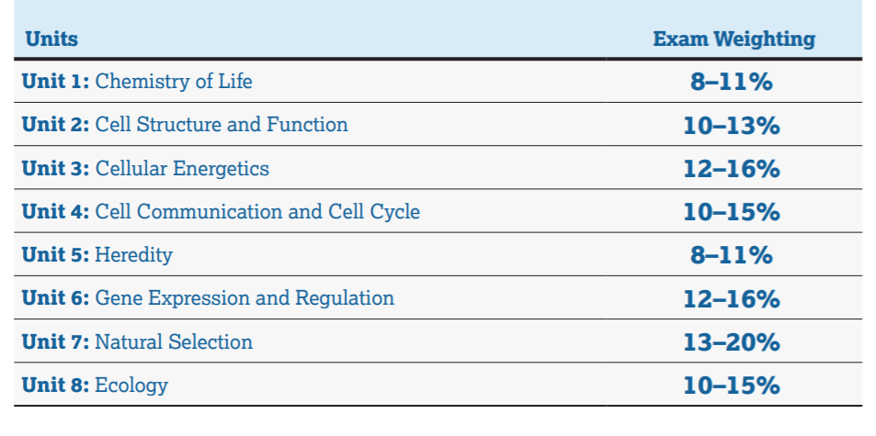
Unit Overview
https://apcentral.collegeboard.org/pdf/ap-biology-course-and-exam-description-0.pdf?course=ap-biology
College Board Full Course and Exam Description

Slide 8
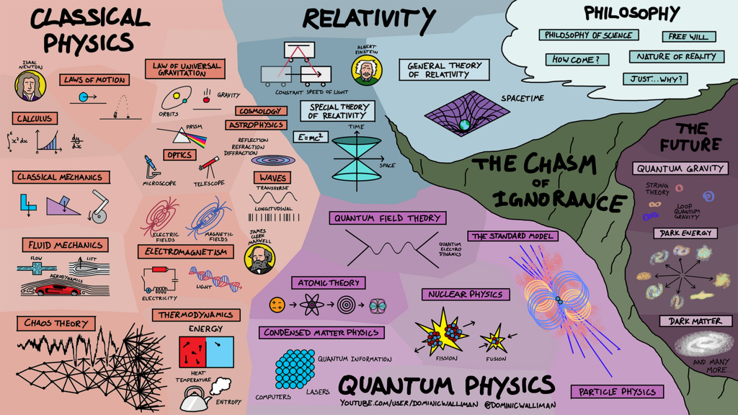
Physics! What is it?
Physics is the most foundational science: a study of how matter and energy interact. It includes mechanics, waves, optics, and electromagnetism.
Physics is crucial for both scientists and engineers. Most STEM and medical careers require exceling at physics.
At SPHS, we offer both Physics Honors and AP Physics 1.
Credit to Dominic Walliman and DoS – Domain of Science.

Slide 9
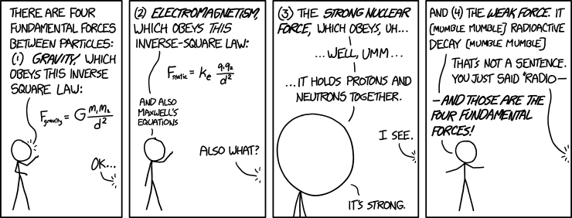
What’s the difference between the two?
Physics Honors
AP Physics
Honors level introduction to physics
Algebra only interpretation of classical physics
Good preparation for continuing in STEM career
Advanced course in physics
AP Exam at the end of the course
College level preparation course
Physics honors NOT pre-requisite
Both
Same topic covered
Good algebra skills recommended
Look great on college applications
Credit to XKCD. https://xkcd.com/1489/

Slide 10
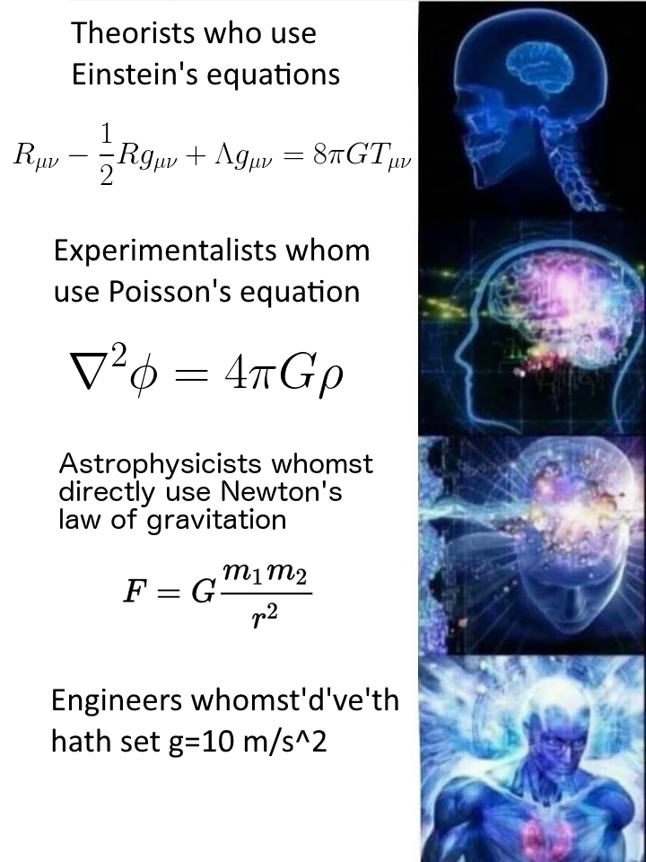
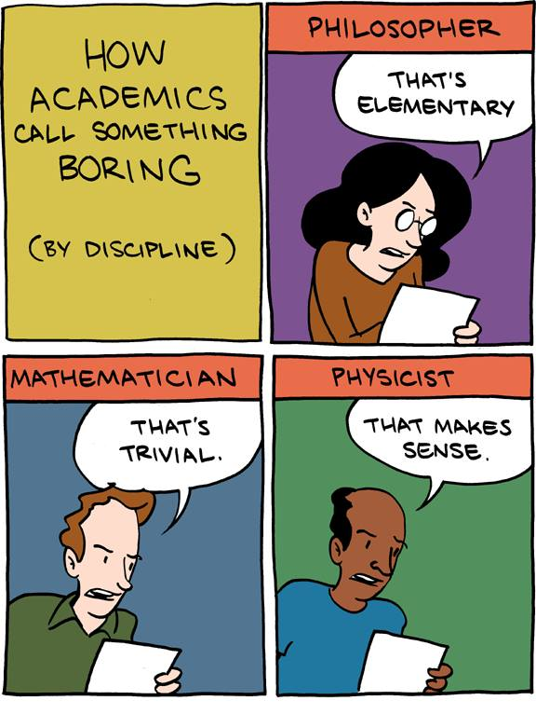
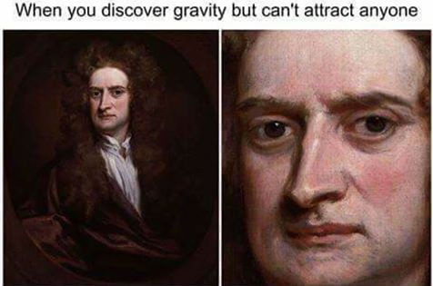
Student Testimonials and Physics Memes
“Physics Honors was one of my favorite classes last year and Mr. Polino is a wonderful teacher! The class itself was a fun and enriching experience through all of the interesting labs and lessons. Mr. Polino was and still is one of my favorite teachers, so take his class because it is great!” – Faith Jones
“Physics was a super chill class and a great break from traditional high school classes.” – Arabella Readey
“The labs were really fun and a great learning experience.” – Logan Lambeth
Credit to SMBC.

Slide 11
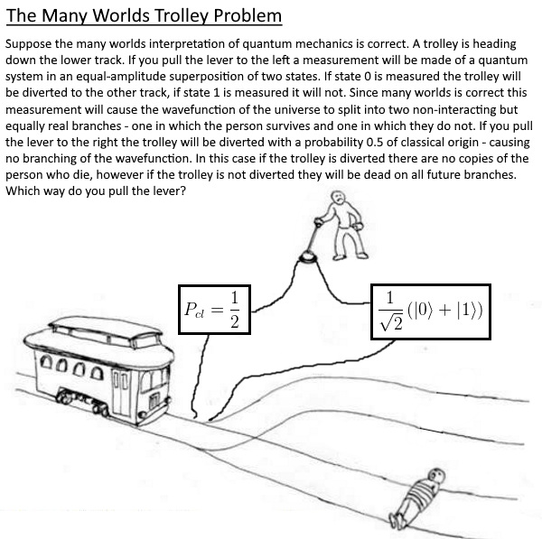
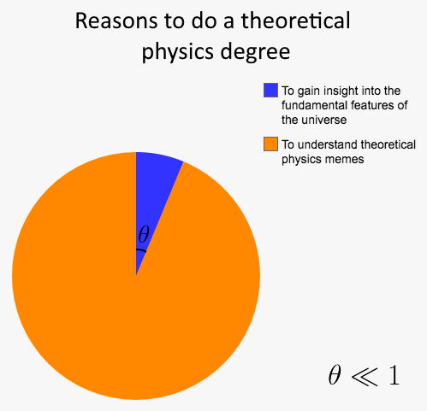
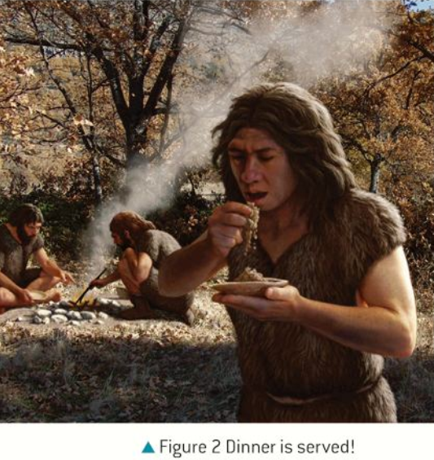
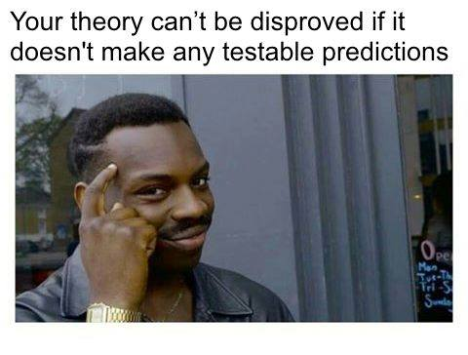
More Student Testimonials and Physics Memes
"Mr. Polino approached teaching us physics in a very engaging manner without sacrificing the quality of the education, highly recommended“ – Hubert Pugzlys
“Physics was incredibly fun and relaxed while still learning a lot about physics! It is really helpful as an introductory course for higher level physics classes. Mr. Polino teaches physics in an understandable way and he is so patient when helping if you don't understand. Overall, he's a really chill, awesome, and fun teacher so definitely take his class!” – Joanne Lioe
Credit to Meme-Theoretic Theoretical Physics Memes
Physics: Course Companion

Slide 12
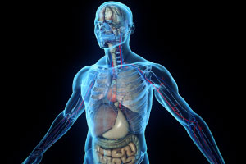
Human Anatomy and Physiology Honors is a laboratory-based course that investigates the structure and function of the human body. Students will engage in many topics and competencies related to understanding the structure and function of the human body. Students will learn through reading, video lessons, case studies, collaborative group work, interactive projects, and labs. Dissection of a cat and other appropriate organs will complement our course work. One of the goals of this course is to prepare students with the skills necessary to be successful in future science classes in college and medical fields.
Human Anatomy and Physiology Honors

Slide 14
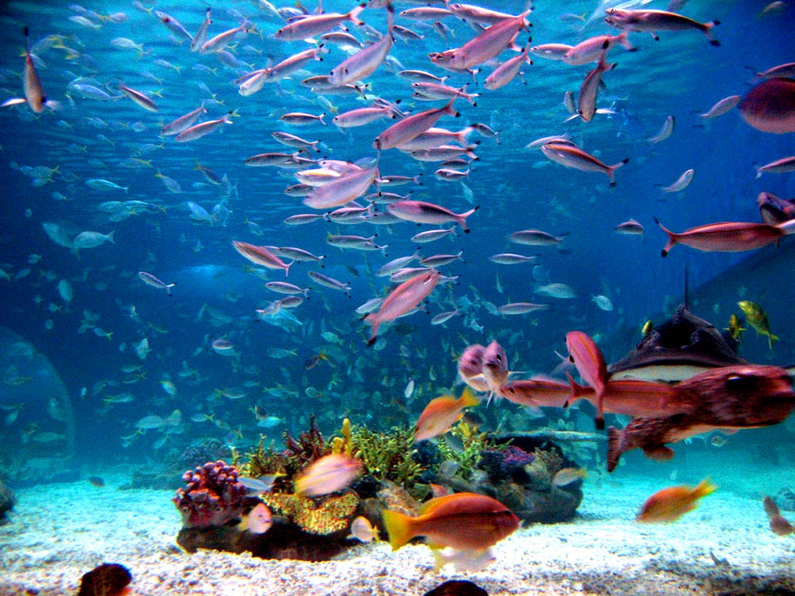
MARINE BIOLOGY
This Photo by Unknown Author is licensed under CC BY-SA

Slide 15
1st SEMESTER TOPICS
GEOLOGY OF THE OCEANS
WATER, WAVES AND TIDES

Slide 16
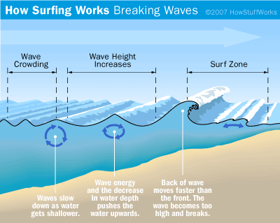

Slide 17
2ND SEMESTER TOPICS
MARINE ORGANISMS
INVERTEBRATE
VERTEBRATE
MARINE ECOSYSTEMS

Slide 18
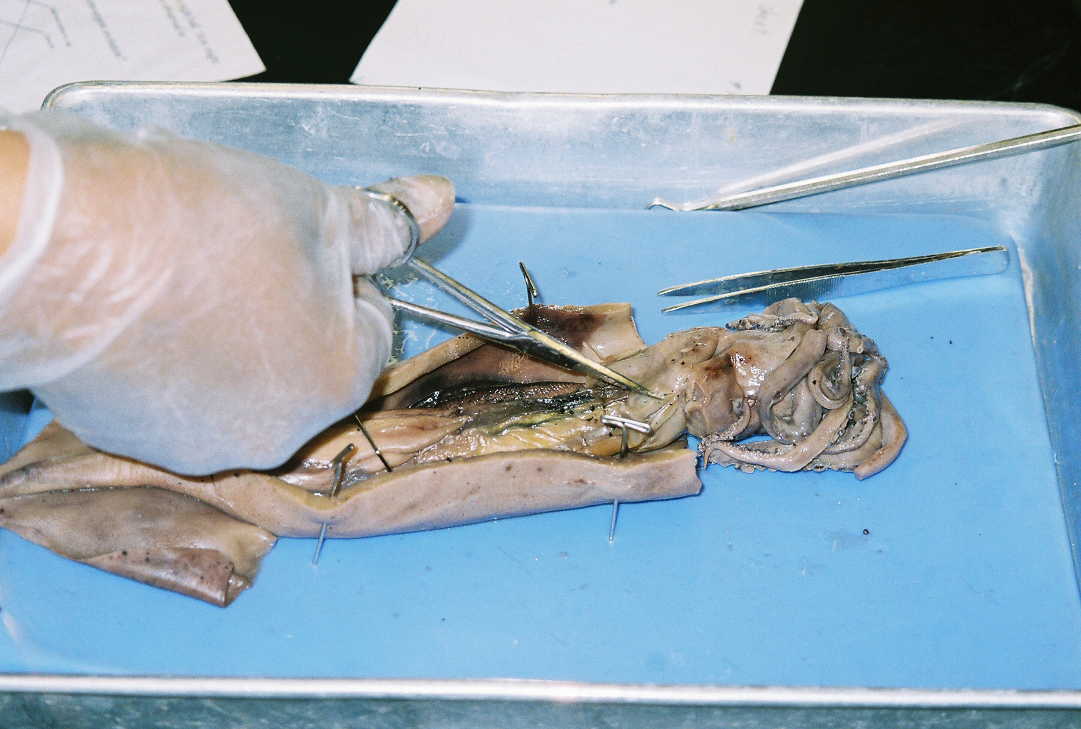
2nd semester dissecting squid

Slide 19
“The reason I really enjoy AVID is because I can learn how to be organized and it helps me to keep up with my classes. AVID is an essential course for learning about colleges as well as how to be more effective in school.”
- Alexander Lambridis
“I like AVID because the teachers are always wanting to know if your doing good in your classes and they’re very nice to each kid. I like to be in AVID because it keeps me on track.”
- Victor Santos

