Slide 1
SAC
School Advisory Council
Jennifer Gil
Principal
gilje@pcsb.org

Slide 2
Agenda
Purpose of the School Advisory Council
Make-up of council
Meeting times/dates
Informational Videos
SAC Funds
2021-2022 Achievement Data
School Improvement Plan Goals
Controversial Materials Committee
Open

Slide 3
School Advisory Council
Make-Up and Meeting Dates
Purpose
Parents, staff members, community members & students.
Board Members
Representative of the school/community demographics
2nd Monday of the month at 6 p.m.
The purpose of the SAC is to assist the principal in developing and evaluating the results of the School Improvement Plan and the management of school improvement and state recognitions funds.

Slide 4
Informational SAC Videos

Slide 5
SAC Funds
Teachers submit request to principal
Principal will present request to SAC
SAC members vote to approve request
Examples: science lab materials, AP writing grading system, t-shirts, band equipment, etc.

Slide 6
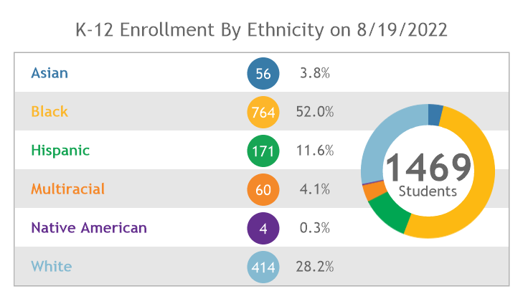
BCHS Demographics

Slide 7
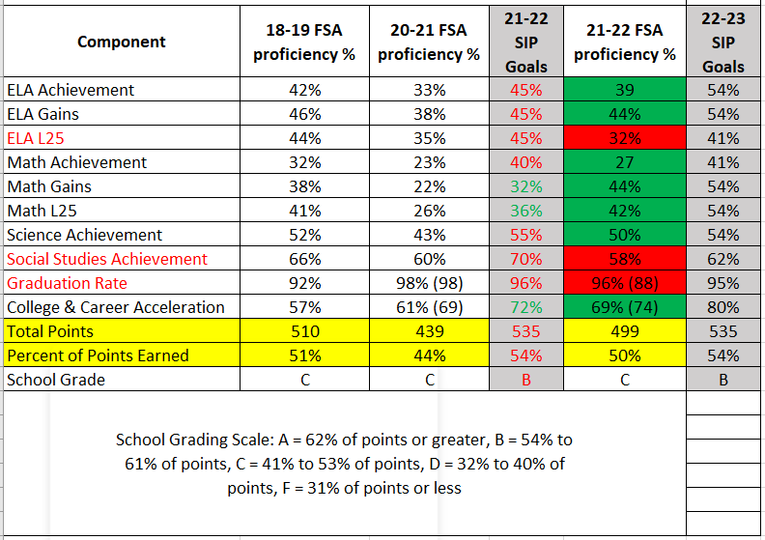

Slide 8
Highlights
ESE ESSA Federal Student index increased from 29%-39%.
9th Grade ELA proficiency scores increased12 points.
Biology proficiency scores increased 8 points.
Geometry proficiency scores increased 9 points.
Among the highest math learning gains in the district.
Overall improved 66 points or 4% points away from a grade B

Slide 9
SIP Highlights

Slide 10
22-23 Instructional Focus
Expansion of the following AVID WICOR strategies across all contents: Focused-Note Taking, Socratic Seminars with anchor text and the AVID Binder.

Slide 11
22-23 Instructional Focus
Daily authentic use of learning goals and scales for identifying critical content and as a means of tracking and monitoring student progress.
Compliance vs Authentic

Slide 12
22-23 Instructional Focus
The use of digital tools for the purpose of learning through student engagement and collaboration.
Neither death by worksheet nor death by digital worksheet will entice students to come to school.

Slide 13
Wall-to-Wall Academy Model
Center for Wellness & Medical Professions
The Academy of Creators, Scholars & Leaders
The Fundamental Program

Slide 14
What does it mean to be a wall-to-wall academy model school?
Small Learning Community with like-minded peers
Course alignment with student interests
College credit & industry certifications opportunities

Slide 15
Controversial Materials Committee
The purpose of the committee is to review any objections to library, classroom or instructional materials brought to a teacher and administration.
This committee only meets if there is an objection to an instructional or library media material.
Library Media Specialist: Rebecca Cochran
cochranr@pcsb.org

Slide 16
Good of the School Report
August

Slide 17
Thank you!

