Slide 1

SAC
School Advisory Council
Jennifer Gil
Principal
gilje@pcsb.org

Slide 2
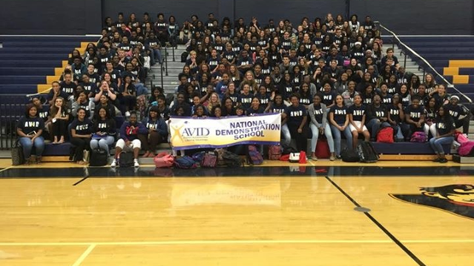
Agenda
  Purpose of the School Advisory Council
  BCHS – A quick look
  2022-2023 Achievement Data
  School Improvement Plan Goals
  Open

Slide 3
School Advisory Council
Make-Up and Meeting Dates
Purpose
Parents, staff members, community members & students.
Board Members
Representative of the school/community demographics
2nd Monday of the month at 6 p.m.
The purpose of the SAC is to assist the principal in developing and evaluating the results of the School Improvement Plan and the management of school improvement and state recognitions funds.

Slide 4
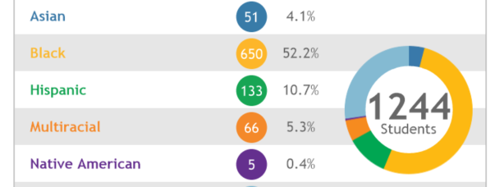
BCHS Demographics

Slide 5
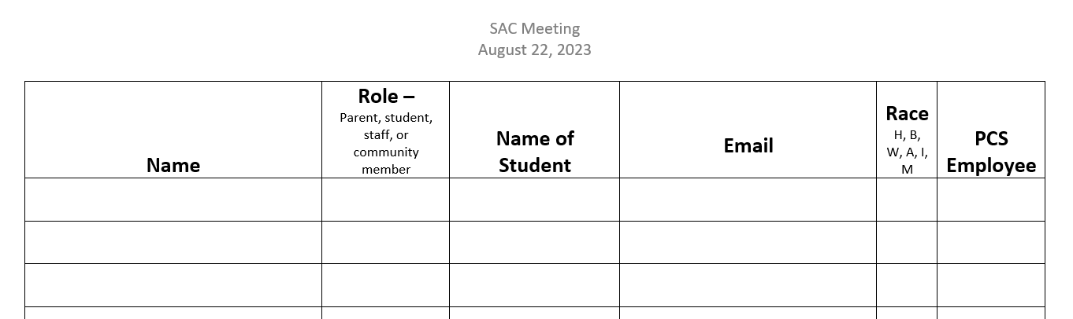
SAC Roster

Slide 6

SAC Funds
Teachers submit request to principal
Principal will present request to SAC
SAC members vote to approve request
Examples: science lab materials, AP writing grading system, t-shirts, band equipment, etc.

Slide 7
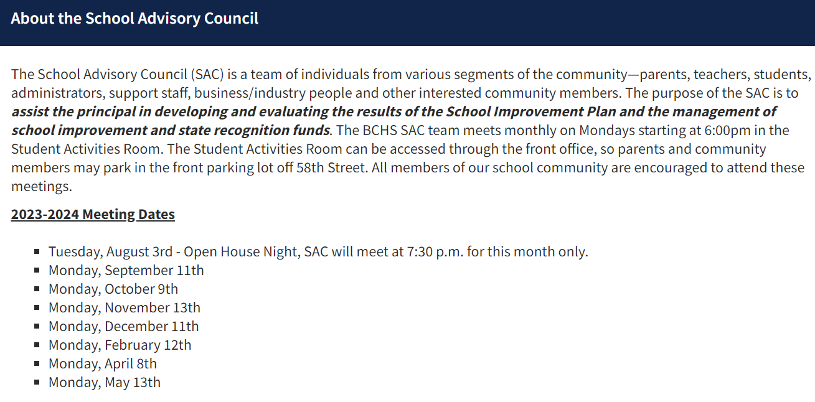

Slide 8

SAC Board
Principal: Jennifer Gil
Chair: Jean-Paulo Lemos
Vice Chair: Kathy Rodriquez

Slide 9

BCHS in a Quick Look
Wall-to-Wall Academies: CWMP, Fundamental, CSL
AVID National Demonstration Site
Model College & Career Center
Over 20 advanced courses: Pre-AP, AP, AICE and dual enrollment (SPC/USF)
Career Technical Education: Digital Design, Business (OJT) ,TV Production, Emerging Technologies, EKG, CNA, EMT and now LPN
Award winning fine arts and performing arts programs
Engaging extra curriculars and competitive athletic teams

Slide 10

Wall-to-Wall Academy
Model
Center for Wellness & Medical Professions
The Academy of Creators, Scholars & Leaders
The Fundamental Program

Slide 11

What does it mean to be a wall-to-wall academy model school?
Small Learning Community with like-minded peers
Course alignment with student interests
College credit & industry certifications opportunities

Slide 12
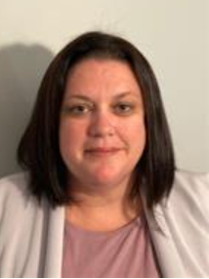
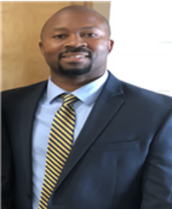
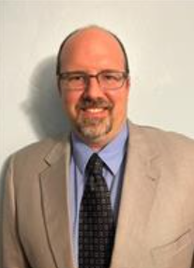
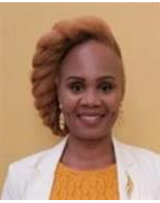
Your Administrative Staff
Mrs. Spurgeon
CWMP
Mr. Washington
Fundamental
Mr. Sager
CSL
11th & 12th
Mrs. Lewis
CSL
9th & 10th

Slide 13
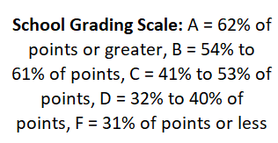

Notes:
Let’s look at our 22-23 results. We were graded this year on a 6-cell formula instead of a 10-cell formula. This is because the State of Florida switched from the FSA to the FAST assessments. As a result, learning gains were not including in the calculation.
Explain the data including Graduation and Acceleration
Here is this guy on his journey much like us reaching for the top.
What do you notice about his path?
Ups and downs.

Slide 14
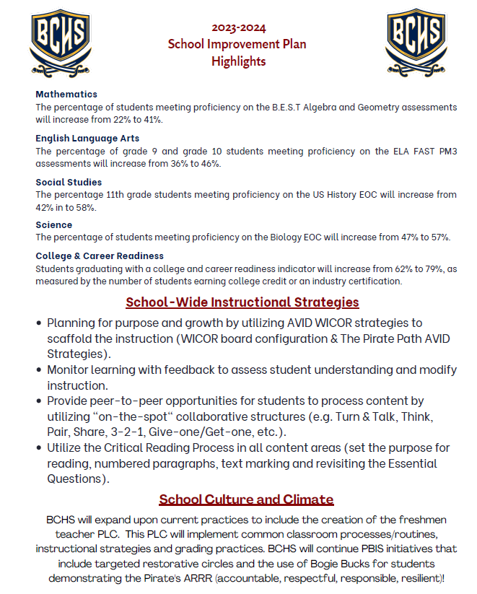
SIP Highlights

Slide 15
After School Free Tutoring
Tutoring in the core academic areas plus Spanish.
Credit recovery
Monday, Wednesday, and Thursday 2 p.m. to 3 p.m. in the media center.
Students must be present by 2:05 p.m. in order to be allowed entrance.
Students arriving later than 2:05 p.m. must have a pass from a coach or staff members

Slide 16
Graduation Requirements
Graduation Requirements- Standard High School Diploma
4 Credits in English
4 Credits in Math including Algebra 1 and Geometry
3 Credits in Science including Biology 1
3 Credits in Social Studies including World History, US
History, Government, Economics
Personal Financial Literacy for students entering 9th grade in 2023-24 and beyond
1 Credit in Fine or Performing Arts, Speech & Debate, CTE course or approved Practical Arts
1 Credit in H.O.P.E. (PE with Health included)
8 Credits in Elective Courses
Must have a 2.0 Cumulative GPA (un-weighted)

Slide 17
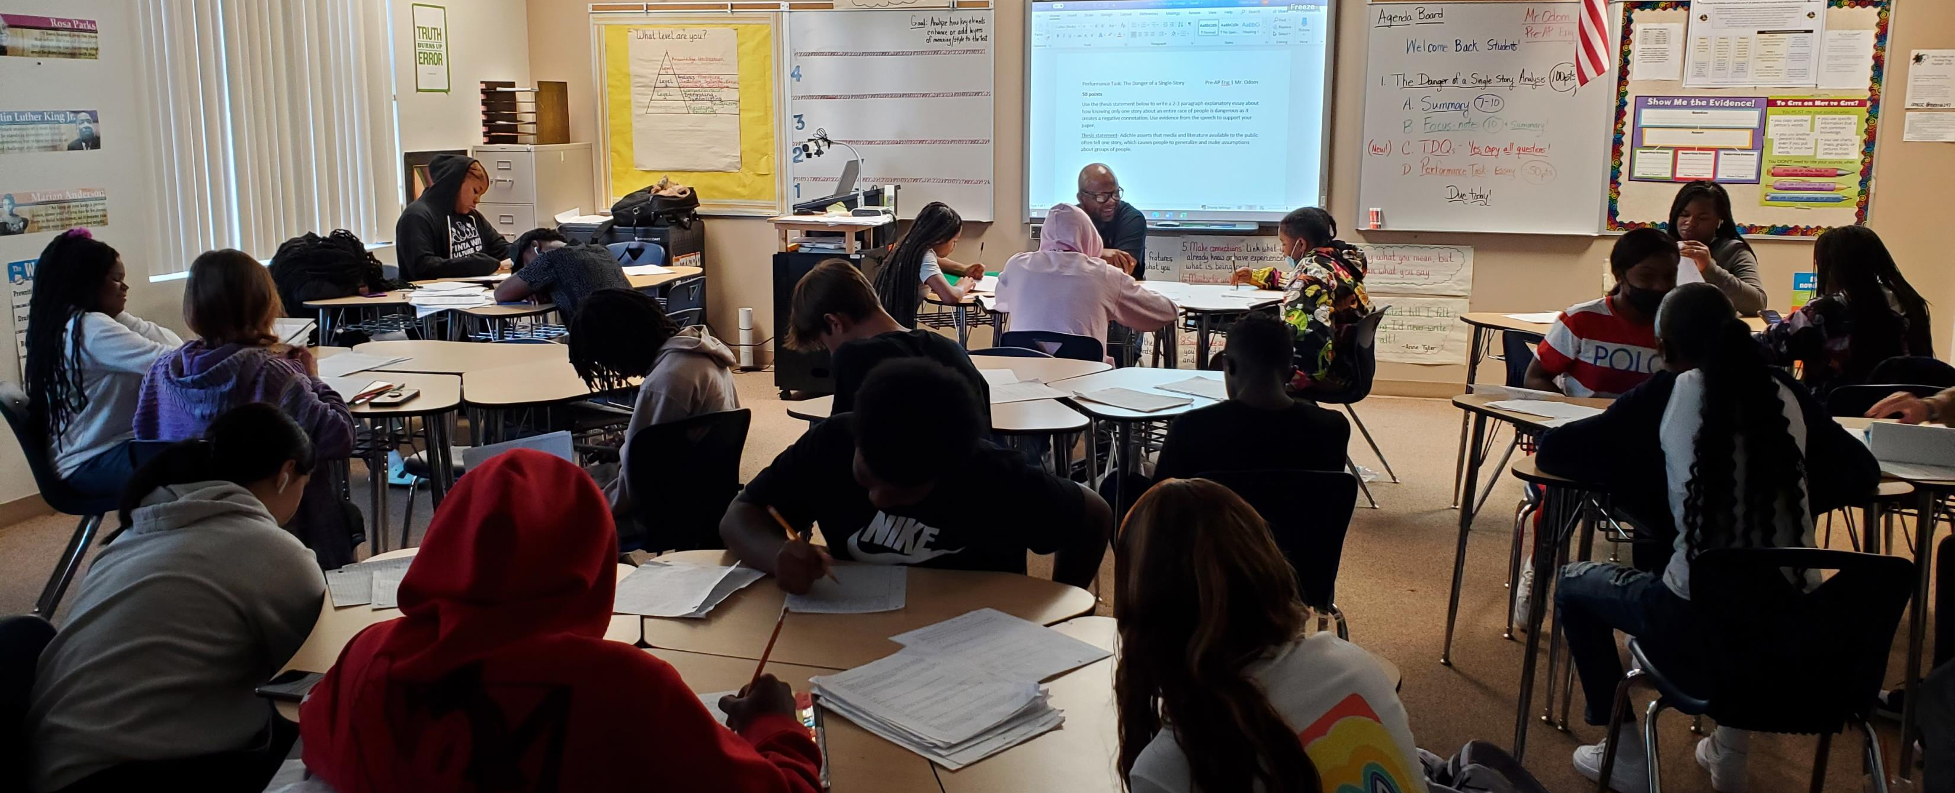
CLASS SEMINARS
FALL AND SPRING SEMINARS
SCHOOL COUNSELORS & COLLEGE CAREER COUNSELORS DELIVER LESSONs
  Transcript review
  Grade level specific information
  Course registration (spring)

Slide 18
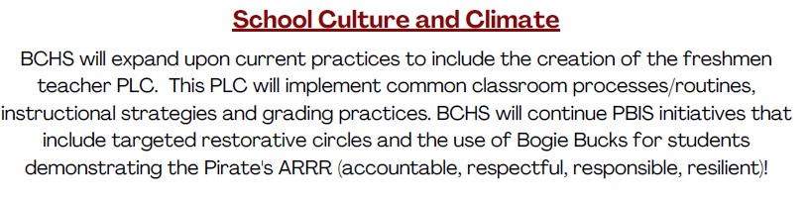
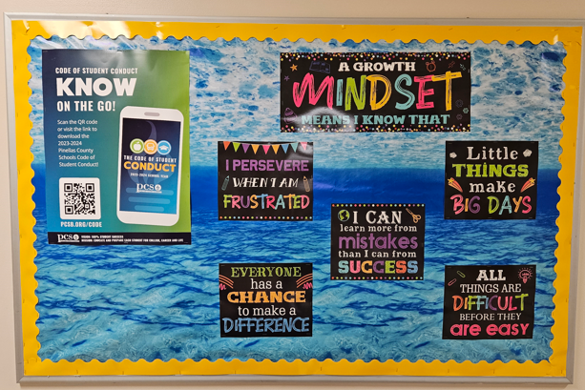
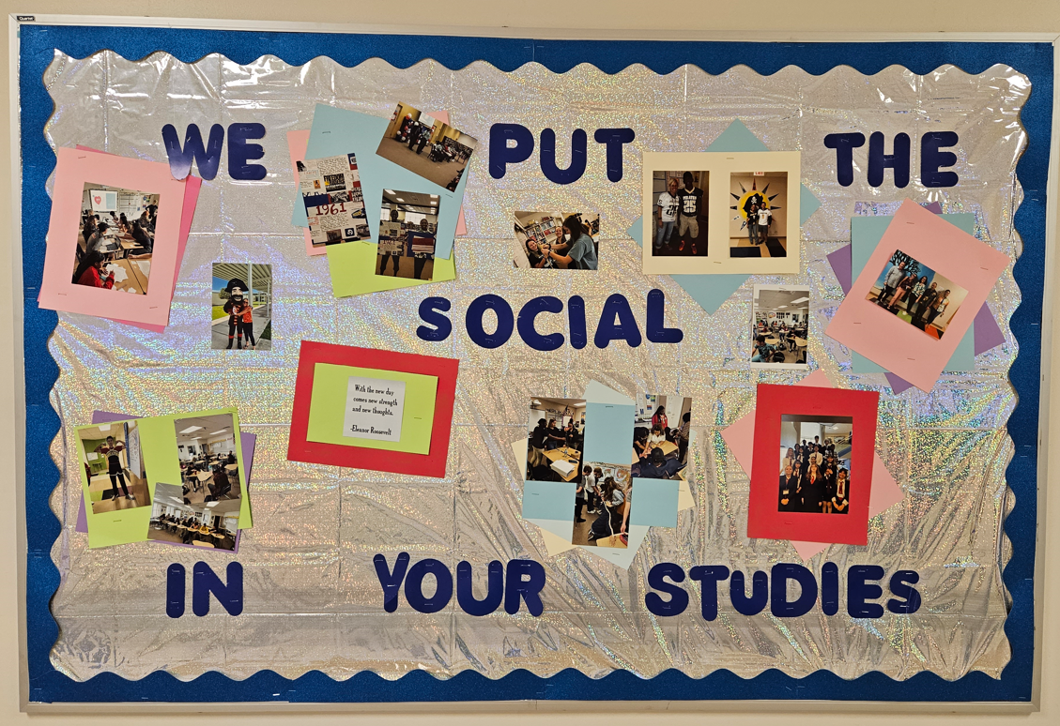
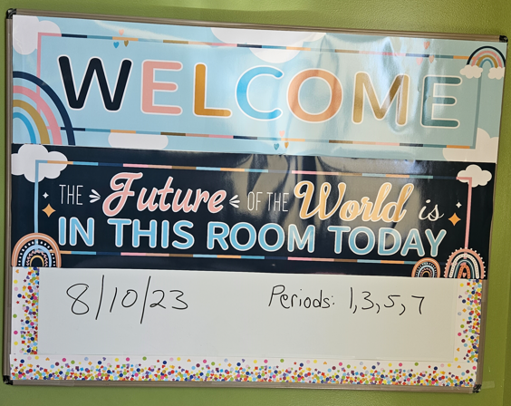
9th Grade PLC
  Freshmen Family Fun Night
  Monday morning circles
  Common gradebook/grading practices
  Common classroom rules/routines
Summer Junior Bootcamp
Back-to-School Party
Academy Assemblies
Pirate Parents
Restorative Circles
Color coded hall passes

Slide 19

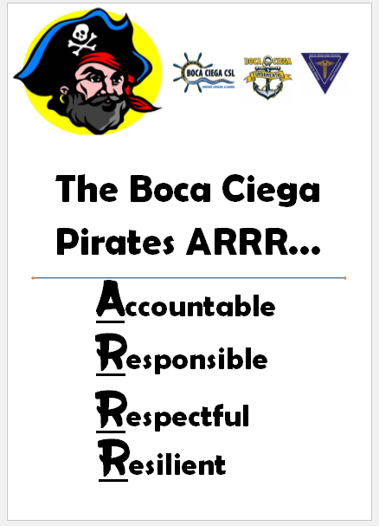
We ARRR the Pirates!
The code that we live by!

Slide 20
Other Services/Supports
MTSS Team & CST Team
School Counselors, Social Worker & Psychologist
Suncoast Partnerships
Food Pantry

Slide 21
Good of the School Report
August

Slide 22

Stay in the Know
Parents
Sunday Communication
BCHS Website
Facebook
Students
Instagram
Canvas Announcements
Eye Patch News

Slide 23

Thank you!

