Slide 1



Title I Annual
Parent Meeting
Wednesday August 27, 2025
Mildred Helms Elementary School
Principal: Shannon Brennan
Asst. Principal : Katrina Schneider
Notes:
1.7.2013
Evidence: Upload completed presentation and recorded feedback as part of the evidence to support the Annual Meeting Materials. Do not forget the sign-in sheets, and survey/feedback that you receive throughout the meeting. ​
‹#›

Slide 2


ALL ABOUT TITLE I
    Title I is the LARGEST federal assistance program for our nation’s schools
    The Program serves 95 schools in Pinellas County including students in 38 non-public schools
Notes:
1.7.2013
Highlight the Title I Program here in Pinellas County.
‹#›

Slide 3



Title I Funding
Process
Florida Department of Education
Pinellas County Schools
Mildred Helms Elementary
Federal
government
Notes:
1.7.2013
The Florida Department of Education receives funds from the federal government. Districts receive Title I funds from Department of Education, and the school district distributes these funds to schools based on the percentage of children eligible for free/reduced price lunch; however, students do not have to be from low-income families to receive help. ​
‹#›

Slide 4
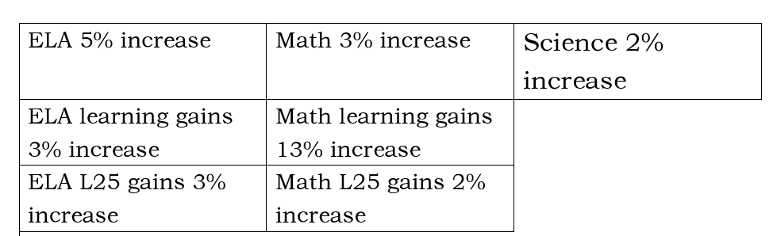

Increase in Proficiency
Overall score increasing 4 % moving from 62% to 66%
Notes:
1.7.2013
Evidence: Upload completed presentation and recorded feedback as part of the evidence to support the Annual Meeting Materials. Do not forget the sign-in sheets, and survey/feedback that you receive throughout the meeting. ​
‹#›

Slide 5
Title I Programs Provide Supplemental Support
Supplemental Resource | Positive Impact
Additional supplemental personnel Full time MTSS coach Part time hourly Literacy instructor
Additional training opportunities for school staff IB inquiries and Exploration
Extended Learning Opportunities (before and/or after school programs)
Parent and Family Engagement Resources and Training Workshops
Supplemental teaching materials equipment and technology
  MTSS coaches provides ongoing professional development, coaching, and support to teachers and staff.
  This builds internal capacity for staff to meet the academic and behvioral needs of all students.
  Rigorous learning for all students
  Strengthen core academic programs
  Provide academically related support services to low-achieving students
  Elevate instructional quality
t
  Family Reading Night
  Math and Science Night
  Student Led Conferences
  International Showcase & IB exhibition
  Art Show and Musical Performance
  Instructional materials support core curriculum interventions and enrichment.
Notes:
1.7.2013
Use additional slides if necessary. This is where you want to really highlight Title I funding and how it positively impacts your scholars! Additional supplemental personnel (add specific positions)​
If there are connections that they can make, they call it out!
‹#›

Slide 6




Title I
Schoolwide Planning and Input
FIRST
Seek input from school, family, and community members determine how Title I funds are used based on a needs assessment
SECOND
Please attend online or in-person meetings/trainings and complete surveys to provide input on Title I funding
LAST
All Title I schools must document that parents are involved in the schoolwide planning process
Notes:
1.7.2013
Evidence for input – input from school can be a survey or notes, which include quotes related to what was shared as feedback AND how this input will be used to inform the PFEP and future engagement activities. ​
​
Evidence of Attendance – please include attendance of DIVERSE stakeholder group/s.
‹#›

Slide 7


Title I Schoolwide Budget
Mildred Helms Elementary
$81,725.00.
    Personnel
    Professional Development
    Curriculum Coordination
    Family Engagement Activities
Notes:
1.7.2013
change ALL in red to reflect your school
‹#›

Slide 8

PARENT’S
RIGHT TO KNOW
Be provided information on your child’s level of achievement on assessments in Reading/Language Arts, Writing, Mathematics and Science
Be notified of non-highly qualified or out-of-field teachers at the school
Request and receive information on the qualifications of your child’s teacher and supplemental personnel working with your child.
Be informed if your child is taught by a non-highly qualified teacher for four or more consecutive weeks.

Slide 9

Working Together for Student Success
SCHOOL
TITLE I
PARENT
SCHOOL
School Improvement Plan (SIP)
Title I Schoolwide Plan
Parent and Family Engagement Plan (PFEP)
School - Parent - Student - Compact
Notes:
1.7.2013
As a Title I parent you have the right to be involved in the development of the following plans and documents for our school which can be found on our website (insert website) to view as well as in the Parent Station located (insert location here). ​
​
Our school’s Title I Parent Station is located (insert location or photo of Title I Parent Station- front office and on the webpage). Please include photo as part of the evidence monitoring. ​
​
You will find a copy of our School Improvement Plan, Title I Schoolwide Plan, School’s PFEP, the School District’s PFEP, Parent’s Right to Know Memo, Upcoming Events, Compact, (insert other documents at your station)​
​
School Improvement Plan (SIP)​
​
Parent and Family Engagement Plan ​
​
Title I Schoolwide Plan ​
​
School-Parent-Student Compact​
​
‹#›

Slide 10

Parent - School - Student Compact
The purpose of the compact is to foster student achievement.
By signing the Parent - School - Student Compact, Mildred Helms Elementary, teachers, staff, parents and students agree to work together to share the responsibility of helping students meet or exceed state, district and school academic goals.
The Parent - School - Student Compact is updated every year to include parent, student, teacher and staff input. Parent, Student, Teacher and Staff comments are welcome at any time during the year.
Please review and sign your child’s Compact.
Our GOAL is to receive 100% signed compacts!
Notes:
1.7.2013
At the elementary level, school compacts are used as a progress monitoring tool through the year during parent teacher conferences.
‹#›

Slide 11

Mildred Helms COMPACT
Notes:
1.7.2013
Please insert the an example of your updated school compact. Highlight any things that unique to your school’s compact.
‹#›

Slide 12
Parent and Family
Engagement Plan (PFEP)
The PFEP Sections include information about the following:
    Parent trainings to increase student achievement
    Staff trainings for engaging parents
    Communication methods between home and school
    Flexible meeting times
    Accessibility for parents
    Coordinating with other Federal Programs
Notes:
1.7.2013
Provide information on the specific committees that parents can be involved. Include the purpose, date and time of meetings. ​
Explain the PFEP and its purpose. ​
Consider the evidence related Title I Crate, Sample of Evidence,
‹#›

Slide 13

Florida Benchmark for Excellent Student Thinking Standards (B.E.S.T). You may read more information by visiting, www.fldoe.org
Notes:
1.7.2013
All curriculum, instruction and assessments are based on student-centered expectations.
‹#›

Slide 14





School’s
Curriculum
Florida Benchmark for Excellent Student Thinking Standards (B.E.S.T) form the framework of everything taught at school.
Core Curriculum:
    Reading
    Mathematics
    Writing
    Science
    Social Studies
Notes:
1.7.2013
This slide is optional if this will be discussed with classroom teacher ​
School’s Curriculum​
Describe and explain the curriculum (Specific names of texts)​
​
‹#›

Slide 15

School Report Cards:
    School Grade and Overview
    Population and Enrollment
    Assessments- Academic Achievement, Growth, and Population
    Assessments -English Language Learners
    Graduation and Beyond
    Educator Qualifications and Equity
    Long-Term Goals and Interim Progress
    Accelerated Course Enrollment
    Per-Pupil Expenditures
    National Data
Available online at School Report Cards:
    School Grade and Overview
    Population and Enrollment
    Assessments- Academic Achievement, Growth, and Population
    Assessments -English Language Learners
    Graduation and Beyond
    Educator Qualifications and Equity
    Long-Term Goals and Interim Progress
    Accelerated Course Enrollment
    Per-Pupil Expenditures
    National Data
Available online at https://edudata.fldoe.org OR Front Office

Slide 16
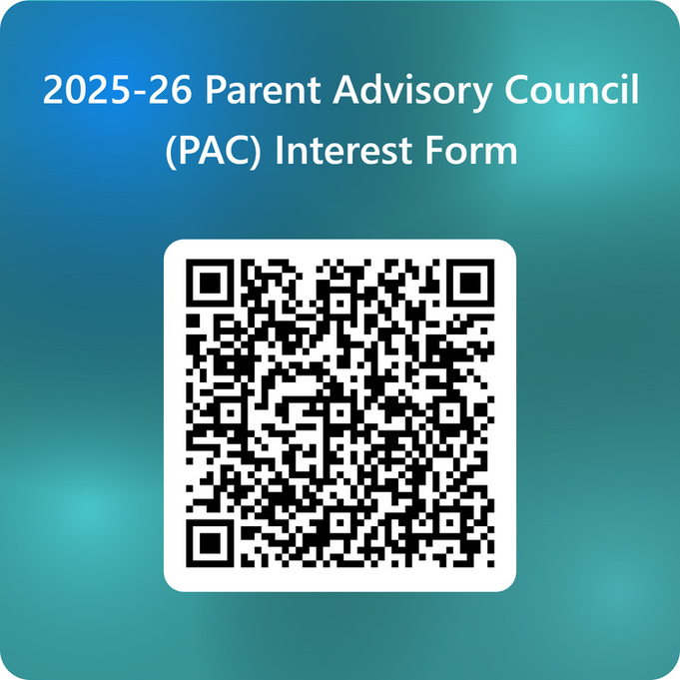
Parent Advisory
Council (PAC)
    The district has a Parent and Family Engagement Plan. The summary of the plan is in the Title I School & Family Partnership Overview.
    You may access the full plan at www.pcsb.org/titleone
    The Parent Advisory Council (PAC) is responsible for reviewing and revising the District PFEP.
    PAC will meet virtually or in-person with the district’s Title I Staff.
    Each school is committed to having at least one member representing our school please notify, Katrina Schneider at schneiderk@pcsb.org.
Notes:
1.7.2013
Please add your PAC representative in slide and share with your Title I Specialist. ​
​https://forms.office.com/Pages/ResponsePage.aspx?id=BZM8c9c5GkaGb_3ye_PH_ywWjljlMQdDv9wc58mKxfhUMlBCTlJTQkVCUkNDTjNIUTBaQTZSSDI1My4u
‹#›

Slide 17

STAY INVOLVED
PTA events
Family Reading Night
Math and STEM Nights
Student Led Conferences
International Showcase & IB Exhibition
Art Show & Musical Performances
SAC : School Advisory Council meets 6 times a year
Notes:
1.7.2013
Do you have a calendar of key events that are included in your PFEP. ​
​
Evidence – Consider this as evidence to include to support Family Engagement.
‹#›

Slide 18

Additional Resources
Learning at Home Family Resources - https://www.pcsb.org/Page/32836​
​
Volunteer in a Pinellas County School - https://www.pcsb.org/Page/459​
​
Parent Academy POWER HOURS Webinars - https://www.pcsb.org/Page/26534​
​
Partnerships - https://www.pcsb.org/Page/418

Slide 19






Contact Us
727-588-3569
https://www.pcsb.org/mildred-es
561 S. Clearwater-Largo Rd. Largo, FL 33770-3294
Notes:
1.7.2013
Please insert the school contact information and the best way to reach out to the school.
‹#›

Slide 20
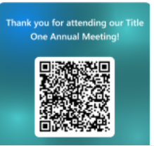
Notes:
1.7.2013
Please duplicate Microsoft Forms provided or create school survey. To generate a QR code hover over your school’s survey and right click. Create QR code for this page will be an option.​
​
https://forms.office.com/Pages/ResponsePage.aspx?id=BZM8c9c5GkaGb_3ye_PH_ywWjljlMQdDv9wc58mKxfhUNUlRMzRNRDRTVEdXS1JCUzZMQ01MR0VXTy4u
‹#›

Slide 21

Thank You!
For your time!

