Slide 1
Bonjour!!
Welcome!

Slide 2

1. Research shows that DP
graduates are much more
likely to be enrolled at op
higher education institutions
than entrants holding
other qualifications*
2. Through creativity, action,
service, (CAS) you learn
outside the classroom and
develop emotionally and ethically
as well as intellectually.
3. For example, the extended
essay requires independent
research through an in-depth study.
5. Language classes encourage
an international mindset, key
for increasingly globalized
societies.
4. The DP is recognized globally by
universities and employers.

Slide 3
6. Learn how to analyze and
evaluate issues, generate ideas
and consider new perspectives
9. Theory of knowledge (TOK)
classes encourage you to make
connections between subjects.
7. Take good study habits and
strong time management to
further education and the
working world.
10. You are able to choose courses from six subject groups and study subjects at different levels.
8. Learn to understand,
not just memorize facts or topics
and prepare for exams.

Slide 4


Slide 5

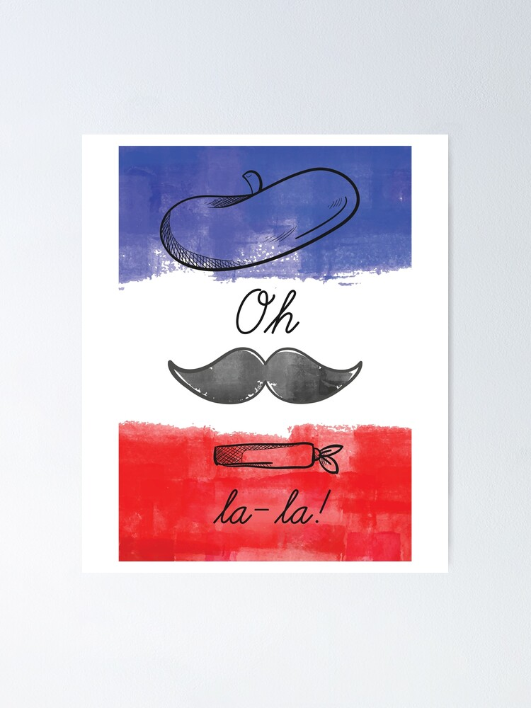
Français B

Slide 6
Français B
9th French PRE IB
10th French PRE IB
11th Français B (HL or SL)
12th Français B (HL or SL)
HL: High Level
SL: Standard Level
Le programme

Slide 7

Français B
Espaces Units 1-9
9th French PRE IB

Slide 8
Français B
Espaces Units 10-15
10th French PRE IB

Slide 9

Français B
D’accord 3
11th Français B

Slide 10

Français B
French IB (Oxford)
12th Français B

Slide 11
Français B
Assessments:
External assessment
  Writing
  Listening comprehension
  Reading comprehension
Internal assessment
  Speaking
12th Français B

Slide 12

Français B
Summer assignment
Units 1,2,3
Quizlet: vocabulary for each unit
Kahoots: grammar each unit
9th French PRE IB

Slide 13
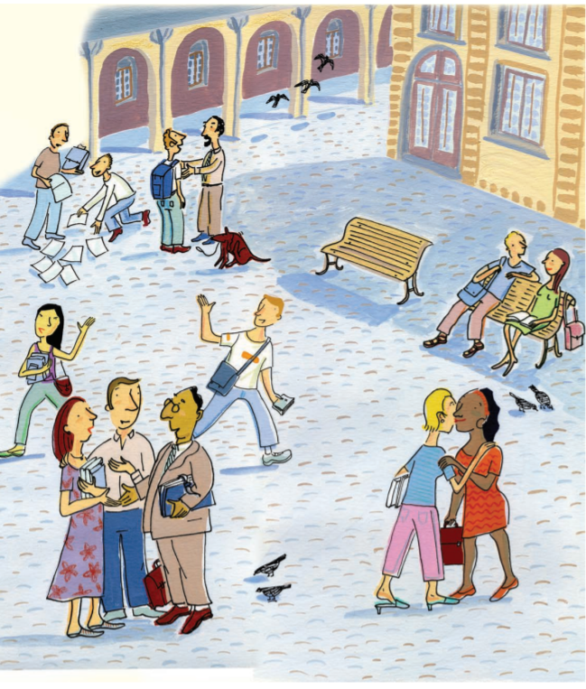
Français B
Espaces: Unité 1 Salut !
Lesson 1A.1
Ça va?
9th French PRE IB

Slide 14
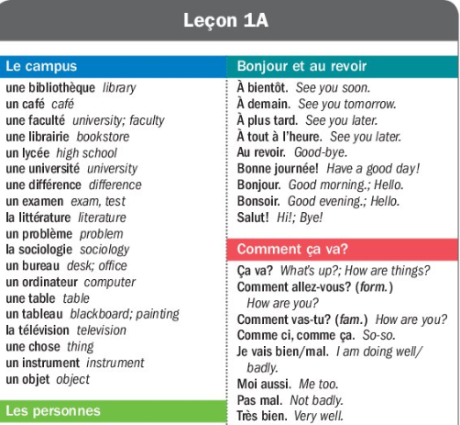
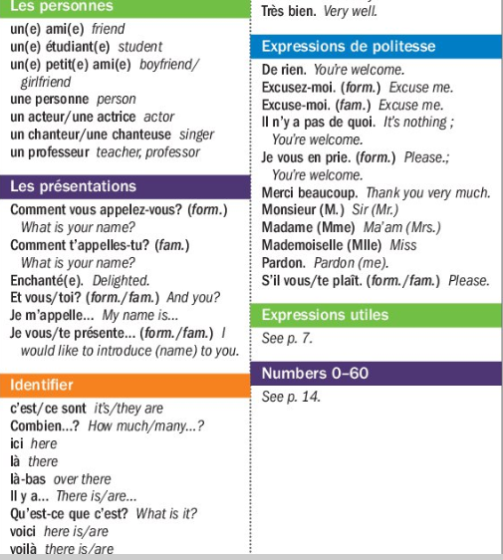
Notes:
14

Slide 15

Point de départ
A noun designates a person, place, or thing. As in English, nouns in French have number (singular or plural). However, French nouns also have gender (masculine or feminine).
Notes:
15

Slide 16
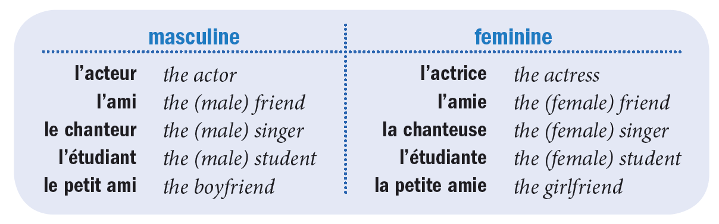
Nouns that designate a male are usually masculine. Nouns that designate a female are usually feminine.
Notes:
16

Slide 17
Some nouns can designate either a male or a female regardless of their grammatical gender; in other words, whether the word itself is masculine or feminine.
Notes:
17

Slide 18
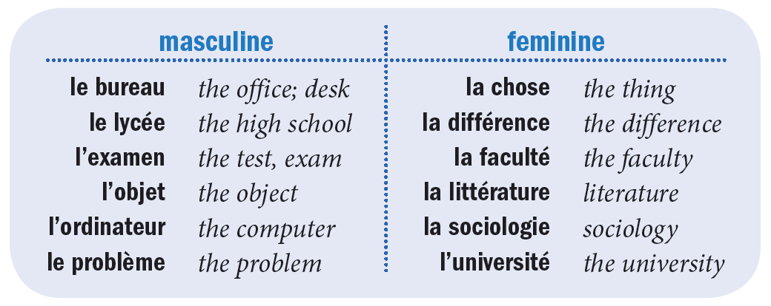
Nouns for objects that have no natural gender can be either masculine or feminine.
Notes:
18

Slide 19
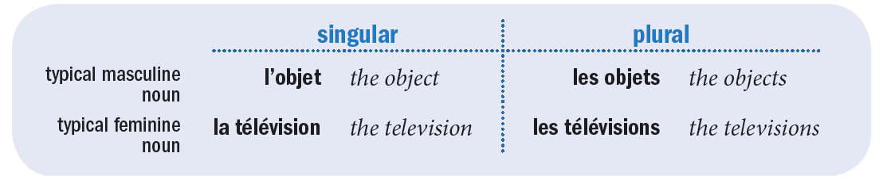
You can usually form the plural of a noun by adding -s.
Notes:
19

Slide 20
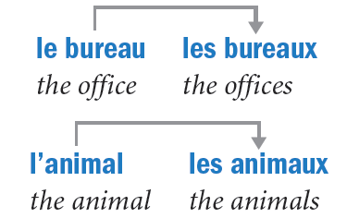
However, in the case of words that end in -eau in the singular, add -x to the end to form the plural. For most nouns ending in -al, drop the -al and add -aux.
Notes:
20

Slide 21
When you have a group composed of males and females, use the masculine plural noun to refer to it.
Notes:
21

Slide 22
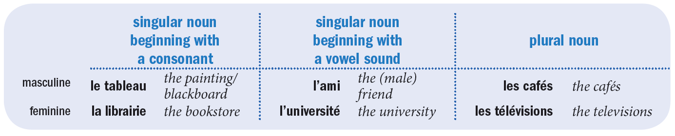
The English definite article the never varies with number or gender of the noun it modifies. However, in French the definite article takes four different forms depending on the gender and number of the noun that it accompanies: le, la, l’ or les.
Notes:
22

Slide 23
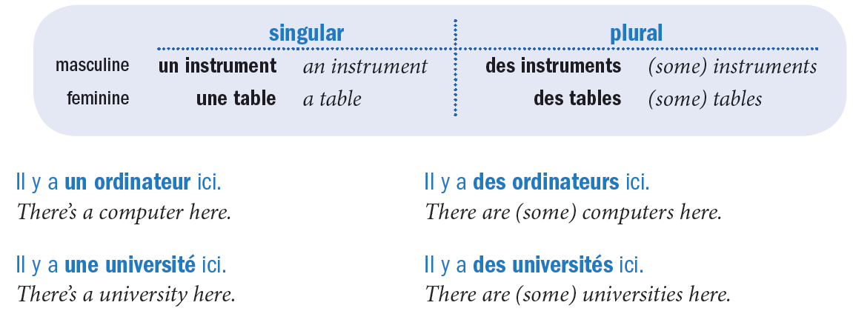
In English, the singular indefinite article is a/an, and the plural indefinite article is some. In French, the singular indefinite articles are un and une, and the plural indefinite article is des. Unlike in English, the indefinite article des cannot be omitted in French.
Notes:
23

Slide 24
Use c’est followed by a singular article and noun or ce sont followed by a plural article and noun to identify people and objects.
Notes:
24

Slide 25
Français B
Espaces:
Lesson 1A.2
Ça va?
9th French PRE IB

Slide 26
Point de départ
Numbers in French follow patterns, as they do in English. First, learn the numbers 0–30. The patterns they follow will help you learn the numbers 31–60.

Slide 27
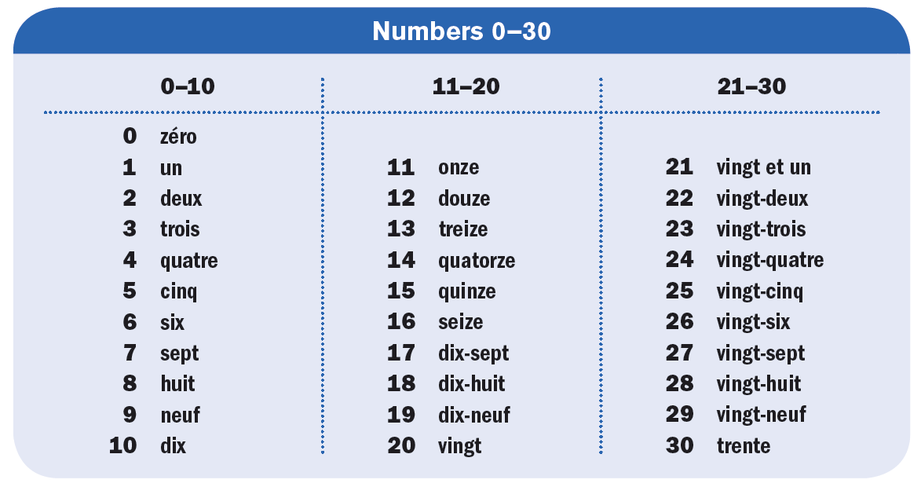

Slide 28


When counting a series of numbers, use un for one.
When one is followed by a noun, use un or une depending on whether the noun is masculine
or feminine.

Slide 29

Note that the number 21 (vingt et un) follows a different pattern than the numbers 22–30. When vingt et un precedes a feminine noun, add -e to the end of it: vingt et une.

Slide 30
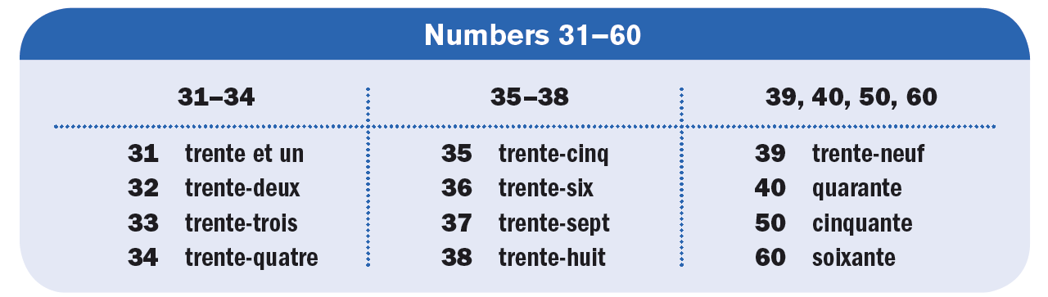
Notice that the numbers 31–39, 41–49, and 51–59 follow the same pattern as the numbers 21–29.

Slide 31
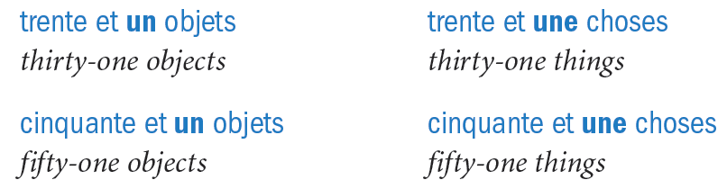
As with the number 21, to indicate a count of 31, 41, or 51 for a feminine noun, change the un to une.

Slide 32
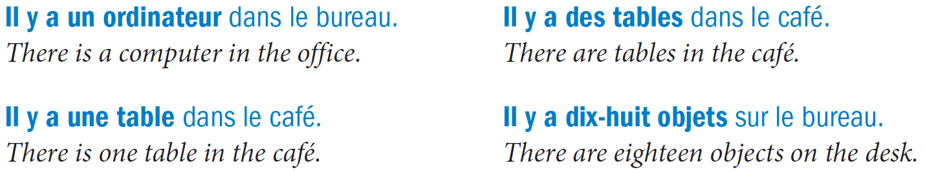
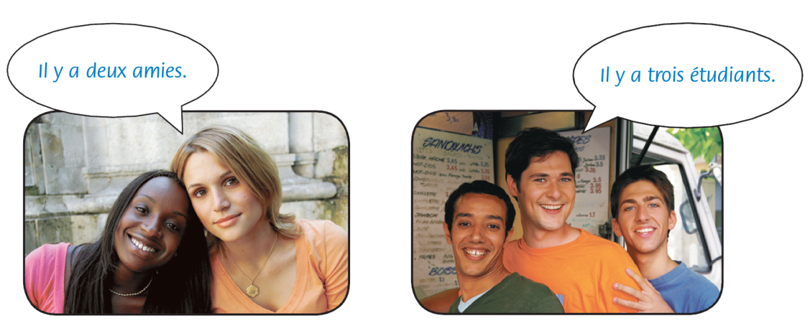
Use il y a to say there is or there are in French. This expression doesn’t change, even if the noun that follows it is plural.

Slide 33
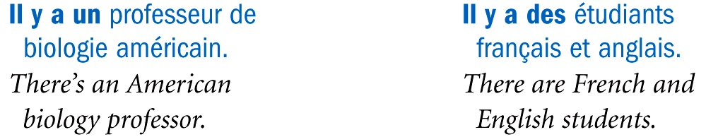
In most cases, the indefinite article (un, une,
or des) is used with il y a, rather than the definite article (le, la, l’, or les).

Slide 34
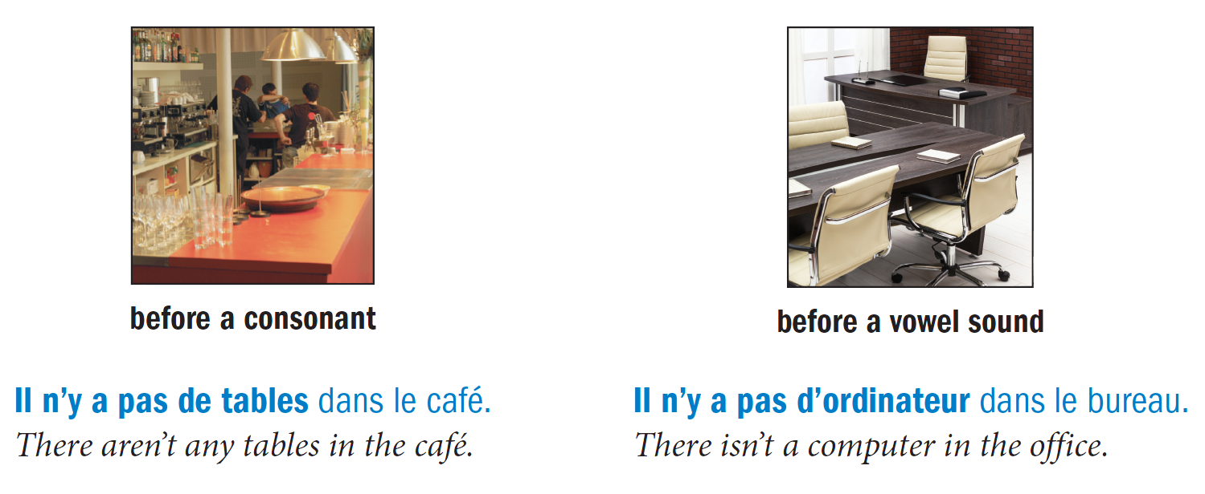
Use the expression il n’y a pas de/d’ followed by a noun to express there isn’t a… or there aren’t any.... Note that no article (definite or indefinite) is used in this case. Use de before a consonant sound and d’ before a vowel sound.

Slide 35
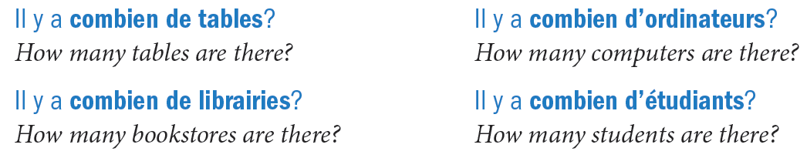
Use combien de/d’ to ask how many of something there are.

Slide 36
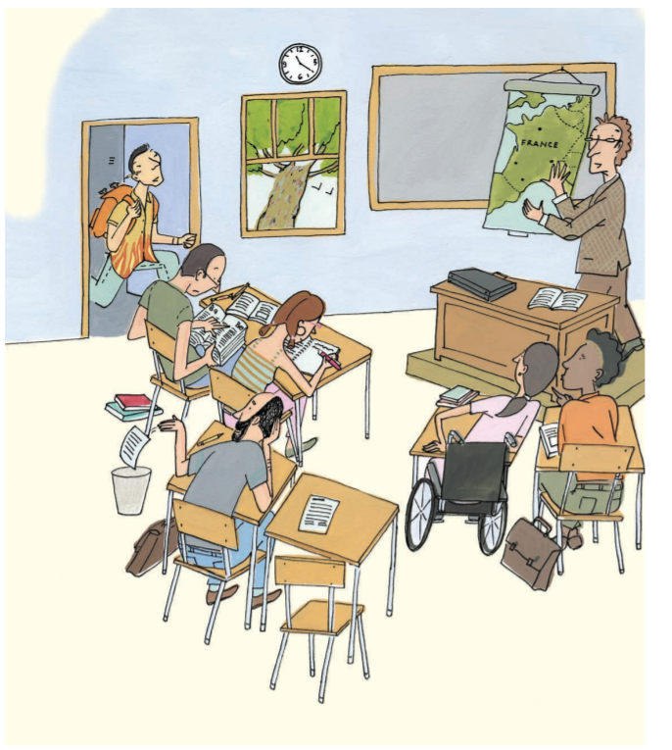
Français B
Espaces:
Lesson 1B.1
En classe
9th French PRE IB

Slide 37
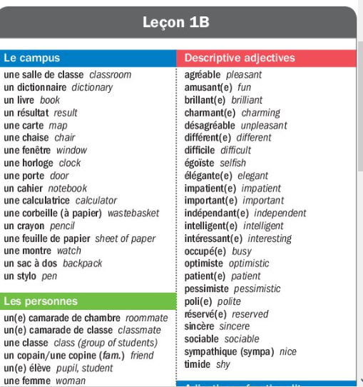
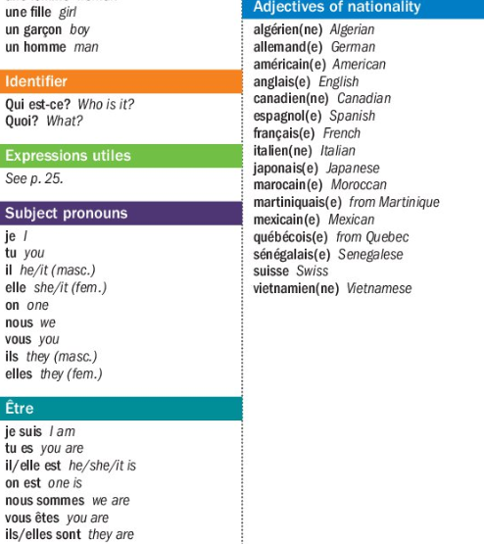

Slide 38
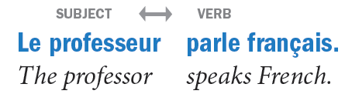
Point de départ
In French, as in English, the subject of a sentence is the person or thing that carries out the action. The verb expresses the action itself.

Slide 39
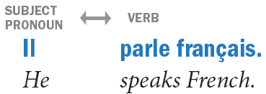
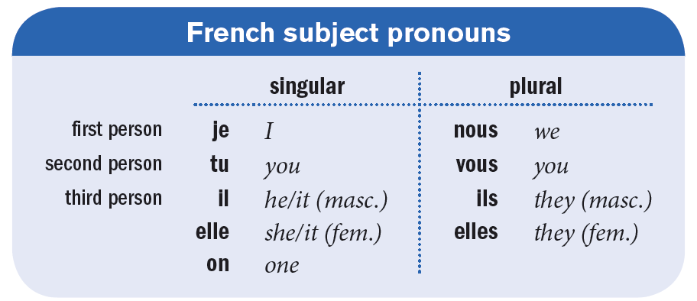
Subject pronouns
Subject pronouns replace a noun that is the subject of a verb.

Slide 40
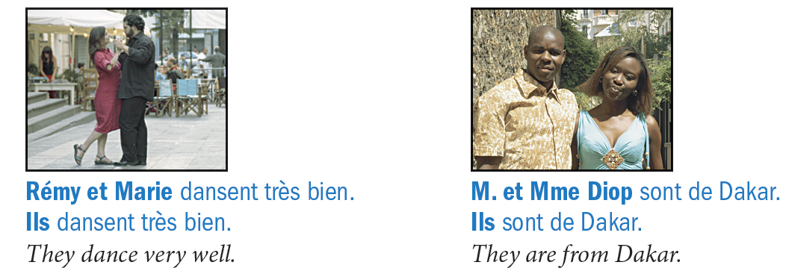
Subject pronouns (continued)
Subject pronouns in French show number (singular vs. plural) and gender (masculine vs. feminine). When a subject consists of both males and females, use the masculine form of the pronoun to replace it.

Slide 41
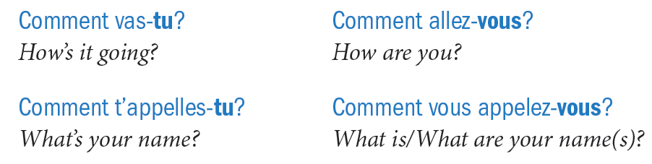
Subject pronouns (continued)
Use tu for informal address and vous for formal. Vous is also the plural form of you, both informal and formal.

Slide 42
Subject pronouns (continued)
The subject pronoun on refers to people in general, just as the English subject pronouns one, they, or you sometimes do. On can also mean we in a casual style. On always takes the same verb form as il and elle.

Slide 43
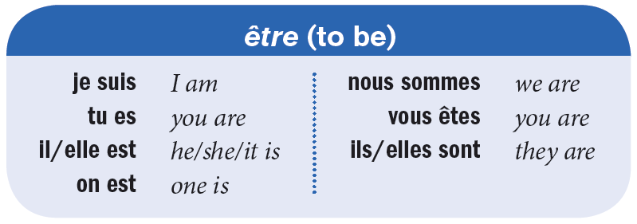
The verb être
Être (to be) is an irregular verb; its conjugation (set of forms for different subjects) does not follow a pattern. The form être is called the infinitive; it does not correspond to any particular subject.

Slide 44
The verb être (continued)
Note that the -s of the subject pronoun vous is pronounced as an English z in the phrase vous êtes.

Slide 45
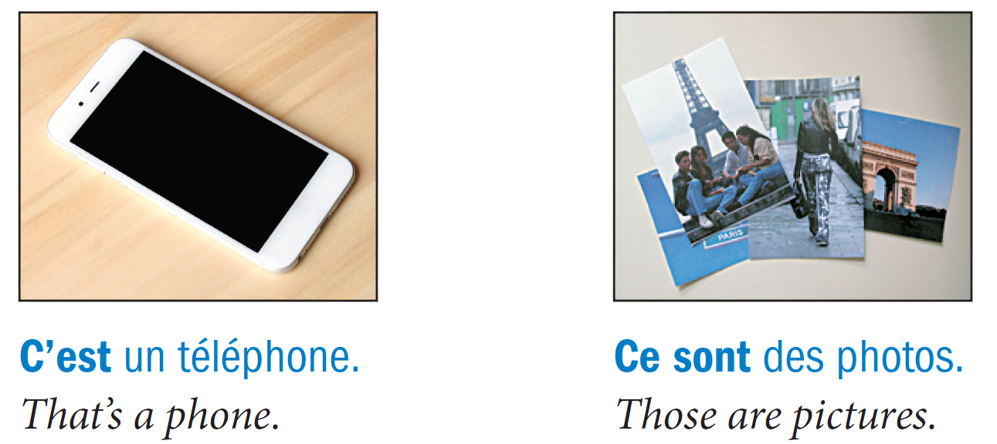
C’est and il/elle est
Use c’est or its plural form ce sont plus a noun to identify who or what someone or something is. Remember to use an article before the noun.

Slide 46
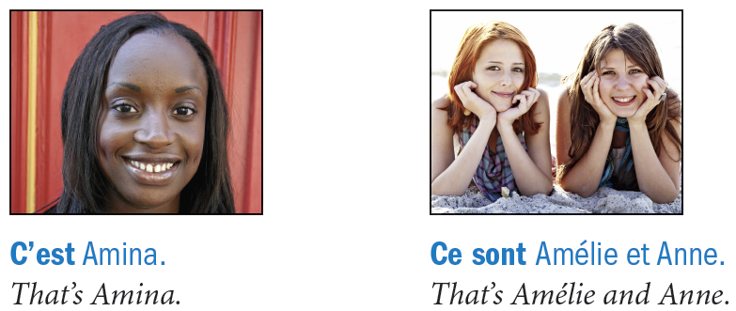
C’est and il/elle est (continued)
When the expressions c’est and ce sont are followed by proper names, don’t use an article before the names.

Slide 47
C’est and il/elle est (continued)
Use il/elle est and ils/elles sont to refer to someone or something previously mentioned.
Use the phrases il/elle est and ils/elles sont to tell someone’s profession. Note that in French, you do not use the article before the profession.

Slide 48
Français B
Espaces:
Lesson 1B.2
En classe
9th French PRE IB

Slide 49
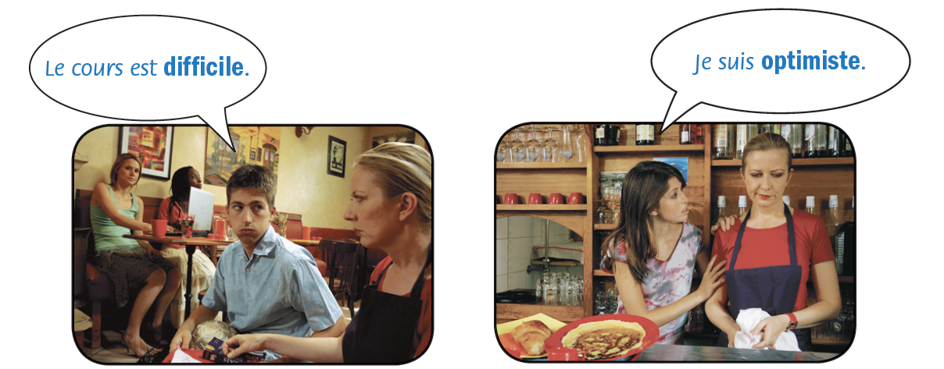
Point de départ
Adjectives are words that describe people, places, and things. In French, adjectives are often used with the verb être to point out the qualities of nouns or pronouns.

Slide 50
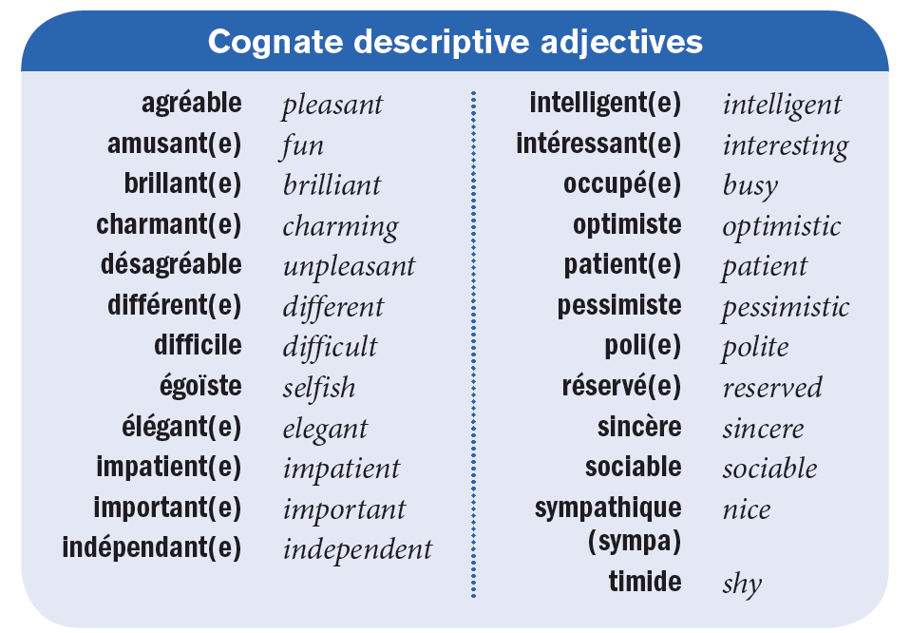
Many adjectives in French are cognates; that is, they have the same or similar spellings and meanings in French and English.

Slide 51
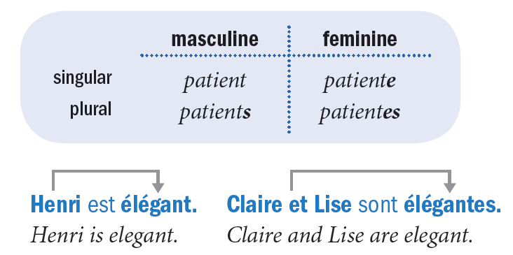
In French, most adjectives agree in number and gender with the nouns they describe. Most adjectives form the feminine by adding a silent -e (no accent) to the end of the masculine form. Adding a silent -s to the end of masculine and feminine forms gives you the plural forms of both.

Slide 52
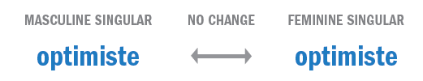
If the masculine form of the adjective already ends in an unaccented -e, do not add another one for the feminine form.

Slide 53
French adjectives are usually placed after the noun they modify when they don’t directly follow a form of être.

Slide 54
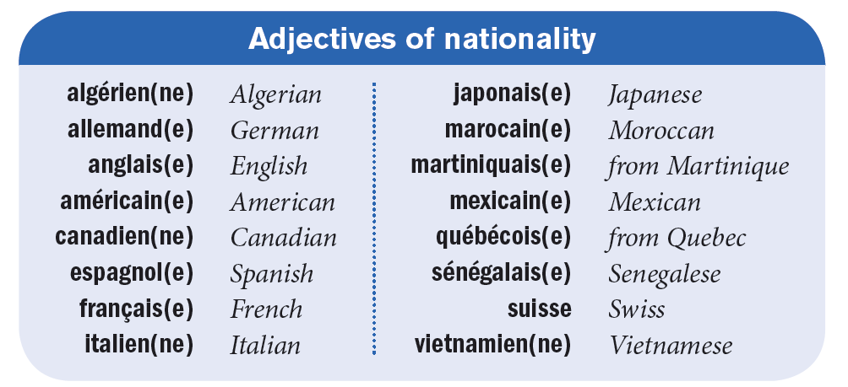
Here are some adjectives of nationality. Note that the -n of adjectives that end in -ien doubles before the final -e of the feminine form: algérienne, canadienne, italienne, vietnamienne.

Slide 55
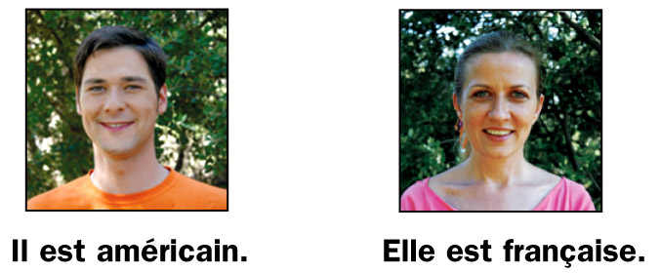
The first letter of adjectives of nationality is not capitalized.

Slide 56
An adjective whose masculine singular form already ends in -s keeps the identical form in the masculine plural.

Slide 57
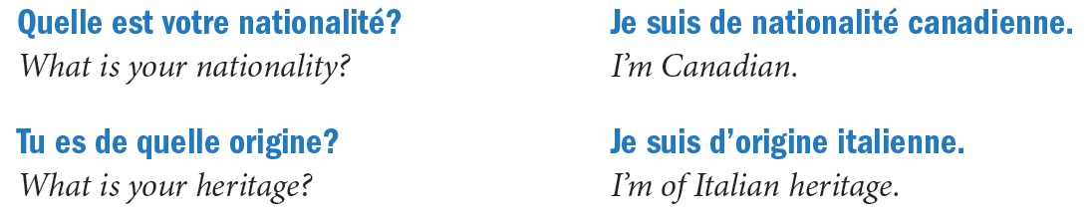
To ask someone’s nationality or heritage, use Quelle est ta/votre nationalité? or Tu es/Vous êtes de quelle origine?

Slide 58
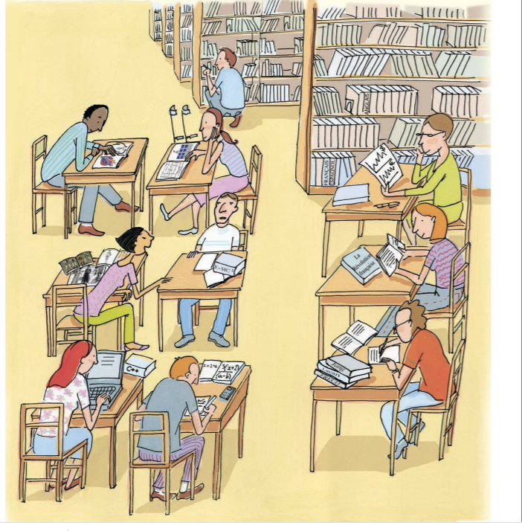
Français B
Espaces: Unité 2 À la fac
Lesson 2A.1
Les cours
9th French PRE IB

Slide 59
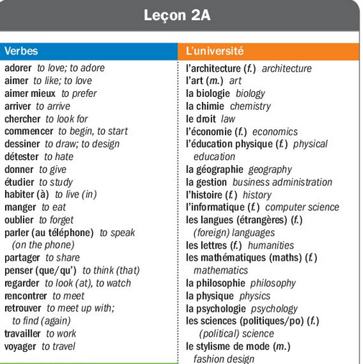
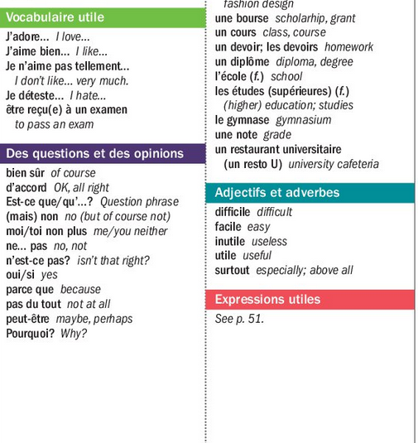

Slide 60
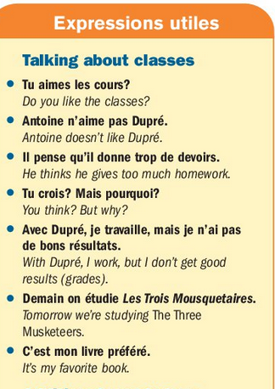
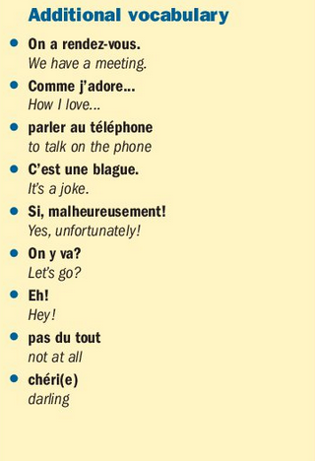

Slide 61
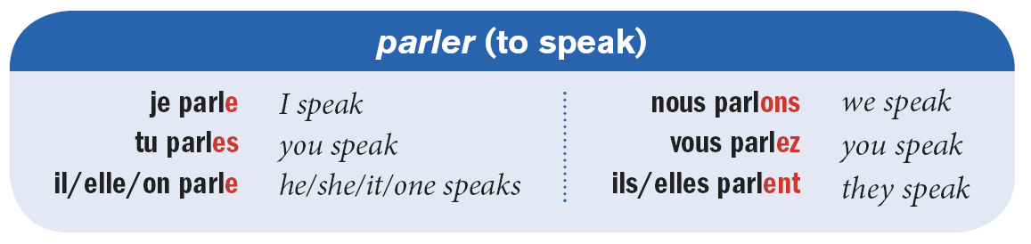
The infinitives of most French verbs end in -er. To form the present tense of regular -er verbs, drop the -er from the infinitive and add the corresponding endings for the different subject pronouns. This chart demonstrates how to conjugate regular -er verbs.

Slide 62
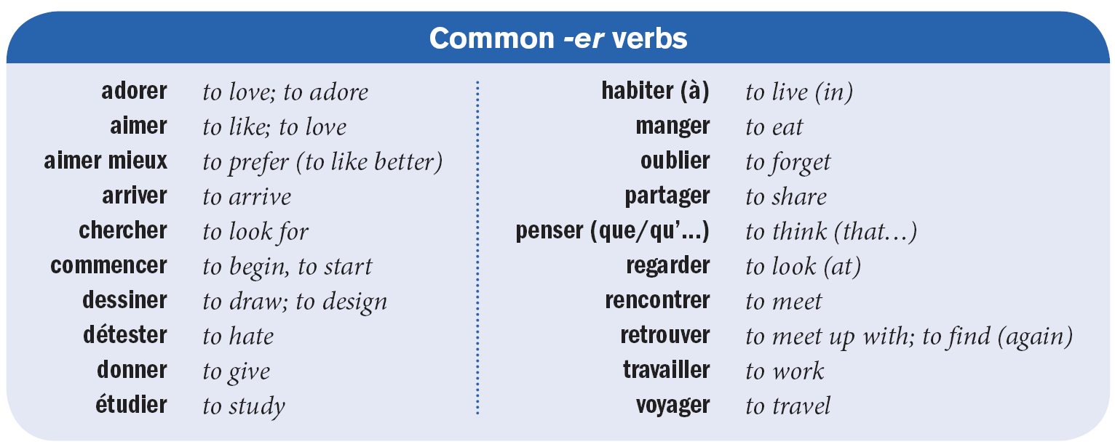
Here are some other verbs that are conjugated the same way as parler.

Slide 63
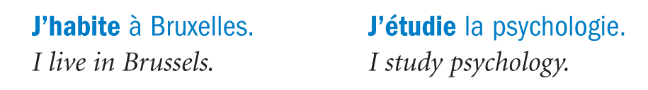
Note that je becomes j’ when it appears before a verb that begins with a vowel sound.

Slide 64
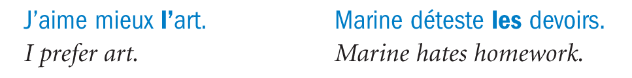
With the verbs adorer, aimer, and détester, use the definite article before a noun to tell what someone loves, likes, prefers, or hates.

Slide 65
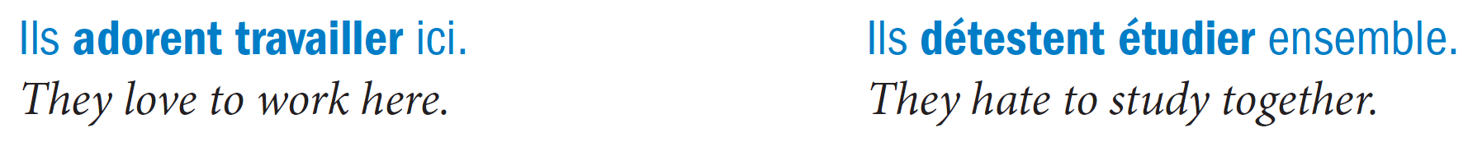
Use infinitive forms after the verbs adorer, aimer, and détester to say that you like (or hate, etc.) to do something. Only the first verb should be conjugated.

Slide 66
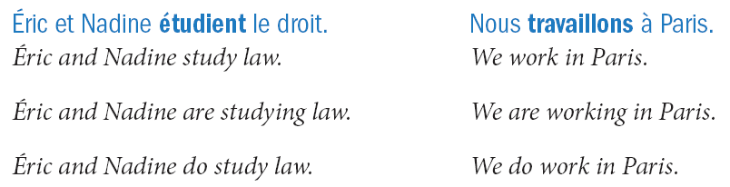
The present tense in French can be translated in different ways in English. The English equivalent for a sentence depends on its context.

Slide 67
Sometimes the present tense can be used to indicate an event in the near future, in which case it can be translated using will in English.

Slide 68
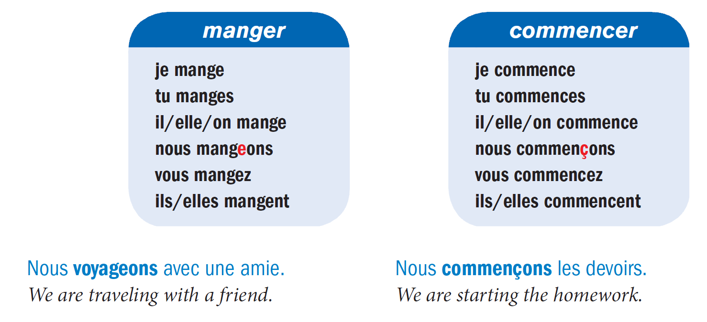
Verbs ending in -ger (manger, partager, voyager)
and -cer (commencer) have a spelling change in the nous form. All the other forms are the same as regular -er verbs.

Slide 69
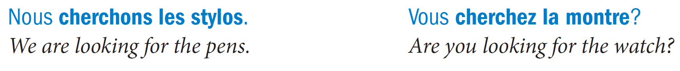
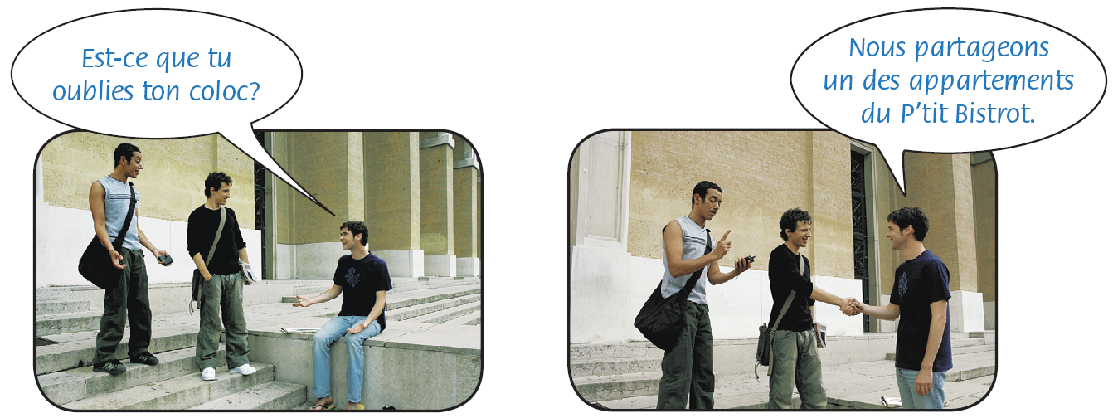
Unlike the English to look for, the French chercher requires no preposition before the noun that follows it.

Slide 70
Français B
Espaces:
Lesson 2A.2
Les cours
9th French PRE IB

Slide 71
Point de départ
You have already learned how to make statements about yourself and others. Now you will learn how to ask questions, which are important for gathering information, and how to make statements and questions negative.

Slide 72

Forming questions
There are four principal ways to ask a question in French. The first and simplest way to ask a question when speaking is to make a statement but with rising intonation. In writing, simply put a question mark at the end. This method is considered informal.

Slide 73

Forming questions (continued)
A second way is to place the phrase Est-ce que… directly before a statement. This turns it into a question. If the next word begins with a vowel sound, use Est-ce qu’. Questions with est-ce que are somewhat formal.

Slide 74
Forming questions (continued)
A third way is to end a statement with a tag question, such as n’est-ce pas? (isn’t that right?) or d’accord? (OK?). This method can be formal or informal.

Slide 75

Forming questions (continued)
A fourth way is to invert the order of the subject pronoun and the verb and place a hyphen between them. If the verb ends in a vowel and the subject pronoun begins with one (e.g., il, elle, or on), insert -t- between the verb and the pronoun to make pronunciation easier. Inversion is considered more formal.

Slide 76


Forming questions (continued)
If the subject is a noun rather than a pronoun, place the noun at the beginning of the question followed by the inverted verb and pronoun.
The inverted form of il y a is y a-t-il. C’est becomes est-ce.

Slide 77

Forming questions (continued)
Use pourquoi to ask why? Use parce que (parce qu’ before a vowel sound) to answer because.
You can use est-ce que after pourquoi to form a question. With est-ce que, you don’t use inversion.

Slide 78
Expressing negation
To make a sentence negative in French, place ne
(n’ before a vowel sound) before the conjugated verb
and pas after it.
In the construction [conjugated verb + infinitive], ne (n’) comes before the conjugated verb and pas after it.

Slide 79

Expressing negation (continued)
In questions with inversion, place ne before the inversion and pas after it.

Slide 80


Expressing negation (continued)
Use these expressions to respond to a statement or a question that requires a yes or no answer.

Slide 81

Expressing negation (continued)
Use si instead of oui to contradict a negative question.

Slide 82

Français B
Espaces: Lesson 2B.1
Une semaine à la fac
9th French PRE IB

Slide 83



Slide 84



Slide 85

Point de départ
The verb avoir (to have) is used frequently. You will have to memorize each of its present tense forms because they are irregular.

Slide 86


Slide 87

Liaison is required between the final consonants of on, nous, vous, ils, and elles and the first vowel of the forms of avoir that follow them. When the final consonant is an -s, pronounce it as a z before the verb forms.

Slide 88

Keep in mind that an indefinite article, whether singular or plural, usually becomes de/d’ after a negation.

Slide 89

The verb avoir is used in certain idiomatic or set expressions where English generally uses to be or
to feel.

Slide 90


Slide 91

The expressions avoir besoin de, avoir honte de, avoir peur de, and avoir envie de can be followed by either a noun or a verb.

Slide 92
Français B
Espaces: Lesson 2B.2
Une semaine à la fac
9th French PRE IB

Slide 93
Point de départ
Use the verb être with numbers to tell time.
There are two ways to ask what time it is.

Slide 94

Use heures by itself to express time on the hour. Use une heure for one o’clock.

Slide 95

Express time from the hour to the half-hour by stating the number of minutes it is past the hour.

Slide 96

Use et quart to say that it is fifteen minutes past the hour. Use et demie to say that it is thirty minutes past the hour.

Slide 97

To express time from the half hour to the hour, subtract the number of minutes or the portion of an hour from the next hour.

Slide 98

To express at what time something happens, use the preposition à.

Slide 99
In French, the hour and minutes are separated by the letter h, which stands for heure, whereas in English a colon is used.

Slide 100

Liaison occurs between numbers and the word heure(s). Final -s and -x in deux, trois, six, and dix are pronounced like a z. The final -f of neuf is pronounced like a v.

Slide 101

You do not usually make a liaison between the verb form est and a following number that starts with a vowel sound.

Slide 102

The 24-hour clock is often used to express official time. Departure times, movie times, and store hours are expressed in this fashion. Only numbers are used to tell time this way. Expressions like et demie, moins le quart, etc. are not used.

Slide 103

Français B
Espaces:
Unité 3 La famille et les copains
Lesson 3A.1
La famille de Marie Laval
9th French PRE IB

Slide 104



Slide 105

Point de départ
As you learned in Leçon 1B, adjectives describe people, places, and things. In French, unlike English, the forms of most adjectives will vary depending on whether the nouns they describe are masculine or feminine, singular or plural. Furthermore, French adjectives are usually placed after
the noun they modify when they don’t directly follow a
form of être.

Slide 106

You’ve already learned several adjectives of nationality and some adjectives to describe your classes. Here are some adjectives used to describe physical characteristics.

Slide 107

Notice that, in the examples below, the adjectives agree in gender (masculine or feminine) and number (singular or plural) with the subjects. Generally add -e to make an adjective feminine. If an adjective already ends in an unaccented -e, add nothing. To make an adjective plural, generally add -s. If an adjective already ends in an -s, add nothing.

Slide 108
Use the expression de taille moyenne to describe someone or something of medium size.

Slide 109


The adjective marron is invariable; in other words, it does not agree in gender and number with the noun it modifies. The adjective châtain is almost exclusively used to describe hair color.

Slide 110


Slide 111

The forms of the adjective nouveau (new) follow the same pattern as those of beau.
Other adjectives that follow the pattern of heureux are curieux (curious), malheureux (unhappy), nerveux (nervous), and sérieux (serious).

Slide 112

Position of certain adjectives
Certain adjectives are usually placed before the noun they modify. These include: beau, bon, grand, gros, jeune, joli, long, nouveau, petit, and vieux.
Other adjectives that are also generally placed before a noun are: mauvais(e) (bad), pauvre (poor as in unfortunate), vrai(e) (true, real).

Slide 113

Position of certain adjectives (continued)
When placed before a masculine singular noun that begins with a vowel sound, these adjectives have a special form.

Slide 114

Position of certain adjectives (continued)
The plural indefinite article des changes to de when the adjective comes before the noun.

Slide 115
Français B
Espaces: Lesson 3A.2
La famille de Maie Laval
9th French PRE IB

Slide 116

Point de départ
In both English and French, possessive adjectives express ownership or possession.

Slide 117


Possessive adjectives are always placed before the nouns they modify.

Slide 118

In French, unlike English, possessive adjectives agree in gender and number with the nouns they modify.

Slide 119

Note that the forms notre, votre, and leur are the same for both masculine and feminine nouns. They only change to indicate whether the noun is singular or plural.

Slide 120

The masculine singular forms mon, ton, and son are used with all singular nouns that begin with a vowel even if they are feminine.

Slide 121
In English, the owner's gender is indicated by the use of the possessive adjectives his or her. In French however, the choice of son, sa, and ses depends on the gender and number of the noun possessed, not the gender and number of the owner.
Context will usually help to clarify the meaning of the possessive adjective.

Slide 122

Possession with de
In English, you use ’s to express relationships or ownership. In French, use de (d’) + [the noun or proper name] instead.

Slide 123

Possession with de (continued)
When the preposition de is followed by the definite articles le and les, they contract to form du and des, respectively. There is no contraction when de is followed by la and I’.

Slide 124

Possession with de (continued)

Slide 125

Français B
Espaces: Lesson 3B.1
Comment sont-ils?
9th French PRE IB

Slide 126



Slide 127


Slide 128

Numbers that end in the digit 1 are not usually hyphenated. They use the conjunction et instead.
Note that 81 and 91 are exceptions:
The number quatre-vingts ends in -s, but there is no -s when it is followed by another number.

Slide 129
Français B
Espaces: Lesson 3B.2
Comment sont-ils?
9th French PRE IB

Slide 130
Point de départ
You have already learned expressions in French containing prepositions like à, de, and en. Prepositions of location describe the location of something or someone in relation to something or someone else.

Slide 131

Use the preposition à before the name of any city to express in, to. The preposition that accompanies
the name of a country varies, but you can use en
in many cases.

Slide 132

Use the forms du, de la, de l’ and des in prepositional expressions when they are appropriate.

Slide 133

You can further modify prepositions of location by
using intensifiers such as tout (very, really) and
juste (just, right).

Slide 134

You may use a preposition without the word de if it is not followed by a noun.

Slide 135

The preposition chez has no exact English equivalent.
It expresses the idea of at or to someone’s house
or place.

Slide 136

The preposition chez is also used to express the idea of at or to a professional’s office or business.

Slide 137

When you want to use a pronoun that refers to a person after any type of preposition, you don’t use a subject pronoun. Instead, you use what are called disjunctive pronouns.

Slide 138


Slide 139
Français B
Summer assignment
Units 1,2,3
Study the grammar concepts.
Look at Youtube videos
Practice pronunciation
9th French PRE IB
2. Quizlet: Do a quizlet
https://quizlet.com/latest
- vocabulary for each unit
3. Do Duolingo

Slide 140
From the Students

Slide 141
What should you practice over the summer?
Grammar Concepts
  I can not stress the importance of learning your grammar concepts. Being comfortable with these concepts will come in hand for future years.
Verb Conjugation
  You will be expected to know the verb conjugations you have learned in previous years. You will not spend a lot of time reviewing, so make sure you are comfortable with what you have already been taught!!
Studying
  As a student, I recommend learning ways to study. As a rising Freshman I did not work on my study habits, and what works for me. Because of that, I found the pace of this class to be a bit challenging. I would 100% recommend the rising Freshman to find what studying habits work for them.
Speaking
  In Madame Rioux’s class we aim at only speaking French. This is extremely important when trying to become fluent in a new language. If you can, try to get comfortable speaking French throughout this summer. A good way to do that, is by speaking with other kids taking this course, or exploring apps like Duolingo.

