Slide 1
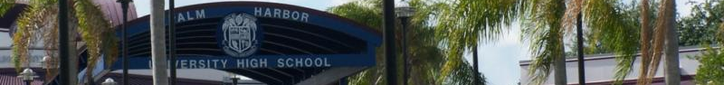

Departments & Courses
Business & Information Technology
Science
Drama-Theater Arts
Social Studies
Driver Education
Visual Arts
Health Sciences Education
World Languages
Language Arts
Mathematics
Music
Notes:
At the top of the screen on the PowerPoint ribbon, click Slide show< From Beginning to navigate the PowerPoint more easily

Slide 2
Business & Information Technology
< Back to first slide
Digital Information Technology*
Digital Design
Business & Entrepreneurial Principles
Personal and Family FInance
BUS Software
Hospitality and Tourism
Accounting I-III
Sport, Recreation, and Entertainment
*Main Prerequisite for all Business and Information Technology Classes

Slide 3

Digital Information Technology
<Back to main Business slide
Course # - 8209020
Grade Level - 9-12
Length - 1 year
Prerequisite - None
Credit - 1
This course is designed to provide a basic overview of current business and information systems and trends and to introduce students to the basics and foundations required for today's business environments. Emphasis is placed on developing proficiency with touch keyboarding and fundamental computer applications, so that they may be used as communication tools for enhancing personal and workplace proficiency in an information-based society. This also includes proficiency with computers using word processing applications, databases, spreadsheets, presentation applications, and the integration of these programs using software that meets industry standards. The appropriate soft skills for developing and maintaining professional business relationships will also be covered.

Slide 4
Business & Entrepreneurial Principles
<Back to main Business slide
Course #
8215120
Grade Level
10-12
Length
1 year
Prerequisite
Introduction to Information Technology(8207310) *Computing for College and Careers (8209020)
Credit
1
This course is designed to provide an introduction to business organization, management, and entrepreneurial principles. Topics include communication skills, various forms of business ownership and organizational structures, supervisory/management skills, leadership skills, human resources management activities, business ethics, and cultural diversity. Emphasis is placed on job readiness and career development. The use of computers is an integral part of this program.

Slide 5
BUS Software
<Back to main Business slide
Course - Business Software Applications I
Course # - 8212120
Grade Level - 10-12
Length - 1 year
Credit - 1
This course is designed to develop proficiency in using the advanced features of software programs to perform office-related tasks.
Course - Business Software Applications II
Course # - 8212160
Grade Level - 11-12
Length - 1 year
Prerequisite - Business Software Applications 1
Credit - 1
The course is designed to use technology to produce high quality employment portfolios, research job opportunities, and compile and disseminate job-seeking documents.

Slide 6

Accounting I-III
<Back to main Business slide
Accounting Applications I
Course # - 8203310
Grade Level - 10-12
Length - 1 year
Prerequisite - Digital Information Technology
This course provides instruction in double-entry accounting. This includes principles of recording business transactions, the preparation of various documents, and the interpretation of financial statements. The use of computers is required.
Accounting Applications II
Course # - 8203320
Grade Level - 10-12
Length - 1 year
Credit - 1
This course is designed to continue the study of accounting principles. The content includes voucher systems, cash receipts, petty cash, payroll records, and internal control systems. The use of computers is required.
Accounting Applications III
Course # - 8203330
Grade Level - 10-12
Length - 1 year
Credit - 1
This course continues the study of accounting principles and applies those principles to various entities. The content includes methods for determining the cost of merchandise inventory, general ledger account analysis, and the aging process. The use of computers is required.

Slide 7
Digital Design I-VI
<Back to main Business slide
Digital Design I-VI(8209600)
Course #
8209510
Grade Level
10-12
Length
1 year
Prerequisite
Digital Information Technology (8207310)
Previous Digital Design Classes
Credit
1
Digital Design I-II
This course is designed to develop entry-level skills required for careers in the digital publishing industry. The content includes computer skills; digital publishing concepts and operations; layout, design and measurement activities; decision making activities, and digital imaging.
Digital Design III-IV
This course continues the development of industry-standard skills required for careers in the digital publishing industry. The content includes the use of a variety of software and equipment to perform digital publishing and digital imaging activities.
Digital Design V
This course is designed to develop advanced industry-standard skills required for careers in the digital publishing industry. The content includes the use of a variety of software and equipment, including digital video cameras and video/audio editing software.
Digital Design VI
This course continues the development of advanced
industry-standard skills required for careers in the digital publishing industry. The content includes the use of a variety of software and equipment used to create multimedia presentations.

Slide 8
Personal and Family Finance
<Back to main Business slide
Course # | 8500120
Grade Level | 9-12
Length | 1 semester
Prerequisite | None
Credit | 1/2 credit
The purpose of this course is to give students an overview of personal and family finance concepts including the American economic system, personal and family management of resources including income, money management, saving and investing, spending and credit, the role of financial institutions and the consumer, consumer information and taxation and financial planning.
This content includes, but is not limited to, consumer rights and responsibilities, record-keeping, decision making and consumer choices, resource management, credit, taxation, wills, savings plans, investments, money management resources, insurance and contracts.

Slide 9
Hospitality and Tourism
<Back to main Business slide
Course - Introduction to Hospitality and Tourism
Course # - 8850110
Grade Level - 9-12
Length - 1 year
Credit - 1
The purpose of this course is to introduce students to the skills necessary for success in the hospitality and tourism industry. Students will also have the opportunity to learn hospitality and tourism terminology and the mathematical, economic, marketing, and sales fundamentals of the industry.
Course - Technology for Travel and Tourism
Course # - 8845140
Grade Level - 9-12
Length - 1 year
Prerequisite - Introduction to Hospitality and Tourism
Credit - 1
This course is designed to provide an introduction to computers and to develop entry-level skills for computer-related careers in the travel and tourism industry.

Slide 10
Sport, Recreation, and Entertainment
<Back to main Business slide
SRE Essentials
Course # - 8827410
Grade Level - 10-12
Length - 1 year
Recommended - Digital Information Technology
The purpose of this course is to develop the competencies essential to sport, recreation, and entertainment marketing. These competencies include employability, human relations, communication, math, and economic skills. The fundamentals of sport, recreation, and entertainment marketing and selling are also included.
SRE Applications
Course # - 8827420
Grade Level - 10-12
Length - 1 year
Credit - 1
Prerequisite - SRE Essentials
This course is designed to provide students with an in-depth study of sport, recreation, and entertainment marketing in a free enterprise society and provide the knowledge, skills and attitudes required for employment in a wide variety of sport, recreation and entertainment marketing occupations.
SRE Marketing Management
Course # - 8827430
Grade Level - 10-12
Length - 1 year
Credit - 1
Prerequisite - SRE Applications
This course provides instruction for career sustaining level employment in the sport, recreation, and entertainment industry. The content includes applied skills related to the sport, recreation, and entertainment marketing functions and industries including employment skills required for success in sport, recreation, and entertainment and career planning as related to the sport, recreation and entertainment industry.

Slide 11

Drivers Education
< Back to first slide
Course #: 1900310
Grade Levels: 9-12
Length: 1 semester
Credit: 1/2
Prerequisite: Restricted License*
Course Description and Aims:
To introduce students to the highway transportation system. To learn strategies which will develop driving knowledge and skills related to today’s and tomorrow’s motorized society, Provide an in depth study of the scope and nature of accident problems and their solutions. Learn and practice with Laboratory instruction in dual controlled vehicles under the direction of an instructor and on off-street multiple vehicle driving ranges.
* Students who do not have their restricted license the first day of class will be given the DATE course required by the DMV during the first few days of class. They must then go to the license bureau to secure their restricted license using the waiver issued by the driver education teacher. Students will be dropped from the course if they do not present a restricted license by a specified date.

Slide 12

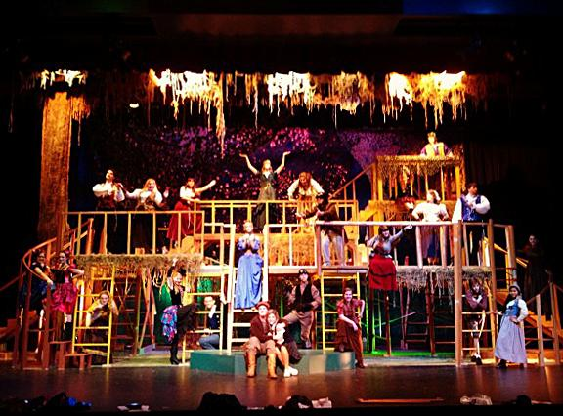
Drama / Theater Arts
< Back to first slide
Theatre
Technical Theatre Design and Production
Musical Theatre
Some courses may require student insurance due to after-school rehearsals and off-school concerts.
Why should I do theatre?

Slide 13
Theatre
< Back to Drama slide
< Back to first slide
Theatre 1
Course #: 0400310
Grade level: 9-12
Length: 1 year
Prerequisite: None
Credit: 1
This year-long, foundational class, designed for students with little or no theatre experience, promotes enjoyment and appreciation for all aspects ol theatre. Classwork focuses on the exploration of theatre literature, performance, historical and cultural connections, and technical requirements. Improvisation, creative dramatics, and beginning scene work are used to introduce students to acting and character development. Incorporation of other art forms in theatre also helps students gain appreciation for other art forms, such as music, dance, and visual art.
Theatre 2
Course #: 0400320
Grade level: 10-12
Length: 1 year
Prerequisite: Theatre 1
Credit: 1
This course is designed for students with a year of experience or more, and promotes enjoyment and appreciation for all aspects of theatre through opportunities to build significantly on existing skills. Classwork focuses on characterization, playwriting, and playwrights’ contributions to theatre; while improvisation, creative dramatics, and scene work are used to help students challenge and strengthen their acting skills and explore the technical aspect of scene work.
Theatre 3 Honors
Course #: 0400330
Grade level: 10-12
Length: 1 year
Prerequisite: Theatre 2
Credit: 1
This course is designed for students with extensive experience in theatre, and promotes significant depth of engagement and lifelong appreciation for theatre through a broad spectrum of primarily self-directed study and performance. In keeping with the rigor expected in an accelerated setting, students assemble a portfolio that showcases a significant body of work representing personal vision and artistic growth over time; mastery of theatre skills and techniques in one or more areas; and evidence of sophisticated oral and written analytical and problem-solving skills based on their structural, historical, and cultural knowledge.
Theatre 4 Honors
Course #: 0400340
Grade level: 10-12
Length: 1 year
Prerequisite: Theatre 3
Credit: 1
This course is designed for students with extensive experience in theatre, and promotes significant depth of engagement and lifelong appreciation for theatre through a broad spectrum of primarily self-directed study and performance. In keeping with the rigor expected in an accelerated setting, students assemble a portfolio that showcases a significant body of work representing personal vision and artistic growth over time; mastery of theatre skills and techniques in one or more areas; and evidence of sophisticated oral and written analytical and problem-solving skills based on their structural, historical, and cultural knowledge.

Slide 14
Technical Theatre Design and Production
< Back to Drama slide
< Back to first slide
Technical Theatre Design and Production 1
Course #: 0400410
Grade level: 9-12
Length: 1 year
Prerequisite: None
Credit: 1
Students focus on developing the basic tools and procedures for creating elements of technical theatre, including costumes, lighting, makeup, properties (props), publicity, scenery, and sound. Technical knowledge of safety procedures and demonstrated safe operation of theatre equipment, tools, and raw materials are central to success in this course. Students explore and learn to analyze dramatic scripts, seeking production solutions through historical, cultural, and geographic research. Students also learn the basics of standard conventions of design presentation and documentation; the organizational structure of theatre production and creative work in a collaborative environment; and the resulting artistic improvement. Public performances may serve as a culmination of specific instructional goals. Students may be required to attend or participate in technical work, rehearsals, and/or performances beyond the school day to support, extend, and assess learning in the classroom.
Technical Theatre Design and Production 2
Course #: 0400420
Grade level: 10-12
Length: 1 year
Prerequisite: Technical Theatre Design and Production 2
Credit: 1
Students focus on the design and safe application of basic tools and procedures to create elements of technical theatre, including costumes, lighting, makeup, properties (props), publicity, scenery, and sound. Students develop assessment and problem-solving skills; the ability to connect selected literature to a variety of cultures, history, and other content areas. Public performances may serve as a culmination of specific instructional goals. Students may be required to attend or participate in technical work, rehearsals, and/or performances beyond the school day to support, extend, and assess learning in the classroom.
Technical Theatre Design and Production 3
Course #: 0400430
Grade level: 11-12
Length: 1 year
Prerequisite: Technical Theatre Design and Production 2
Credit: 1
Students regularly reflect on aesthetics and issues related to and addressed through theatre, and create within various aspects of theatre. Student designers and technicians assemble a portfolio that showcases a body of work representing artistic growth over time; growing command of theatre skills and techniques in one or more areas; and evidence of significant oral and written analytical and problem-solving skills. Public performances may serve as a culmination of specific instructional goals. Students may be required to attend or participate in technical work, rehearsals, and/or performances beyond the school day to support, extend, and assess learning in the classroom.
Technical Theatre Design and Production 4 Honors
Course #: 0400440
Grade level: 11-12
Length: 1 year
Prerequisite: Technical Theatre Design and Production 3
Credit: 1
Students regularly reflect on aesthetics and issues related to and addressed through theatre, and create within various aspects of theatre in ways that are progressively more innovative. Students analyze increasingly more sophisticated theatre literature to inform the work of developing technical design and production pieces for one-acts or a larger production. Students assemble a portfolio that showcases an extensive body of work representing personal vision and artistic growth over time. Public performances may serve as a culmination of specific instructional goals. Students may be required to participate in rehearsals and performances outside the school day to support, extend, and assess learning in the classroom.

Slide 15
Musical Theatre
< Back to Drama slide
< Back to first slide
Musical Theatre 1
Course #: 0400700
Grade level: 9-12
Length: 1 year
Prerequisite: None
Credit: 1
Students’ course work focuses on, but is not limited to, acting, vocal performance, dance, non-dance movement, and staging, which transfer readily to performances in musicals and other venues. Students survey the evolution of music in theatre from ancient Greece to modern Broadway through a humanities approach and representative literature. Music theatre students explore the unique staging and technical demands of musicals in contrast to non-musical plays. Public performances may serve as a culmination of specific instructional goals. Students may be required to attend and/or participate in rehearsals and performances outside the school day to support, extend, and assess learning in the classroom.
Musical Theatre 2
Course #: 0400710
Grade level: 9-12
Length: 1 year
Prerequisite: None
Credit: 1
Students learn from the styles and techniques used by well-known singer-actor-dancers and choreographers to build a performance portfolio for auditions and/or interviews. Students examine the contributions of major writers, composers, lyricists, and choreographers of musical theatre and learn to analyze the structures, stories, and settings of musical theatre exemplars to understand how those components serve the story and concept. Students extend their dance and movement techniques required to sing and dance at the same time. Public performances may serve as a culmination of specific instructional goals. Students may be required to attend and/or participate in rehearsals and performances outside the school day to support, extend, and assess learning in the classroom.
Musical Theatre 3
Course #: 0400720
Grade level: 9-12
Length: 1 year
Prerequisite: None
Credit: 1
Students refine their audition techniques and performance/audition portfolio, and consider the contributions of musical theatre in the community and beyond. Students select a number of pieces to showcase their abilities and become conversant about individuals who, currently and in the past, are considered major contributors to the field. Students refine their dance and movement techniques required to sing and dance for long periods of time in rehearsals and performance. Public performances may serve as a culmination of specific instructional goals. Students may be required to attend and/or participate in rehearsals and performances outside the school day to support, extend, and assess learning in the classroom.
Some music courses may require mandatory after-school rehearsals and performances as a part of the criteria for grading. Students interested in participating in any music course should check with the instructor to determine the requirements of the course.

Slide 16
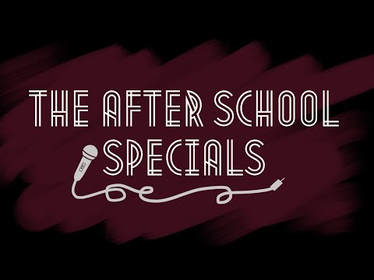
Why should I do theatre?
< Back to Drama slide
< Back to first slide
Past awards
Walker’s Rising Star scholarship semifinalist- 3 acting students, 3 vocal students, 1 instrumental student
Regional Thespians festival- 28 Superior awards and 1 Top Honor Finalist; 12 events selected for State Thespian festival
All-State Chorus- 9 students selected
After school a capella group selected to compete in ICHSA competition
Past projects
https://www.youtube.com/channel/UCcZK45QKHWkA7MEKRkwBJEQ
https://youtube.com/playlist?list=PLfGS1ETTt5bT8LwGCijAm5dP2ILQunR7w
https://youtu.be/0Kp6Fe79PT4
https://youtu.be/5y7pQ1VyfPo

Slide 17

Health Sciences Education:
< Back to first slide
Health Sciences 1
Health Science Foundation
Principles of Biomedical Sciences
Pharm Tech 1-7

Slide 18

Health Sciences 1
< Back To First Slide
< Back To Health Sciences Education
Course #: 8417100 1,2
Grade Level: 9-10
Length: 1 year
Prerequisite: None
Credit: 1
Course Description:
Investigate specific Health career data.
Learn and Study the Human body and the body systems’ functions.
Learn the effects of common diseases on the body.

Slide 19

Health Science Foundation
< Back To First Slide
< Back To Health Sciences Education
Course #: Q8417110
Grade Level: 9-12
Length:1 year
Prerequisite: Health Science*
Credit: 1
Course Description:
Part of the secondary Health Core to provide students with an in depth knowledge of the health care system and associated occupations. Emphasis on communication and interpersonal skills, technological use, ethics, and development of critical thinking and problem solving skills. Students may shadow professionals during the course
* May be currently enrolled in any health science education level 3 class.
This is a designated level 3 course as of 2016

Slide 20
Principles of Biomedical Sciences
< Back To First Slide
< Back To Health Sciences Education
Grade Level: 9-10
Length: 1 year
Prerequisite: Acceptance into the Medical Program
Credit: 2
Course Descriptions:
This course allows students to play the roles of Biomedical professionals. Think CSI meets ER. In this first course students will be introduced to biology concepts through the study of human disease. This course will require high level reading, math, and science in order to be successful. Students investigate various health conditions including heart disease, sickle-cell disease, hypercholesterolemia, and infectious diseases. The activities and projects introduce students to human physiology, medicine, and research processes.
Principle of Biomedical Sciences Example Syllabus

Slide 21

Pharm Tech 1-7
< Back To First Slide
< Back To Health Sciences Education
Grade Level: 9-12
Length: 1 year
Credit: 1
Course Description:
The purpose of this course is to prepare students to become a Pharmacy Technician. Students will take Pharm Tech 1 in their freshman year, Pharm Tech 2/3 in their Sophomore year, Pharm Tech 4/5 in their Junior year and Pharm Tech 6/7 in their Senior year where they will have an internship and sit for their license.

Slide 22

Language Arts
< Back to first slide
English I-II & English Honors I-II
Creative Writing I-II
Speech I
Journalism I-II (Newspaper / Yearbook)
Intensive Reading: Single Block
Social Media 1

Slide 23

English & English Honors
< Back to language arts slide
English I
Length: 1 year
Prerequisite: M/J Language Arts 3 (Any level)
Credit: 1
English Honors I
Length: 1 year
Prerequisite: M/J Language Arts 3A or 3
Credit: 1
English II
Length: 1 year
Prerequisite: English I (any level)
Credit: 1
English Honors II
Length: 1 year
Prerequisite: English I or English Honors I
Credit: 1
These courses focus on the close reading and careful analysis of complex literary and informational texts, and the compositional process. Students develop skill in reading analytically, speaking and listening, language, and composition. Emphasis is placed on key ideas and details, author's craft and structure, integration of knowledge and ideas, the range of reading and level of text complexity, vocabulary development, student research, and the process and production of various modes of writing.
Higher levels of this course are allowed for higher grade levels.

Slide 24

Creative Writing
< Back to language arts slide
Creative Writing I
Length: 1 semester
Prerequisite: None
Credit: 0.5
Creative Writing II
Length: 1 semester
Prerequisite: None
Credit: 0.5
The purpose of these courses is to extend the development of the writing and language skills needed for individual expression in literary forms as introduced in Creative Writing I. Emphasis is placed on writing a variety of literary works, including original poetry, short stories, plays, novels and/or essays, and nonfiction. Also included are the technical aspects of publishing students’ work in literary publications.
Higher levels of this course are allowed for higher grade levels.

Slide 25

Speech I
< Back to language arts slide
Speech I
Length: 1 semester or year
Prerequisite: None
Credit: 1
The purpose of this course is to develop oral communication skills in formal and informal speaking situations. Emphasis is placed on using public speaking skills, listening skills, and group discussion techniques. Students will analyze audiences for speaking purposes and will evaluate speeches and speaking techniques
Higher levels of this course are allowed for higher grade levels.

Slide 26

Journalism I-II (Newspaper/Yearbook)
< Back to language arts slide
Journalism I
Length: 1 semester or year
Prerequisite: None
Credit: 1
Journalism II
Length: 1 semester or year
Prerequisite: None
Credit: 1
The purpose of these courses is to provide instruction in basic aspects of journalism and workshop experiences in journalistic production. Emphasis is placed on identifying and describing elements of the history and traditions of journalism as well as organizing and utilizing appropriate production modes. Students will produce the school newspaper and/or the school yearbook.
Higher levels of this course are allowed for higher grade levels.

Slide 27

Intensive Reading: Single Block
< Back to language arts slide
Intensive Reading: Single Block
Length: 1 year
Prerequisite: None
Credit: 1
The purpose of this course is to provide instruction that enables students to accelerate the development of reading and writing skills and to strengthen those skills so they are able to successfully read and write grade level text independently. Instruction emphasizes reading comprehension, writing fluency, and vocabulary study through the use of a variety of literary and informational texts encompassing a broad range of text structures, genres, and levels of complexity. Texts used for instruction focus on a wide range of topics, including content-area information, in order to support students in meeting the knowledge demands of increasingly complex text. Students enrolled in the course will engage in interactive text-based discussion, question generation, and research opportunities. They will write in response to reading and cite evidence when answering text dependent questions orally and in writing. The course provides extensive opportunities for students to collaborate with their peers. Scaffolding is provided as necessary as students engage in reading and writing increasingly complex text and is removed as the reading and writing abilities of students improve over time.

Slide 28

Social Media 1
< Back to language arts slide
Social Media 1
Length: 1 semester
Prerequisite: None
Credit: 0.5
The purpose of this course is to enable students to develop fundamental skills in the use of social media across print, multimedia, web, and broadcast platforms, including ethical and legal uses.

Slide 29
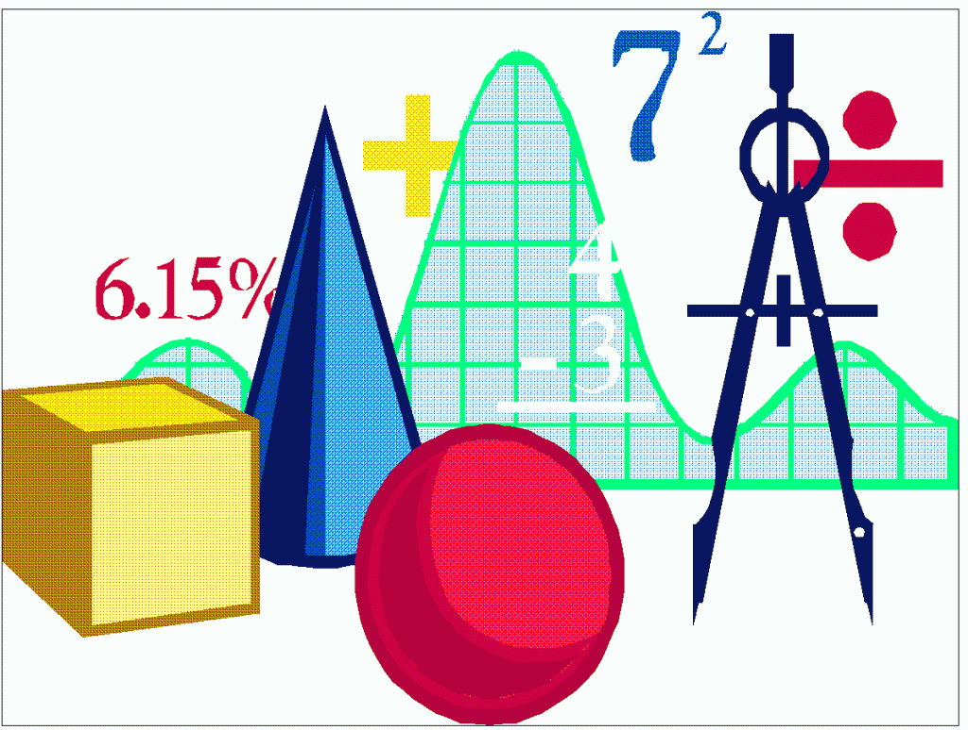
Mathematics
< Back to first slide
Algebra 1 (One-year Algebra Program)
Geometry Honors
Algebra 1A
Liberal Arts Mathematics 1
Algebra 1B
Algebra 2
Geometry
Algebra 2 Honors

Slide 30
Algebra 1 (One-year Algebra Program)
< Back to Math slide
Length: 1 year
Prerequisite: None
Credit: 1
The purpose of this course is to provide the foundation for more advanced mathematics courses and to develop the algebra skills needed to solve real-world and mathematical problems. Topics shall include, but not be limited to, sets, ratios, proportions, radical expressions, variables, the real number system, equations and inequalities, graphs, systems of linear equations and inequalities, integral exponents, polynomials, factoring, irrational numbers, quadratic equations, Venn diagrams, coordinate geometry, problem solving strategies, and literacy strategies. Grades are assigned through completion of course work. Credit is received by obtaining an achievement level of 3, 4, or 5 on the Algebra EOC.

Slide 31
Algebra 1A
< Back to Math slide
Length: 1 semester
Prerequisite: None
Credit: 1
This course is the first half of the algebraic content for the algebra one program. Topics shall include, but not be limited to, the real number system with emphasis on rational and irrational numbers, sets, variables, algebraic expressions, patterns, relations and functions, solutions to linear equations and inequalities, rates, ratios, proportions, coordinate geometry, graphs, Venn diagrams, real-world problems, problem solving strategies, and literacy strategies.

Slide 32
Algebra 1B
< Back to Math slide
Length: 1 semester
Prerequisite: One full credit in Algebra 1A
Credit: 1
This course is the second half of the algebraic content of a two-year algebra program. Topics shall include, but not be limited to, ratios, proportions, radical expressions, algebraic notation, polynomials, factoring, coordinate geometry, graphs, solutions to linear, quadratic, and systems of equations and inequalities, real-world applications, problem solving strategies, and literacy strategies. Algebra 1A and Algebra 1B completes the algebraic content that will be assessed on the Algebra EOC.

Slide 33
Geometry
< Back to Math slide
Length: 1 year
Prerequisite: One full credit of the Algebra 1 course or completion of an Algebra 1 or equivalent course with a passing grade.
Credit: 1
The purpose of this course is to develop the geometric relationships and deductive strategies that can be used to solve a variety of real world and mathematical problems. Topics shall include, but not be limited to, logic, equivalent propositions, Euclidean Geometry, direct and indirect proofs, constructions, lines, polygons, transformations, quadrilaterals, triangles, circles, polyhedral, spheres, trigonometric ratios, problem solving strategies and literacy strategies.
Notes:
Richard

Slide 34
Geometry Honors
< Back to math slide
Length: 1 year
Prerequisite: One Algebra 1 credit of level 4 or 5 and a passing grade in Algebra 1 Honors or one full credit in Algebra 1 or Algebra 1 Honors
Credit: 1
The purpose of this course is to develop the geometric relationships and deductive strategies that can be used to solve a variety of real world and mathematical problems. Topics shall include, but not be limited to, truth tables, logic, equivalent propositions, Euclidean Geometry, direct and indirect proofs, vectors, Fibonacci sequence, golden ratio, constructions, lines, polygons, transformations, quadrilaterals, triangles, circles, polyhedral, cross sections, spheres, coordinate geometry, trigonometric ratios, problem solving strategies and literacy strategies.

Slide 35
Liberal Arts Mathematics 1
< Back to Math slide
Length: 1 year
Prerequisite: One credit in Algebra 1 or equivalent
Credit: 1
The purpose of this course is to strengthen Algebra 1 skills and to explore informal geometry. State assessment skills will be reinforced. Topics shall include, but not be limited to, laws of exponents, real number properties and operations, graphs, functions, equations and inequalities, quadratic equations, coordinate geometry, polygons, quadrilaterals, triangles, solids, data sets, measures of central tendency, real-world applications, problem solving strategies and literacy strategies. Students may not earn credit in both Liberal Arts Mathematics courses.

Slide 36
Algebra 2
< Back to Math slide
Length: 1 year
Prerequisite: One credit in Algebra 1 or equivalent
Credit: 1
The purpose of this course is to continue the study of the structure of algebra and to apply these skills to fields such as science, social science, statistics, and health-related fields. Topics shall include, but not be limited to, complex numbers, functions, equations and inequalities, rational expressions and equations, absolute value, direct, inverse and joint variation, arithmetic and geometric sequences and series, systems of equations and inequalities, parabolas, quadratic equations, powers, roots, exponents and logarithms, polynomials, problem solving strategies and literacy strategies.

Slide 37
Algebra 2 Honors
< Back to Math slide
Length: 1 year
Prerequisite: One full credit in Algebra 1 Honors or one full credit in Algebra 1 and enrollment in AVID
Credit: 1
The purpose of this course is to study algebraic topics in-depth with emphasis on theory, proof, and development of formulas and their applications. Topics shall include, but not be limited to, complex numbers, functions, equations and inequalities, absolute value, direct, inverse and joint variation, systems of equations and inequalities, parabolas, quadratic equations, powers, roots, exponents and logarithms, polynomial equations and inequalities, Binomial Theorem, radical expressions, non-linear systems of equations, conic sections, sigma notation, arithmetic and geometric sequences, equations of circles, real-world applications, problem solving strategies and literacy strategies.

Slide 38


Music
*Some courses may require student insurance due to after-school rehearsals and off-school concerts.
< Back to first slide
Music Theory
Band
Instrumental Techniques
Jazz Ensemble
Chorus
Eurythmics

Slide 39

Music Theory
< Back to music slide
Music Theory 1
Length: 1 year
Prerequisite: None
Credit:1
The purpose of this course is to introduce and explore musical fundamentals as practiced in various historical periods. Emphasis will be placed on aural and notational skill development.
Music Theory 2 Honors
Length: 1 year
Prerequisite: Music Theory 1 OR audition/demonstration of skill knowledge
Credit:1
This course enables the student to analyze and apply musical fundamentals as practiced in various historical periods. Emphasis will be placed on aural skills development, harmonic notation and written analysis. Course includes district developed requirements designed to demonstrate student mastery of rigorous standards required of quality point fine arts courses.

Slide 40

Band
< Back to music slide
Band 1
Length: 1 year
Prerequisite: None
Credit: 1
The purpose of this course is to provide students with the opportunity to develop technical skills on band instruments in an ensemble setting. The content will include developing performance techniques and reading musical notation.
Band 2
Length: 1 year
Prerequisite: Band 1
Credit: 1
This course is designed to extend musicianship skills and the development of technical skills through performance in instrumental ensembles. The content will include the production of characteristic tone, and the development of basic band performance techniques, musical literacy, and music appreciation.
Band 3
Length: 1 year
Prerequisite: Band 2
Credit: 1
This course provides students with instruction in development of musicianship and technical skills through the study of varied band literature. The content will include interpreting medium level band music, establishing appropriate tone production and performance techniques, identifying simple musical form and various styles, and formulating aesthetic awareness.
Band 4
Length: 1 year
Prerequisite: Band 3
Credit: 1
The purpose of this course is to provide students with in-depth instruction in musicianship and technical skills through the study of varied band literature. The content will include interpreting medium/difficult level band literature, refining tone production and performance techniques, demonstrating an understanding of musical form, and evaluating musical performance as a participant and as a listener.
Band 5 Honors
Length: 1 year
Prerequisite: Band 4
Credit: 1
This course enables the student to develop independent musicianship, performance techniques and aesthetic awareness through performance of varied band literature. The student will demonstrate ability to interpret and perform difficult musical notation at sight and formulate critical evaluations about musical performance as a participant and as a listener. Course includes district developed requirements designed to demonstrate student mastery of rigorous standards required of quality point fine arts courses.
Band 6 Honors
Length: 1 year
Prerequisite: Band 5
Credit: 1
This course is designed to foster internalization of independence in musicianship, performance techniques, and aesthetic awareness through the performance of varied band literature. The student will demonstrate awareness and application of appropriate ensemble Band VI performance techniques and demonstrate independent ability to interpret and perform difficult musical notation at sight. Course includes district developed requirements designed to demonstrate student mastery of rigorous standards required of quality point fine arts courses.

Slide 41

Instrumental Techniques
< Back to music slide
Instrumental Techniques 1
Length: 1 year
Prerequisite: None
Credit: 1
The purpose of this course is to develop fundamental performance techniques and the interpretation of musical notation. The student will display knowledge of the care of the instrument, demonstrate a characteristic tone on the instrument of choice and develop beginning level evaluative listening skills.
Instrumental Techniques 2
Length: 1 year
Prerequisite: Instrumental Tech. 1
Credit: 1
This course will provide instruction in performance techniques with emphasis placed on technical and musical fundamentals and listening skills.
Instrumental Techniques 3
Length: 1 year
Prerequisite: Instrumental Tech. 2
Credit: 1
The purpose of this course is to provide students the opportunity to develop solo performance skills. Instruction will include performance techniques such as breath control, tone production, intonation, phrasing, and expression. Students will demonstrate independence in the interpretation of grade III-IV solo literature and the evaluation of critical listening skills.
Instrumental Techniques 4 Honors
Length: 1 year
Prerequisite: Instrumental Tech. 3 or Band 4
Credit: 1
This course will give the student an opportunity to demonstrate advanced solo performance skills and independence in the interpretation of grades IV and V solo literature. The student will integrate performance techniques independently, formulate critical evaluations and make decisions about music performance as a listener and a performer. Course includes district developed requirements designed to demonstrate student mastery of rigorous standards required of quality point fine arts courses.

Slide 42

Jazz Ensemble
< Back to music slide
Jazz Ensemble 1
Length: 1 year
Prerequisite: Previous instrumental experience
Credit: 1
The purpose of this course is to provide students with an introduction to styles and performance techniques of varied contemporary music and jazz literature.
Instrumental Techniques 2
Length: 1 year
Prerequisite: Jazz Ensemble 1
Credit: 1
The purpose of this course is to develop and extend an understanding of styles and performance techniques of contemporary music and jazz literature. An emphasis will be placed on basic improvisation skills, tone production, and individual and ensemble performance.
Instrumental Techniques 3
Length: 1 year
Prerequisite: Jazz Ensemble 2
Credit: 1
This course will develop the ability to apply the knowledge of styles and techniques of varied contemporary music and jazz literature through ensemble performance. Content includes an emphasis on producing a characteristic tone, developing individual and ensemble techniques, improvising and refining an appreciation for the history of jazz.
Instrumental Techniques 4 Honors
Length: 1 year
Prerequisite: Jazz Ensemble 3
Credit: 1
The purpose of this course is to develop independence in the knowledge and demonstration of styles and performance techniques of varied contemporary music and jazz literature. The content will include improvisation, interpretation, and performance of appropriately difficult jazz literature. Course includes district developed requirements designed to demonstrate student mastery of rigorous standards required of quality point fine arts courses.

Slide 43

Chorus
< Back to music slide
Chorus 1
Length: 1 year
Prerequisite: None
Credit: 1
The purpose of this course is to develop basic vocal techniques and musicianship skills through the study of varied choral literature. The content will include fundamental skills in vocal tone production, choral performance techniques, musical literacy and music appreciation.
Chorus 2
Length: 1 year
Prerequisite: Chorus 1
Credit: 1
The purpose of this course is to extend the development of basic musicianship skills including choral performance techniques, vocal tone production, musical literacy and music listening. This course will include the study of a variety of choral literature.
Chorus 3
Length: 1 year
Prerequisite: Chorus 2
Credit: 1
This course provides students with instruction in the development of vocal musicianship and technical skills. An emphasis will be placed on producing an appropriate vocal tone, interpreting musical notation, and formulating aesthetic values.
Chorus 4
Length: 1 year
Prerequisite: Chorus 3
Credit: 1
This course provides students with instruction in the application of vocal musicianship and technical skills. An emphasis will be placed on the refinement of tone production and performance techniques, analysis of musical form, and aesthetic perceptions.
Chorus 5 Honors
Length: 1 year
Prerequisite: Chorus 4
Credit: 1
This course enables students to develop independence in musicianship and performance techniques while performing various styles of choral literature. The student will demonstrate ability to interpret and perform difficult musical notation at sight and formulate critical evaluations about musical performance as a participant and listener. Course includes district developed requirements designed to demonstrate student mastery of rigorous standards required of quality point fine arts courses.
Chorus 6 Honors
Length: 1 year
Prerequisite: Chorus 5
Credit: 1
The purpose of this course is to develop independence in vocal musicianship, performance techniques, and aesthetic awareness through the performance of varied choral literature. The student will consistently demonstrate ability to interpret and perform difficult musical notation at sight. The student will formulate and justify critical evaluations about musical performance as a participant and listener. Course includes district developed requirements designed to demonstate student mastery of rigorous standards required of quality point fine arts courses.

Slide 44

Eurythmics
< Back to music slide
Eurythmics 1 A/B
Length: 1 year
Prerequisite: None
Credit: 1
The purpose of this course is to provide students with instruction in the development of beginning level skills in the art of performing movements in rhythm using musical accompaniment. Content will include basic terminology related to music and movement and the understanding of safety practices related to eurythmic activities including warm-up and cool-down.
Eurythmics 2
Length: 1 year
Prerequisite: Eurythmics 1
Credit: 1
This course will enable students to apply the basic performance techniques in movement sequences set to music. Students will display knowledge of basic rhythms, meter, tempo and form.
Eurythmics 3
Length: 1 year
Prerequisite: Eurythmics 2
Credit: 1
This course will provide students with the opportunity to choreograph and perform solo movement sequences set to music in a given style. Students will display knowledge of terminology related to music and movement.
Eurythmics 4
Length: 1 year
Prerequisite: Eurythmics 3
Credit: 1
The purpose of this course is to extend the study of musical interpretation through movement. Emphasis will be on individual creativity and develop the ability to evaluate the appropriateness and general effects of individual and ensemble performances.
A. Courses may require students insurance for after-school rehearsals and off-school site concerts.
B. May require mandatory after-school rehearsals and performances as part of the criteria for grades.

Slide 45
Science
< Back to first slide
Biology
Physical Science
Earth Science
Chemistry
Anatomy and Physiology
Environmental Science
Marine Science
Physics

Slide 46
Biology
Biology I Honors Example Syllabus
AP Biology Example Syllabus
< Back to science slide
< Back to first slide
AP Biology Curriculum
Biology I
Length: 1 year
Prerequisite: None
Credit: 1
This course focuses on the study of life through the examination of fundamental concepts such as cellular biology, genetics, ecology, evolution and physiology. The scientific process and laboratory skills are emphasized along with biology’s connections to other scientific disciplines. Students learn scientific writing skills and also examine current biological issues.
*Students are required to take the EOC
Biology I Honors
Length: 1 year
Prerequisite: Advanced 8th grade science with C +and a strong reading comprehension.
Credit: 1
This advanced course will cover essentially the same topics as regular biology, but at higher levels of complexity, greater depth, and faster pace. The reading level will be higher and more reading will be required. Students will be required to use a higher level of vocabulary, do more writing, do more homework, and meet the standards of more challenging tests.
*Students are required to take the EOC
AP Biology
Length: 1 year
Prerequisite: Biology and chemistry with a recommended average grade of C or better in biology, and/or enrollment in AVID
Credit: 1
The purpose of this course is to provide a college level course in biology, and to prepare the student to seek credit and/or appropriate placement in college biology courses. To parallel college science courses that have a required laboratory section, it is recommended that this course be accompanied by or paired with Biology II Honors to insure sufficient time for the required laboratory experiences.
*Students are required to take the AP exam

Slide 47


Earth/Space Science
< Back to science slide
< Back to first slide
Earth/Space Science
Length: 1 year
Prerequisite: None
Credit: 1
This course provides opportunities for the student to develop concepts basic to the earth, including its materials, processes, history, and environment in space. Topics such as the origin of the universe and solar system, life cycle of stars, formation of rocks, land forms, plate tectonics, glaciers, meteorology, and geologic periods are included.
Earth/Space Science Honors
Length: 1 year
Prerequisite: None
Credit: 1
This course includes typical topics contained in regular earth/space science, but will require that students demonstrate a deeper level of understanding. Students will be required to complete additional projects and communicate scientific concepts with clarity.

Slide 48
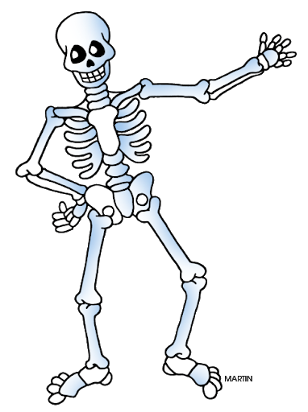
Anatomy and Physiology
< Back to science slide
< Back to first slide
Anatomy and Physiology
Length: 1 year
Prerequisite: Biology I or IH. Recommended average grade of C or better in biology
Credit: 1
This course will provide students with a general introduction to the structure and function of the components of the human body. Topics such as cells and tissues, skeletal system, muscular system, nervous system, sensory organs, immune response, and inheritance are included.
Anatomy and Physiology Honors
Length: 1 year
Prerequisite: Biology I or IH. Recommended C or better in biology and/or enrollment in AVID.
Credit: 1
This advanced course will cover essentially the same topics as regular anatomy and physiology but at higher levels of complexity, greater depth, and faster pace. The reading level will be higher and more reading will be required. Students will be required to use a higher level of vocabulary, do more writing, do more homework, and meet the standards of more challenging tests.
Anatomy and Physiology Example Syllabus

Slide 49
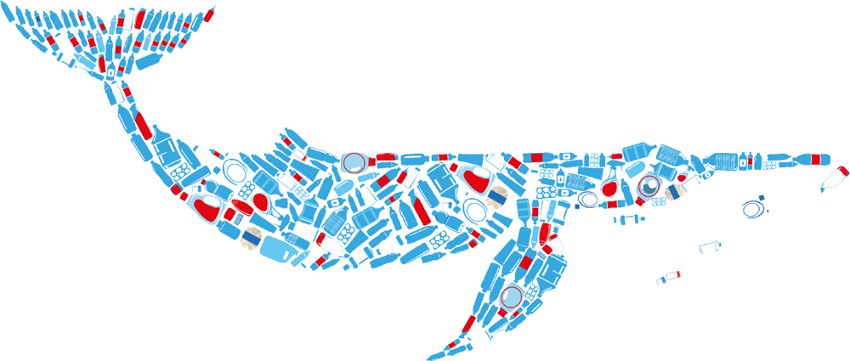
Marine Science
< Back to science slide
< Back to first slide
Marine Science I Honors
Length: 1 year
Prerequisite: Recommended Biology
Credit: 1
This advanced course will cover essentially the same topics as regular Marine Science 1, but at higher levels of complexity, greater depth, and faster pace. The reading level will be higher and more reading will be required.
Marine Science II Honors
Length: 1 year
Prerequisite: Marine Science I Honors with a recommended average grade of C or better in marine science, and/or enrollment in AVID.
Credit: 1
This course will provide an in-depth study of the marine environment begun in marine science. Its goal is to present science in a social context and to give students the foundation needed to be intelligent participants in important societal discussions that involve environmental issues touching on oceans, climate and coastal zones.
Marine Science
Length: 1 year
Prerequisite: Recommended Biology
Credit: 1
This course is designed to present an integrated overview of the principles and concepts of the geology, chemistry, physics, and biology as they relate to the world’s oceans.

Slide 50

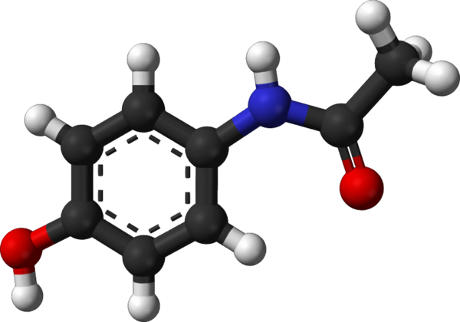


Physical Science
< Back to science slide
< Back to first slide
Physical Science
Length: 1 year
Prerequisite: None
Credit: 1
This course provides students with a qualitative, investigative study of the introductory concepts of physics and chemistry. Topics include dynamics, periodic table, forms of energy, electricity and magnetism and chemical interactions.

Slide 51
Chemistry
< Back to science slide
< Back to first slide
Chemistry I Honors
Length: 1 year
Prerequisite: Algebra I
Credit: 1
This course will provide students with a rigorous study of the composition, properties, and changes associated with matter. Topics include heat, atomic structure, mole concept, reaction rates and equilibrium, solutions, and electrochemistry.
AP Chemistry
Length: 1 year
Prerequisite: Chemistry I and Algebra 1 with a recommended grade of C or better in chemistry, algebra I and/or enrollment in AVID.
Credit: 1
The purpose of this course to provide a college level course in chemistry, and to prepare the student to seek credit and/or appropriate placement in college chemistry courses. To parallel college science courses that have a required laboratory section, it is recommended that this course be accompanied by or paired with Chemistry II Honors to insure sufficient time for the required laboratory experiences.
*Students are required to take the AP Exam
Chemistry I
Length: 1 year
Prerequisite: Algebra I
Credit: 1
This course will provide students with the study of the composition, properties, and changes associated with matter. Topics such as atomic theory, periodic table, bonding, chemical formulas, behavior of gases, and chemical reactions are included.
Chemistry I Example Syllabus
Chemistry I Honors Example Syllabus
AP Chemistry Curriculum

Slide 52

Environmental Science
< Back to science slide
< Back to first slide
Environmental Science
Length: 1 year
Prerequisite: None
Credit: 1
The purpose of this course is to study man's interaction with the environment. The content should include, but not be limited to the following: forms of pollution, conservation, environmental planning and policy, public land usages, population dynamics and major forms of energy.
AP Environmental Science
Length: 1 year
Prerequisite: Biology and chemistry with a recommended average grade of C or better in biology, algebra I and/or enrollment in AVID.
Credit: 1
The purpose of this course is to provide a college level course in environmental science, and to prepare the students to seek credit and/or appropriate placement in college environmental science courses. To parallel college science courses that have a required laboratory section, it is recommended that this course be accompanied by or paired with Earth/Space Science Honors to insure sufficient time for the required laboratory experiences.
*Students are required to take the AP Exam
AP Environmental Science Curriculum
AP Environmental Example Syllabus
AP Environmental Introduction

Slide 53
Physics
< Back to science slide
< Back to first slide
Physics I
Length: 1 year
Prerequisite: Algebra 1
Credit: 1
This course will provide students with an introductory study of the theories and laws governing the interaction of matter, energy and the forces of nature. Topics such as kinematics, dynamics, work and power, thermodynamics, wave characteristics and magnetism are included.
AP Physics C
Length: 1 year
Prerequisite: Chemistry, physics, and must be enrolled in calculus. C or better in Physics I, and/or enrollment in AVID
Credit: 1
This course will provide a college level course in physics and will prepare students to seek credit and/or appropriate placement in college physics. Unlike AP Physics B, this course will involve the students in calculus applications. To parallel college science courses that have a required laboratory section, it is recommended that this course be accompanied by or paired with Physics II Honors to insure sufficient time for the required laboratory experiences.
*Students are required to take the AP Exam
Physics II Honors
Length: 1 year
Prerequisite: Physics I or IH. Recommended grade of C or better in physics
Credit: 1
This course will expand the study of physical concepts introduced in first year physics, and introduce new topics. Topics such as astrophysics, relativity, fluid dynamics, magnetic fields, and quantum mechanics are included.
Physics I Honors
Length: 1 year
Prerequisite: Algebra 1
Credit: 1
This course will provide students with a rigorous introductory study of the theories and laws governing the interaction of matter, energy and the forces of nature. Topics include energy, heat, light, electricity and nuclear physics.
AP Physics Curriculum

Slide 54
Social Studies
< Back to first slide
AP United States Government and Politics
Anthropology
AP United States History
World Cultural Geography
American Government
World History
AP Microeconomics
AP Human Geography
American Government Honors
World History Honors
Psychology 1
Sociology
Law Studies
AP World History
Psychology 2
Holocaust
Court Procedures
United States History
AP Psychology
AP European History

Slide 55

AP US Government and Politics
Back to Social Studies slide
Grade Level: 9-12
Length: 1 Semester
Prerequisite: None
Credit: ½
Course Description:
Students acquire a critical perspective of politics and government in the United States. They learn general concepts used to interpret American politics and analyze specific case studies. Students also become familiar with the various institutions, groups, beliefs and ideas that constitute the American political perspective.
*Students are required to take the AP exam!*
AP US Gov Curriculum
AP US Government Syllabus Example

Slide 56

American Government
Back to Social Studies slide
Grade Level: 9-12
Length: 1 Semester
Prerequisite: None
Credit: ½
Course Description:
Students gain an understanding of American government and political behavior that is essential for effective citizenship and active involvement in contemporary American society.
American Government Syllabus

Slide 57

American Government Honors
Back to Social Studies slide
Grade Level: 9-12
Length: 1 Semester
Prerequisite: None
Credit: ½
Course Description:
Students gain an understanding of American government and political behavior that is essential for effective citizenship and active involvement in contemporary American society. Students in an honors class will study and analyze primary source documents, write document based question essays, and incorporate additional reading and current events.

Slide 58

Law Studies
Back to Social Studies slide
Grade Level: 9-12
Length: 1 Semester
Prerequisite: None
Credit: ½
Course Description:
Students learn that the American legal system is the foundation of American society. In order to function effectively, students examine those laws which have an impact on citizens' lives and are provided with an introduction to fundamental civil and criminal justice procedures.
Law Studies Syllabus

Slide 59

Court Procedures
Back to Social Studies slide
Grade Level: 9-12
Length: 1 Semester
Prerequisite: None
Credit: ½
Course Description:
The grade 9-12 Court Procedures Intern course consists of the following content area strands: American History, World History, Geography, Humanities, Civics and Government. The primary content for the course pertains to the study of the structure, processes and procedures of the judicial systems of the United States and Florida. Content should include, but not be limited to, the structure, processes and procedures of county, circuit and federal courts, civil and criminal procedures, juvenile law, the rights of the accused, evolution of court procedures, comparative legal systems, and career choices in the judicial system.

Slide 60

Anthropology
Back to Social Studies slide
Grade Level: 9-12
Length: 1 Semester
Prerequisite: None
Credit: ½
Course Description:
The grade 9-12 Anthropology course consists of the following content area strands: American History, World History, Geography, Humanities, Civics and Government. The primary content emphasis for this course pertains to the study of the differences and similarities, both biological and cultural, in human populations. Students recognize the characteristics that define their culture and gain an appreciation for the culture of others. Content should include, but is not limited to, human biological and cultural origins, adaptation to the physical environment, the diversity of human behavior, the evolution of social and cultural institutions, patterns of language development, family and kinship relationships, and the effect of change on cultural institutions.
Anthropology Syllabus

Slide 61
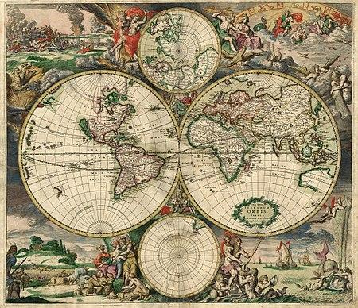
World History
Back to Social Studies slide
Grade Level: 9-12
Length: 1 year
Prerequisite: None
Credit: 1
Course Description:
This World History course consists of the following content area strands: World History, Geography and Humanities. This course is a continued in-depth study of the history of civilizations and societies from the middle school course, and includes the history of civilizations and societies of North and South America. Students will be exposed to historical periods leading to the beginning of the 21st Century. So that students can clearly see the relationship between cause and effect in historical events, students should have the opportunity to review those This World History course consists of the following content area strands: World History, Geography and Humanities. This course is a continued in-depth study of the history of civilizations and societies from the middle school course, and includes the history of civilizations and societies of North and South America. Students will be exposed to historical periods leading to the beginning of the 21st Century. So that students can clearly see the relationship between cause and effect in historical events, students should have the opportunity to review those fundamental ideas and events from ancient and classical civilizations.

Slide 62

World History Honors
Back to Social Studies slide
Grade Level: 9-12
Length: 1 year
Prerequisite: None
Credit: ½
Course Description:
This World History course consists of the following content area strands: World History, Geography and Humanities. This course is a continued in-depth study of the history of civilizations and societies from the middle school course, and includes the history of civilizations and societies of North and South America. Students will be exposed to historical periods leading to the beginning of the 21st Century. So that students can clearly see the relationship between cause and effect in historical events, students should have the opportunity to review those fundamental ideas and events from ancient and classical civilizations.

Slide 63

AP World History
Back to Social Studies slide
Grade Level: 9-12
Length: 1 year
Prerequisite: None
Credit: 1
Course Description:
Students understand the development of civilizations of the world within the context of history by examining connections to the past in order to prepare for the future as participating members of a global community. Students use knowledge pertaining to history, geography, economics, political processes, religion, ethics, diverse cultures, and humanities to solve problems in academic, civic, social, and employment settings.
*Students are required to take the Advanced Placement examination!*
AP World History Curriculum

Slide 64
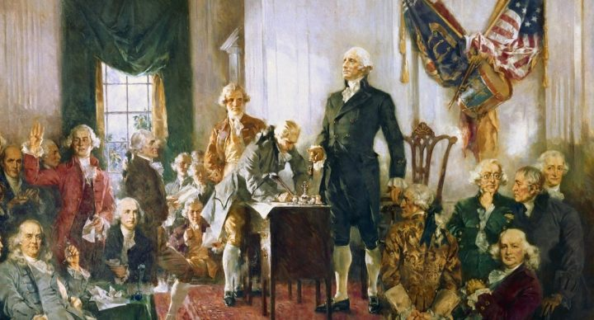
United States History
Back to Social Studies slide
Grade Level: 9-12
Length: 1 year
Prerequisite: None
Credit: 1
Course Description:
Students examine the development of the United States from the Reconstruction period to the current time within the context of history by examining connections to the past to prepare for the future as participating members of a democratic society. They use knowledge pertaining to history, geography, economics, political processes, religion, ethics, diverse cultures and humanities to solve problems in academic, civic, social and employment settings.

Slide 65

United States History Honors
Back to Social Studies slide
Grade Level: 9-12
Length: 1 year
Prerequisite: None
Credit: 1
Course Description:
Students examine the development of the United States from the Reconstruction period to the current time within the context of history by examining connections to the past to prepare for the future as participating members of a democratic society. They use knowledge pertaining to history, geography, economics, political processes, religion, ethics, diverse cultures and humanities to solve problems in academic, civic, social and employment settings. Students in an honors class will study and analyze primary source documents, write document based question essays, and incorporate additional reading and current events.

Slide 66
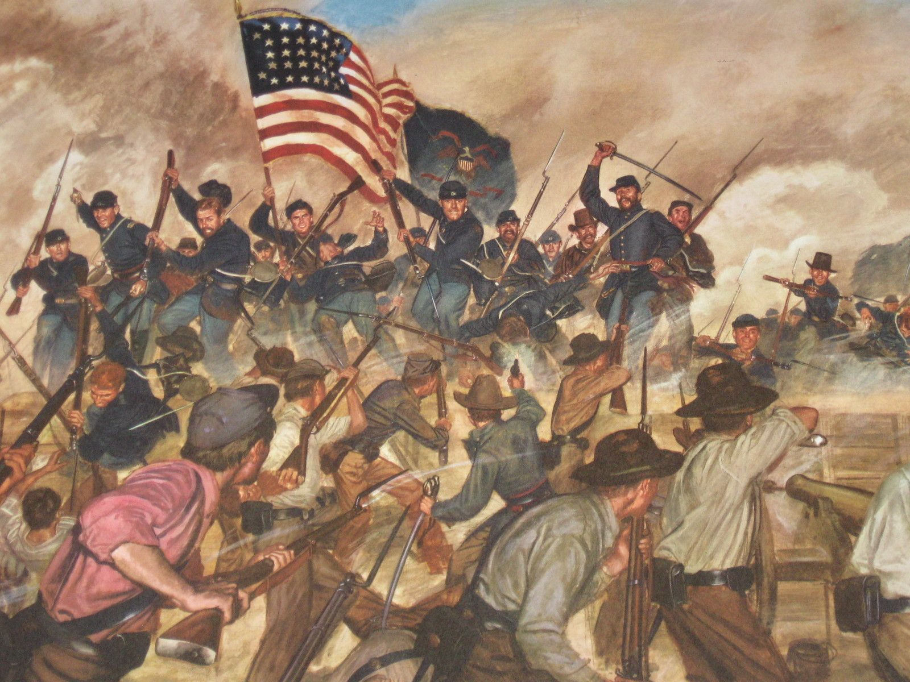
AP United States history
Back to Social Studies slide
Grade Level: 9-12
Length: 1 year
Prerequisite: None
Credit: 1
Course Description:
Students analyze the development of the United States within the context of history by examining connections to the past to prepare for the future as participating members of a democratic society. Students use knowledge pertaining to history, geography, economics, political processes, religion, ethics, diverse cultures and humanities to solve problems in academic, civic, social and employment settings.
*Students are required to take the AP exam!*
AP US History Curriculum

Slide 67
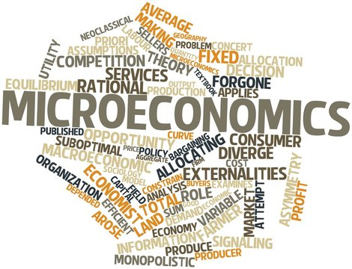
AP Microeconomics
Back to Social Studies slide
Grade Level: 9-12
Length: 1 semester
Prerequisite: None
Credit: ½
Course Description:
Students acquire the decision-making tools necessary for understanding that society must organize its limited resources to satisfy its unlimited wants, and understand the factors that influence the economic system.
*Students are required to take the AP exam!*
AP Microeconomics Curriculum

Slide 68

Psychology 1
Back to Social Studies slide
Grade Level: 9-12
Length: 1 semester
Prerequisite: None
Credit: ½
Course Description:
Through study of psychology, students acquire an understanding of and an appreciation for human behavior, behavior interaction and the progressive development of individuals. This will better prepare them to understand their own behavior and the behavior of others.
Psychology 1 Syllabus

Slide 69
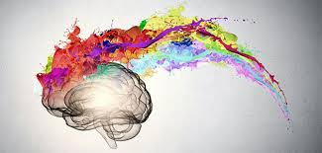
Psychology 2
Back to Social Studies slide
Grade Level: 9-12
Length: 1 semester
Prerequisite: Psychology 1
Credit: ½
Course Description:
Through the study of psychology, students acquire an understanding of and an appreciation for human behavior, behavior interaction and the progressive development of individuals. The content examined in this second introductory course includes statistical research, psychobiology, motivation and emotion, sensation and perception, states of consciousness, psychological testing, and social psychology.

Slide 70

AP Psychology
Back to Social Studies slide
Grade Level: 9-12
Length: 1 year
Prerequisite: Psychology 1 (recommended)
Credit: 1
Course Description:
Analyze human behavior, behavior interaction and the progressive development of individuals. This will better prepare them to understand their own behavior and the behavior of others.
*Students are required to take the AP exam!*
AP Psychology
AP Psychology Example Syllabus

Slide 71

World Cultural Geography
Back to Social Studies slide
Grade Level: 9-12
Length: 1 year
Prerequisite: none
Credit: 1
Course Description:
Students develop multicultural understanding and use geographical concepts and skills to acquire information and systematically apply decision-making processes to real-life situations. They will acquire an understanding of interrelationships between people and their environment.

Slide 72
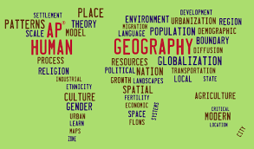
AP Human Geography
Back to Social Studies slide
Grade Level: 9-12
Length: 1 year
Prerequisite: none
Credit: 1
Course Description:
The purpose of this course is to prepare students to understand the discipline of geography, including its tools, themes, and concepts; think critically about geographic problems on a global, national, and local scale; appreciate global cultures and their economic characteristics; and understand how cultural landscapes are created and how they change over time.
*Students are required to take the AP exam for this course!*
AP Human Geography Curriculum

Slide 73

Sociology
Back to course slide
Grade Level:
Length: 1 Semester
Prerequisite: None
Credit: .5
Course Description:
Students acquire an understanding of group interaction and its impact on individuals in order that they may have a greater awareness of the beliefs, values and behavior patterns of others. In an increasingly interdependent world, students need to recognize how group behavior affects both the individual and society.

Slide 74
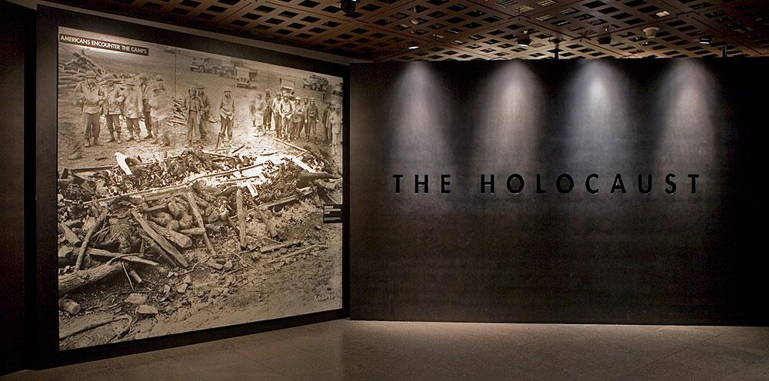
Holocaust
Back to Social Studies slide
Grade Level:
Length: 1 Semester
Prerequisite: None
Credit: .5
Course Description:
The Grade 9-12 Holocaust course consists of the following content area strands: American History, World History, Geography, Humanities, Civics and Government. The primary content emphasis for this course pertains to the examination of the events of the Holocaust (1933-1945), the systematic, planned annihilation of European Jews and other groups by Nazi Germany. Content will include, but is not limited to, the examination of twentieth century pogroms and of twentieth century and twenty-first century genocides, investigation of human behavior during this period, and an understanding of the ramifications of prejudice, racism, and stereotyping.

Slide 75
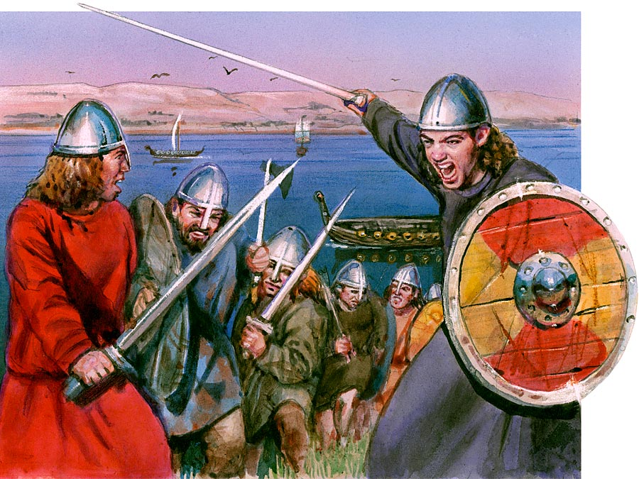
AP European History
Back to Social Studies slide
Grade Level: 9-12
Length: 1 year
Prerequisite: none
Credit: 1
Course Description:
Students analyze the development of Europe within the context of history by examining connections to the past in order to prepare for the future as participating members of a global community. Students use knowledge pertaining to history, geography, economics, political processes, religion, ethics, diverse cultures, and humanities to solve problems in academic, civil, social and employment settings.
*Students are required to take the AP exam for this course!*
AP European History Curriculum

Slide 76

World Religions
Back to Social Studies slide
Grade Level:
Length: 1 Semester
Prerequisite: None
Credit: .5
Course Description:
Students acquire an understanding of the way people in different cultures satisfy their spiritual needs. Students understand the place of religion in culture, the importance that has been attached to religion in people’s lives and the relationship between religion and other social institutions.

Slide 77
Visual Arts
< Back to first slide
Two-Dimensional Studio Art
Digital Art Imaging
Three-Dimensional Studio Art
Creative Photography
AP Studio Art 2D
AP Art History
AP Studio Art 3D
AP Art/Drawing Portfolio

Slide 78
2D Studio Art
Back to Visual Arts slide
Two-Dimensional Studio Art 1
Length: 1 year
Prerequisite: None
Credit: 1
Grade: 9-12
Students experiment with the media and techniques used to create a variety of two dimensional (2-D) artworks through the development of skills in drawing, painting, printmaking, collage, and/or design. Students practice, sketch, and manipulate the structural elements of art to improve mark making and/or the organizational principles of design in a composition from observation, research, and/or imagination. Through the critique process, students evaluate and respond to their own work and that of their peers. This course incorporates hands-on activities and consumption of art materials.
Two-Dimensional Studio Art 2
Length: 1 year
Prerequisite: 2D Studio Art 1
Credit: 1
Grades: 9-12
Students develop and refine technical skills and create 2-D compositions with a variety of media in drawing, painting, printmaking, collage, and/or design. Student artists sketch, manipulate, and refine the structural elements of art to improve mark-making and/or the organizational principles of design in a composition from observation, research, and/or imagination. Through the critique process, students evaluate and respond to their own work and that of their peers. This course incorporates hands-on activities and consumption of art materials.

Slide 79
3D Studio Art
Back to Visual Arts slide
Three-Dimensional Studio Art 1
Length: 1 year
Prerequisite: None
Credit: 1
Grades: 9-12
Students explore how space, mass, balance, and form combine to create aesthetic forms or utilitarian products and structures. Instruction may include, but is not limited to, content in green or industrial design, sculpture, ceramics, or building arts. Media may include, but are not limited to, clay, wood, plaster, and paper maché with consideration of the workability, durability, cost, and toxicity of the media used. Student artists consider the relationship of scale (i.e., hand-held, human, monumental) through the use of positive and negative space or voids, volume, visual weight, and gravity to create low/high relief or freestanding structures for personal intentions or public places. They explore sharp and diminishing detail, size, position, overlapping, visual pattern, texture, implied line, space, and plasticity, reflecting craftsmanship and quality in the surface and structural qualities of the completed art
forms. Students in the 3-D art studio focus on use of safety procedures for process, media, and techniques. Student artists use an art criticism process to evaluate, explain, and measure artistic growth in personal or group works. This course incorporates hands-on activities and consumption of art materials.
Three-Dimensional Studio Art 2
Length: 1 year
Prerequisite: Creating Two-Dimensional Art, Creating Three-Dimensional Art, Two-Dimensional Studio Art 1, OR Three-Dimensional Studio Art 1
Credit: 1
Grades: 10-12
Students explore spatial relationships through the use of nonobjective, abstract, or representational forms, products, or structures. Instruction may include, but is not limited to, content in green or industrial design, sculpture, ceramics, or building arts. Processes and techniques for substitution include wheel-thrown clay, glaze formulation and application, or extruded, cast, draped, molded, laminated, or soft forms. Media may include, but are not limited to, clay, wood, metal, plaster, paper maché, and plastic with consideration of the workability, durability, cost, and toxicity of the media used. 3-D artists experiment with and manipulate space-producing devices, including overlapping, transparency, interpenetration, vertical and horizontal axis, inclined planes, disproportionate scale, fractional or abstracted representation, and spatial properties of the structural art elements. Craftsmanship and quality are reflected in the surface and structural qualities of the completed art forms. Students in the 3-D art studio focus on use of safety procedures for process, media, and techniques. Student artists use an art criticism process to evaluate, explain, and measure artistic growth in personal or group works. This course incorporates hands-on activities and consumption of art materials.

Slide 80

AP Studio Art
Back to Visual Arts slide
AP Studio Art 2D
Length: 1 year
Prerequisite: 2 years of art
Credit: 1
Grades: 10-12
This Advanced Placement course is intended to address a very broad interpretation of two-dimensional (2-D) design issues. This type of design involves purposeful decision-making about how to use the elements and principles of art in an integrative way. It is for the advanced student who wishes to seek AP Credit through submitting a Portfolio of work for consideration by the College Board. Course includes district developed requirements that demonstrate students’ mastery of rigorous standards required of quality point art courses.
AP Studio Art 3D
Length: 1 year
Prerequisite: 2 years of art
Credit: 1
Grades: 10-12
This Advanced Placement course is intended to address a very broad interpretation of sculptural issues in three-dimensional (3-D) design. Such elements and concepts may be articulated through additive, subtractive, and/or fabrication processes. It is for the advanced student who wishes to seek AP Credit through submitting a Portfolio of work for consideration by the College Board. Course includes district developed requirements that demonstrate students’ mastery of rigorous standards required of quality point art courses.
AP 2D Art Curriculum
AP 3D Art Curriculum

Slide 81
Digital Art
Back to Visual Arts slide
Digital Art Imaging 1
Length: 1 year
Prerequisite: 1 year of visual art
Credit: 1
Grades: 10-12
Students explore the fundamental concepts, terminology, techniques, and applications of digital imaging to create original work. Students produce digital still images through the single or combined use of computers, digital cameras, scanners, photo editing software, drawing and painting software, graphic tablets, printers, new media, and emerging technologies. Through the critique process, students evaluate and respond to their own work and that of their peers to measure artistic growth. This course incorporates hands-on activities, the use of technology, and consumption of art materials.

Slide 82
Creative Photography
Back to Visual Arts slide
Creative Photography
Length: 1 year
Prerequisite: 1 year of visual art
Credit: 1
Grade: 9-12
Students explore the aesthetic foundations of art making using beginning photography techniques. This course may include, but is not limited to, color and/or black and white photography via digital media and/or traditional photography. Students become familiar with the basic mechanics of a camera, including lens and shutter operation, compositional foundations, printing an image for display, and evaluating a successful print. Student photographers may use a variety of media and materials, such as 35mm black and white film, single lens reflex camera, digital camera, darkroom, computer application, filters, various papers, digital output, photogram, cyanotypes, Sabatier effect, and pinhole photography. Craftsmanship and quality are reflected in the surface of the prints and the care of the materials. Photographers use an art criticism process to evaluate, explain, and measure artistic growth in personal or group works. This course incorporates hands-on activities and consumption of art materials.

Slide 83
AP Art History
AP Art History Curriculum
Back to Visual Arts slide
AP Art History
Length: 1 year
Prerequisite: 1 year of visual art
Credit: 1
Grades: 11-12
The purpose of this course is to introduce students to the appreciation of works of art, the intelligent examination of works of art, and to the major forms of artistic expression in Western art from 1400 to the present. Course includes district developed requirements that demonstrate students’ mastery of rigorous standards required of quality point art courses.
*Students are required to take the AP Exam

Slide 84
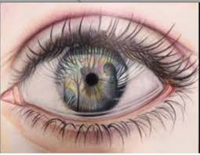
AP Art Drawing Portfolio
Back to Visual Arts slide
AP Art Drawing Portfolio
Length: 1 year
Prerequisite: 2 years of art
Credit: 1
Grades: 9-12
The purpose of this course is to give advanced students the opportunity to develop quality, concentration, discipline, and breadth in drawing. Course includes district developed requirements that demonstrate students’ mastery of rigorous standards required of quality point art courses.
AP Art Drawing Portfolio Curriculum

Slide 85

World Languages
< Back to first slide
Spanish
French

Slide 86
World Languages
Why Learn a New Language?
< Back to first slide
Become a better communicator and listener
Connect with others
Improve your memory
Boost your confidence
Gain perspective and cultural appreciation
Facilitate future language learning
Improve your English ability
Enhance your brain’s health
Boost your creativity
Strengthen your concentration skills

Slide 87


Spanish
< Back to World Languages
< Back to first slide
Spanish 1
Spanish 2
Spanish 3 Honors
Spanish 4 Honors
Spanish 5 Honors
Advanced Placement: Spanish Language

Slide 88
Spanish 1
< Back to World Languages
< Back to first slide
Grade Level: 9-12
Length: 1 year
Prerequisite: Spanish 1 or equivalent
Credit: 1
Spanish 1 introduces students to the target language and its culture. The student will develop communicative skills in all 3 modes of communication and cross-cultural understanding. Emphasis is placed on proficient communication in the language. An introduction to reading and writing is also included as well as culture, connections, comparisons, and communities. Students are expected to demonstrate proficiency at the Novice-low to Novice-high level by the end of this course.
< Back to Spanish

Slide 89
Spanish 2
< Back to World Languages
< Back to first slide
Grade Level: 9-12
Length: 1 year
Prerequisite: Spanish 1 or equivalent
Credit: 1
Spanish 2 reinforces the fundamental skills acquired by the students in Spanish 1. The course develops increased listening, speaking, reading, and writing skills as well as cultural awareness. Specific content to be covered is a continuation of listening and oral skills acquired in Spanish 1. Reading and writing receive more emphasis, while oral communication remains the primary objective. The cultural survey of the target language-speaking people is continued. Students are expected to demonstrate proficiency at the Intermediate-low to Intermediate-mid level by the end of this course.
< Back to Spanish

Slide 90
Spanish 3 Honors
< Back to World Languages
< Back to first slide
Grade Level: 9-12
Length: 1 year
Prerequisite: Spanish 2 or equivalent
Credit: 1
Spanish 3 provides mastery and expansion of skills acquired by the students in Spanish 2. Specific content includes, but is not limited to, expansion of vocabulary and conversational skills through discussions of selected readings. Contemporary vocabulary stresses activities that are important to the everyday life of the target language-speaking people. Students are expected to demonstrate proficiency at the Intermediate-high to Advanced-low level by the end of this course.
< Back to Spanish

Slide 91
Spanish 2
< Back to World Languages
< Back to first slide
Grade Level: 9-12
Length: 1 year
Prerequisite: Spanish 1 or equivalent
Credit: 1
Spanish 2 reinforces the fundamental skills acquired by the students in Spanish 1. The course develops increased listening, speaking, reading, and writing skills as well as cultural awareness. Specific content to be covered is a continuation of listening and oral skills acquired in Spanish 1. Reading and writing receive more emphasis, while oral communication remains the primary objective. The cultural survey of the target language-speaking people is continued. Students are expected to demonstrate proficiency at the Intermediate-low to Intermediate-mid level by the end of this course.
< Back to Spanish

Slide 92
Spanish 4 Honors
< Back to World Languages
< Back to first slide
Grade Level: 9-12
Length: 1 year
Prerequisite: Spanish 3 or equivalent
Credit: 1
Spanish 4 expands the skills acquired by the students in Spanish 3. Specific content includes, but is not limited to, more advanced language structures and idiomatic expressions, with emphasis on communication skills. There is additional growth in vocabulary for practical purposes, including writing. Reading selections are varied and taken from the target language newspapers, magazines, and literary works. Students are expected to demonstrate proficiency at the Advanced-low to Advanced-mid level by the end of this course.
< Back to Spanish

Slide 93
Spanish 5 Honors
< Back to World Languages
< Back to first slide
Grade Level: 9-12
Length: 1 year
Prerequisite: Spanish 4 or equivalent
Credit: 1
Spanish 5 expands the skills acquired by the students in Spanish 4. Specific content includes, but is not limited to, developing presentational speaking skills through oral reports on literary and cultural topics, current events, and personal experiences. Reading selections include newspaper and magazine articles, adaptations of short stories and plays, ad surveys of target language literature. Interpretive writing is enhanced through compositions using correct language structures. Students are expected to demonstrate proficiency at the Advanced-high level by the end of this course.
< Back to Spanish

Slide 94
Advanced Placement:
Spanish Language
< Back to World Languages
< Back to first slide
Grade Level: 9-12
Length: 1 year
Prerequisite: *Spanish 4 and/or 5 or equivalent
Credit: 1
The purpose of this course is to develop oral and written fluency in the language. Content includes, but is not limited to, that determined by the Advanced Placement Program Guidelines.
Students are required to tale the Advanced Placement examination
*It is recommended that students complete the highlest level of Spanish offered at the school before enrolling in an AP course.
< Back to Spanish
Course and Exam Description
Info From College Board

Slide 95


French
< Back to World Languages
< Back to first slide
French 1
French 2
French 3 Honors
French 4 Honors
French 5 Honors

Slide 96
French 1
< Back to World Languages
< Back to first slide
Grade Level: 9-12
Length: 1 year
Prerequisite: None
Credit: 1
French 1 introduces students to the target language and its culture. The student will develop communicative skills in all 3 modes of communication and cross-cultural understanding. Emphasis is placed on proficient communication in the language. An introduction to reading and writing is also included as well as culture, connections, comparisons, and communities. Students are expected to demonstrate proficiency at the Novice-low to Novice-high level by the end of this course.

Slide 97
French 2
< Back to World Languages
< Back to first slide
Grade Level: 9-12
Length: 1 year
Prerequisite: French 1 or Equivalent
Credit: 1
French 2 reinforces the fundamental skills acquired by the students in French 1. The course develops increased listening, speaking, reading, and writing skills as well as cultural awareness. Specific content to be covered is a continuation of listening and oral skills acquired in French 1. Reading and writing receive more emphasis, while oral communication remains the primary objective. The cultural survey of the target language-speaking people is continued. Students are expected to demonstrate proficiency at the Intermediate-low to Intermediate-mid level by the end of this course.

Slide 98
French 3 Honors
< Back to World Languages
< Back to first slide
Grade Level: 9-12
Length: 1 year
Prerequisite: French 2 or Equivalent
Credit: 1
French 3 provides mastery and expansion of skills acquired by the students in French 2. Specific content includes, but is not limited to, expansion of vocabulary and conversational skills through discussions of selected readings. Contemporary vocabulary stresses activities that are important to the everyday life of the target language-speaking people. Students are expected to demonstrate proficiency at the Intermediate-high to Advanced-low level by the end of this course.

Slide 99
French 4 Honors
< Back to World Languages
< Back to first slide
Grade Level: 9-12
Length: 1 year
Prerequisite: French 3 or Equivalent
Credit: 1
French 4 expands the skills acquired by the students in French 3. Specific content includes, but is not limited to, more advanced language structures and idiomatic expressions, with emphasis on conversational skills. There is additional growth in vocabulary for practical purposes, including writing. Reading selections are varied and taken from the target language newspapers, magazines, and literary works. Students are expected to demonstrate proficiency at the Advanced-low to Advanced-mid level by the end of this course.

Slide 100
French 5 Honors
< Back to World Languages
< Back to first slide
Grade Level: 9-12
Length: 1 year
Prerequisite: French 4 or Equivalent
Credit: 1
French 5 expands the skills acquired by students in French 4. Specific content to be covered includes, but is not limited to, developing presentational speaking skills through oral reports on literary and cultural topics, current events, and personal experiences. Reading selections include newspaper and magazine articles, adaptations of short stories and plays, and surveys of target language literature. Presentational writing is enhanced through compositions using correct language structures. Students are expected to demonstrate proficiency at the Advanced-high level by the end of this course.

