Slide 1
Senior class of 2024 information night

Slide 2
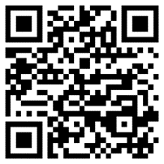
Senior Portraits
Cady Premier Photography is the official photography partner of CSHS
Yearbook photo sessions can be booked at www.cady.com/senior2024
Sessions must be booked in advance- all sessions include a formal yearbook photo, cap & gown photo, and at least one casual image
Cady Studios will be on Campus on Friday, October 27th for a Senior Roadshow. Only the basic session will be available for seniors having their portraits made at school that day. The session fee is $29
You must register online at www.cady.com/senior2024 to sign up for a Roadshow
appointment on October 27th.
Contact information:
-678-722-3449
- CADY studio address:
4899 W Waters Ave Suite F & G,
Tampa, FL 33634
Scan to make your appointment with Cady Studios!

Slide 3
Yearbooks & Senior Ads
Yearbooks can be purchased on www.yearbookordercenter.com
- Order Number is 17261 or you can search by school name
Deadline to purchase and submit Senior Ads for the yearbook is 2/14/24-This is done online through the same website link as above
Yearbooks are starting at $70 for pre-orders online
Senior Panoramic Photo will be taken in the gymnasium on 11/11 during school hours

Slide 4
Grad bash at universal Studios
Grad bash will be on 4/19/24
This is an evening event
Tickets are non-refundable and range from $150-$170 which includes transportation cost as well as park admission
Tickets on sale in December 2023

Slide 5
Senior breakfast & PRoM
Senior Breakfast
prom
Location and time TBD
Business casual attire required
Price to be determined (less than $15)
April 12, 2024 at 7pm at Ruth Eckerd Hall
Prom Tickets will be available beginning in February of 2024

Slide 6
Graduation

Slide 7
Ceremony
Time and location TBD
All textbooks, technology, obligations, and graduation fees must be paid prior to participation.
Walking fee and cap and gown fee are separate

Slide 8
Graduation fees
Cap and Gown Fee:
Herff Jones will be on campus October 17th and 18th to assist students during lunch with placing orders for cap and gown as well as graduation announcements
Also can be placed online at www.HerffJonesTampaBay.com
727-545-3288
Cannot use previous gowns as we have new ones this year
Walking Fee:
$60 to be paid on Revtrak- www.pcsb.revtrak.net
-Click 2024 commencement fees on the left side of the screen
Due by Friday, April 5, 2024

Slide 9
Thank you!
Senior Sponsors
Alison Anderson
andersonali@pcsb.org
Carly Saren
sarenc@pcsb.org
Guidance Counselors, Administrators, and Herff Jones are also on site tonight to assist with questions!

Slide 10
Cougar Graduation Convo

Slide 11
Cougar Graduation Convo
State of Florida Graduation Requirements
Credits, GPA and Specific Courses Required
State Assessments required for Graduation
English and Math
Supports available for your student to meet graduation requirements by grade level

Slide 12
Cougar Graduation Convo
Students must maintain a Grade Point Average (GPA) of 2.0 overall
This is equivalent to a C grade when ALL grades are averaged together each year
Credit Recovery & Grade Forgiveness is available in our school!
Program we use is called Edmentum
Available: During the day AND after school in Extended Learning Programs (ELP)

Slide 13
Cougar Graduation Convo
4 Credits in English Language Arts
English 1, 2, 3, and 4 which can include Advanced Placement, International Baccalaureate, AICE*, or Dual Enrollment (SPC) English classes
4 Credits in Mathematics
Which must include Algebra 1 and Geometry

Slide 14
Cougar Graduation Convo
3 Credits in Science
Which must include Biology and 2 other “equally rigorous” science courses
3 Credits in Social Studies
Which must include World History, US History, Economics, and Government

Slide 15
Cougar Graduation Convo
Specific Courses within 24 credit option (other areas*)
1 Credit in Health Options Physical Education
1 Credit in fine arts OR performing arts OR practical arts courses
8* Elective Credits
the State University System admissions process does require 2 of these electives to be 2 years in a World Language

Slide 16
Cougar Graduation Convo
10th grade Florida Assessment of Student Thinking (FAST): READING
Algebra 1 End-of-Course (EOC) Assessment (usually given in the 9th or 10th grade)
Students who do not pass one or both of these tests the first time they take them become Re-Takers in their junior and senior years

Slide 17
Cougar Graduation Convo
Where can parents get information specific to their student?
You can use PARENT PORTAL in FOCUS and review your student’s course history and test history to determine credits earned, GPA and state tests passed…

Slide 18
Cougar Graduation Convo
What are the options available to students who do not pass the state tests the first time?
RETAKE each test they need several times during their junior and senior years
AND/OR… take another test (called a concordant test) that the state accepts with a specific qualifying score, for ex:
PSAT, SAT and ACT

Slide 19
Cougar Graduation Convo
Concordant Tests and Scores for Algebra 1 EOC
ACT: Score a combined score of 18 on the English and Reading Sections on the
ACT (17.5 rounds up to 18)
SAT EBRW: Score a 480 or higher

Slide 20
Cougar Graduation Convo
Concordant Tests and Scores for Algebra 1 EOC
ACT Math 16
PSAT/NMSQT Math 430
SAT Math 420
Geometry EOC Scale Score 499

Slide 21
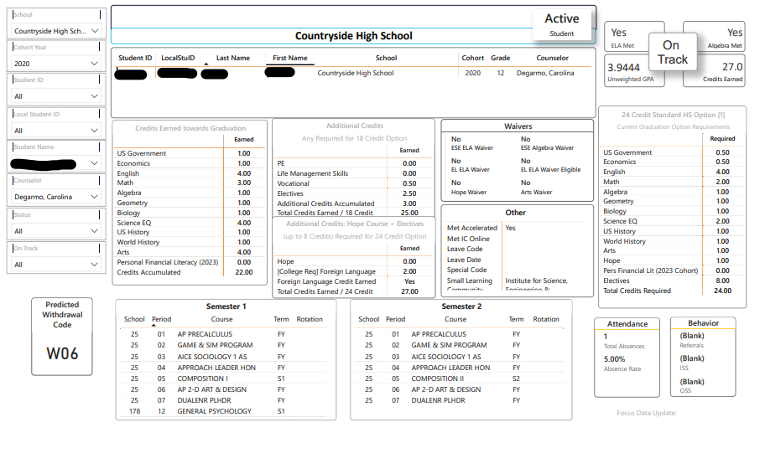
Cougar Graduation Convo

Slide 22
CHS Supports
-Tutoring on campus in each core content area
-Credit recovery through Edmentum
-Saturday FAST and BEST practice
-Critical Thinking and Reading classes for concordance

Slide 23
Cougar Graduation Convo

Slide 24
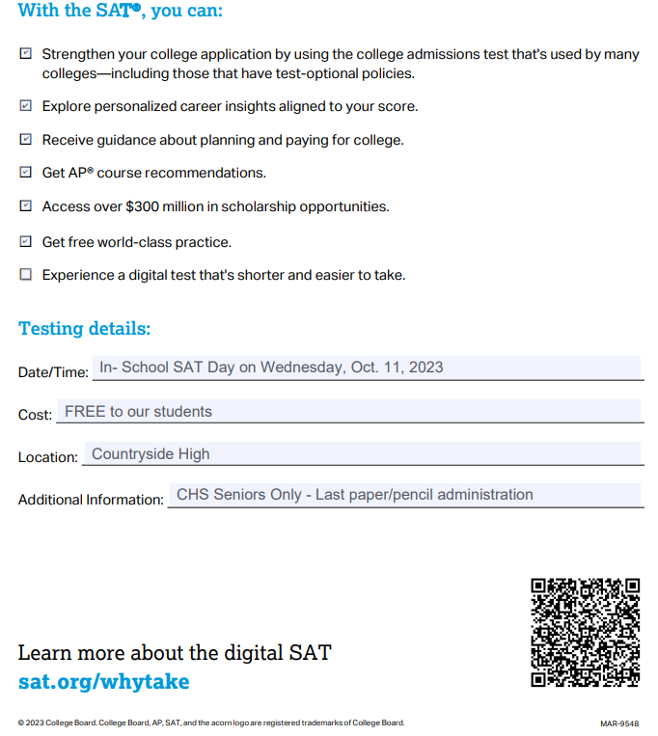

Slide 25
https://satsuite.collegeboard.org/media/pdf/sat-school-day-student-guide.pdf

Slide 26
Cougar Graduation Convo

Slide 28
