Slide 1
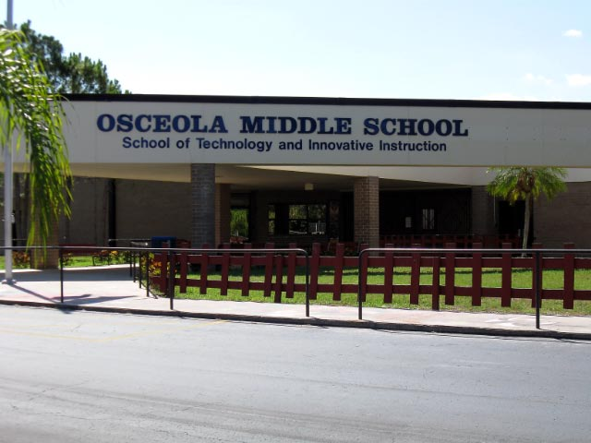
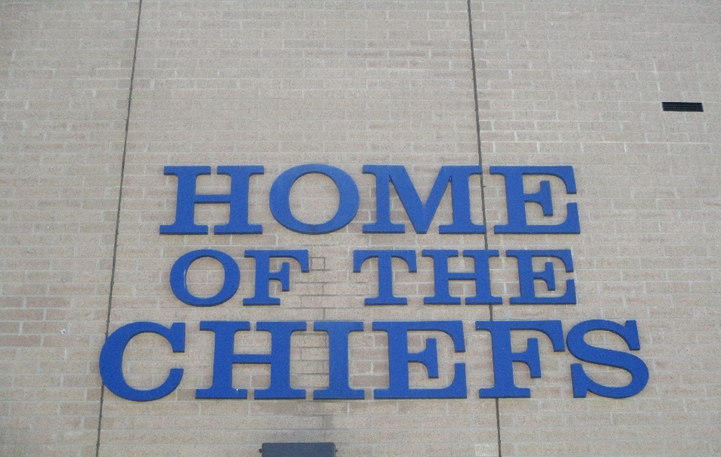
Welcome to OMS

Slide 2
6 Opportunity Day
6 Classes per day
Electives
4 Core Classes include Math, Science, Language Arts, US or World History
Gifted
Enrichment period for all students 6-8
Advanced classes include: Math, Science, Language Arts & US and World History
Intensive classes for Reading

Slide 3
Osceola MS Dress code
Above and beyond PCSB
We have provided a handout with specifics

Slide 4
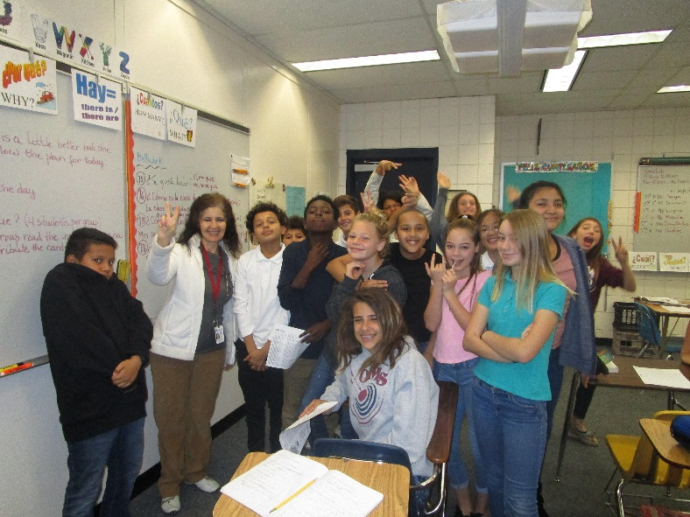
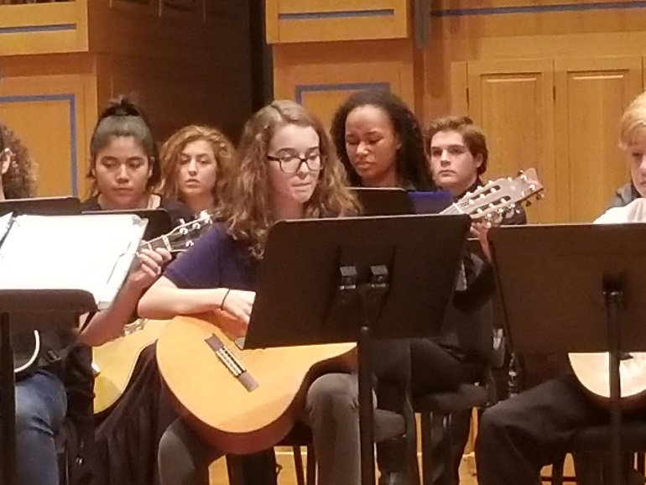
Electives
Exploratory Wheel: Music/Art/Technology/STEM
PE /Technology (a semester each)
Chorus, Band, Orchestra, AVID (yearlong)-application required
6th grade schedules will be available and final at our Chief Community Day Tuesday August 8th

Slide 5
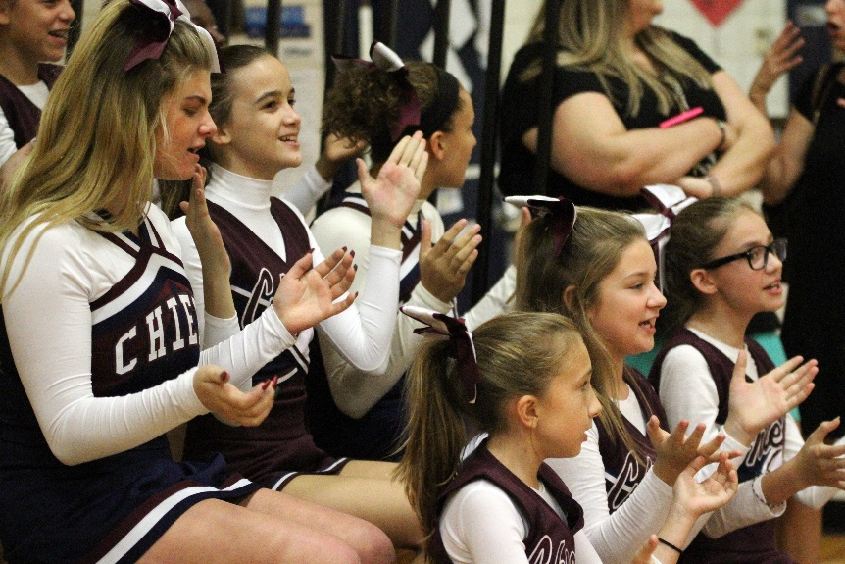
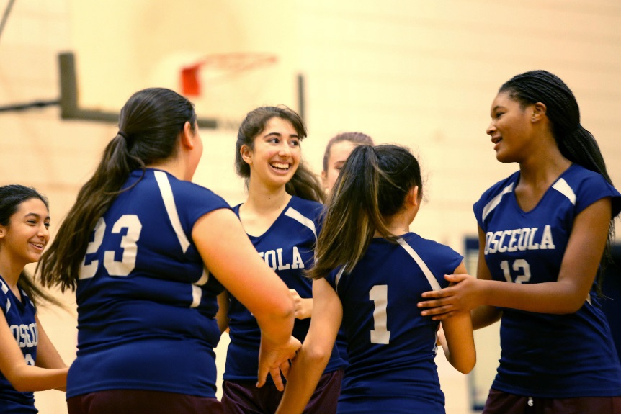
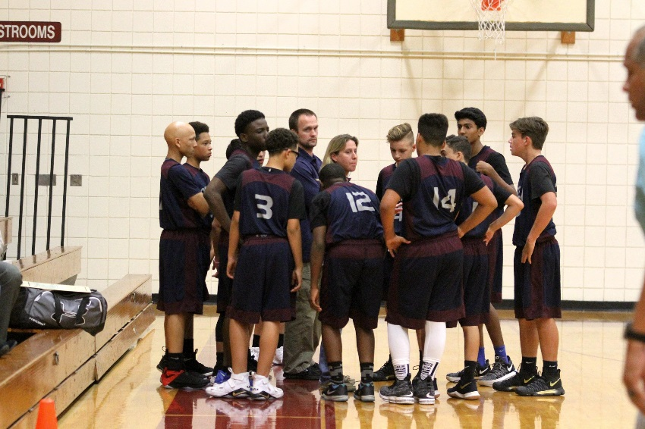
Sports
Volleyball, Basketball, Track, Cheerleading, & Flag Football

Slide 6
Clubs
AVID
Chess
Gaming
GSA
Music Club
NJHS (8th only)
STE(A)M
SAVE/Leadership
Unclub

Slide 7
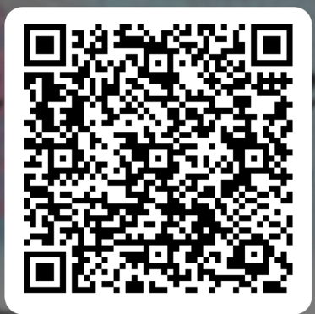
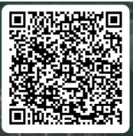
AVID and STEAM Academy Opportunities
STEAM QR: AVID QR:

Slide 8
Peer Connect
Each year Osceola Middle invites our incoming 6th graders to attend our Peer Connection Program. This 3- hour orientation program will be offered twice to give students the opportunity to familiarize themselves with OMS. The students will be split into small groups with a staff member and 8th grade students to help facilitate. The students take a tour of the campus, learn how to use the school locks, team build, and have a chance to ask the 8th graders questions to learn some valuable information. July 27 9:00am-11:00am OR 5:00pm-7:00pm. Choose one.

Slide 9
Website
Please visit the following link for valuable information regarding 6th grade.
Dr. Adams- Assistant Principal
adamsdu@pcsb.org
Mrs. McLellan- 6th grade Counselor
mclellana@pcsb.org

