Slide 1
University Preparatory Academy
Pinellas County Public Schools
UPA - School Improvement Plan
September 16, 2014

Slide 2
UPA’s vision and mission is to prepare students to succeed and thrive in college, career and life
OUR VISION
University Preparatory Academies aims to provide students in historically underserved communities with access to a college preparatory experience. UPA will open a K-8 school in Tampa that will serve approximately 780 students.
UPA’s vision is reflected through three key pillars of our program:
1.) Curriculum and instruction for rigorous college preparation
2.) Continuous improvement through data utilization and collaboration , and
3.) Single gender classrooms
OUR MISSION
UPA provide students from underserved communities with:
Access – to gain access to the opportunities afforded by having a college education
Possibilities- to be marketable and competitive in a 21st century global economy
Change – to develop the skills necessary to contribute to the transformation of their communities
Choice – to develop the perspective and skills necessary to make positive life long decisions
Freedom – to develop the skills necessary to pursue life dreams without hindrance or restraint

Slide 3
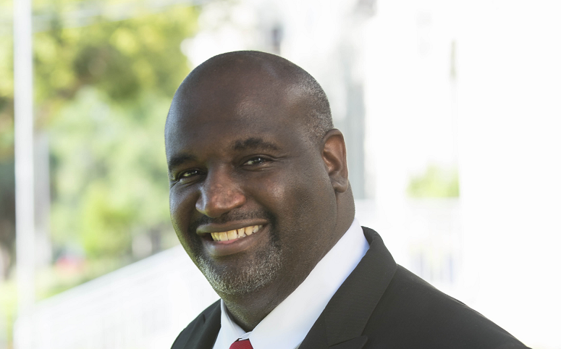
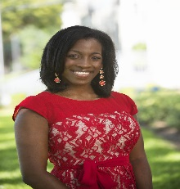
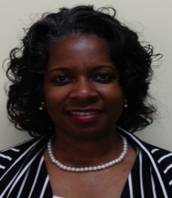
UPA Leadership Team - Who We Are
Name & position
Previous positions
Relevant experience & accomplishments
Darius Adamson
Executive
Director
Regional Superintendent
Executive Director
Managing Director
School Transformation Coach
Principal, Teacher
Consultant, Founder of The Solomon Group
Extensive experience working with CMO’s and traditional school systems in school improvement and turnaround initiatives at national, state, and local levels
Served as Executive Director of the Achievement Zone in Charlotte-Mecklenburg Schools
White House Participant on Convening of Low Performing Schools
Rebecca Watson
Academics Director
Coach and Trainer – TNTP
Consultant
Principal – K-12, public, charter
Teacher – public, charter
Increased school, district and state-level capacity to assess and improve teacher performance in NYC, Camden, NJ
Served as principal of ACT Charter School-leading growth in reading achievement from less than 20% to 75% of students making expected gains in 1 year
New Leaders for New Schools Fellow 2006
Dr. Kendra March
Curriculum Consultant
Deputy Superintendent - ATL
Assistant Superintendent - NC
School Transformation Coach
Principal – K-12, public
Established 4 leadership academies for teacher leaders
School and District leader in a traditional school system of 99,000 students
Accomplished state high growth and federal adequate yearly progress as a principal in high and low poverty schools

Slide 4
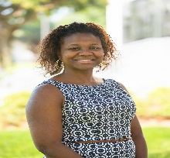
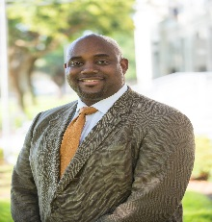
UPA Leadership Team - Who We Are
Name & position
Previous positions
Relevant experience & accomplishments
Crystal Boyd
K-4 Administrator
1st-5th teacher
Grade level leader
New Teacher Mentor
13 years of educational experience
Consulted with NY State Education Department
Earned reputation for closing the achievement gap
Kalu Kalu
5-8 Administrator
Assistant Principal
Consultant
Administrative Assistant
Teacher
14 years of educational experience
Consulted with schools, organizations, adult education, and universities

Slide 5
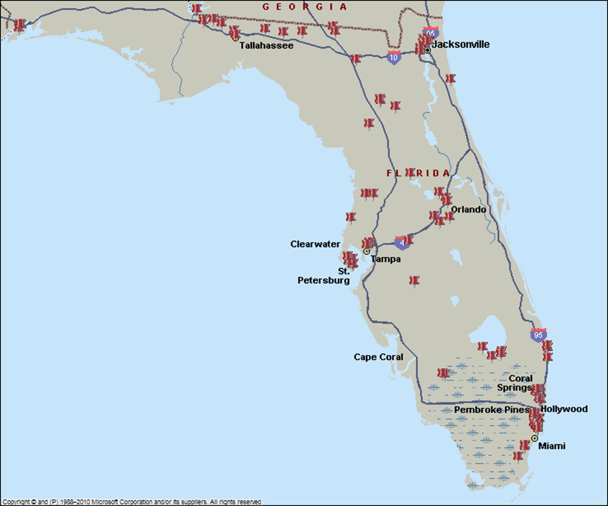
UPA – Why We Are Here
Neighborhoods with schools in the lowest 5% in terms of state test performance and graduation rates
Significant clustering of these schools in Dade, Duval, Pinellas, Osceola, Orange, Palm Beach and Hernando
Florida’s graduation rates for black males is among the lowest in the nation, and two major Florida school districts – Pinellas and Duval have among the lowest rates

Slide 6
UPA – Why We Are Here
Date | Activity
December 2012 | University Preparatory Academies secures funding from the Charter School Growth Fund to build a network of high performing schools in underserved communities throughout Florida
July 2013 | University Preparatory Academy– Pinellas K-8th campus is founded to provide a college prep education to underserved St. Petersburg students
August -December | UPA-Pinellas opens with over 500 students in grades K-8th, however due to management and operational challenges enrollment declines to 300 students
January 2014 | New management team is hired to turnaround the UPA-Pinellas campus
February - June | New management team stabilizes enrollment, rebuilds community trust and develops positive school culture
July - August | UPA - Pinellas has approximately 410 students registered for the 2014-15 school

Slide 7
UPA Snapshot and Where We Are Academically
Founded | Grades | % Low-Income | % Non-White | 2014% Proficient (ELA) | 2014% Proficient (Math) | 2014% Proficient (ELA) | Parent Satisfaction
2013 | K-8 | 99% | 98% | 17% | 11% | 9% | 80%
From these data points the following conclusions were drawn:
Students are in need of intensive academic supports in ELA and Math including more instructional time and strategic interventions
Students are in need of a comprehensive science learning experience with curricula that is aligned to Florida NGSSS
Parents are satisfied when school to family communication is consistent and on-going
Parents satisfaction will increase as student achievement and learning gains increase

Slide 8
UPA’s SIP - Continuous School Improvement
Content
“PRESS”
“SUPPORT”
Instructional
Core
Teacher
Student

Slide 9
UPA’s model focuses on increasing learning and academic growth
Stage 3
6th & 8th
Stage 2
3rd & 5th
Stage 1
K thru 2nd
Foundations/College Prep
MS Prep
HS Prep
Goals | Demonstrate grade level proficiency in Reading and Math
Base Line Year | Show at least 1 year of grade level growth
Growth Target | 1.5 to 2 years growth per year
Method of Evaluation | NWEA, FAIR, and SRI Reading

Slide 10
UPA’s School-Wide Strategic Initiatives
Teachers
2/3 of school has been re-staffed
Focus on intensive coaching and modeling support for teachers (professional development weekly; quarterly additional planning days; significant summer planning time)
Intervention for Students
Additional tiered intervention blocks focused on literacy
Mandatory Study Hall
Assessment and Evaluation of Learning
Use of Thinkgate for formative Assessment creation, to supplement NWEA
Use of Corrective Reading for phonemic awareness and decoding skills Use of I-Ready to supplement reading and math Use of ST MATH
Use of AVID methodology

Slide 11
UPA - ELA Strategic Goals
Target
Action Steps
Schedule and Implement an additional hour of literacy intervention beyond the core classroom instruction
Identify and schedule Level 1 and/or Level 2 students in Corrective Reading
Plan collaboratively to deliver Florida Standards-aligned instruction
Train all teachers in high-yield instructional strategies
Purchase, train teachers, construct and implement common formative assessments by grade level for ELA
Execute regular data meetings to track and monitor progress of students, especially lowest 25%, Level 1s and 2s
Increase ELA proficiency from 17% to 27% by June 2015
At least 90% of students in the lowest 25% will demonstrate 1 year of learning gains in ELA as measured by the FSA-ELA
75% of students will show at least 1 year of grade level growth between pre-and post-assessments (NWEA)

Slide 12
UPA - Math Strategic Goals
Target
Action Steps
Identify and schedule Level 1 and 2 students in ST Math, i-REady.
Plan collaboratively to deliver Florida Standards-aligned instruction
Train all teachers in high-yield instructional strategies
Purchase, train teachers, construct and implement common formative assessments by grade level for Math
Execute regular data meetings to track and monitor progress of students, especially lowest 25%, Level 1s and 2s
Increase Math proficiency from 11% to 21% by June 2015
At least 90% of students in the lowest 25% will demonstrate 1 year of learning gains in Math
75% of students will show at least 1 year of grade level growth between pre-and post-assessments (NWEA)

Slide 13
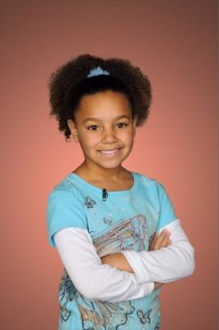
UPA’s emphasis on educating and developing the whole child
1
Art
2
Sharp minds
Music
3
Big hearts
Physical Education
Strong bodies
4
Foreign Language
Noble goals
5
Information and Media Literacy

Slide 14
Thank you for the opportunity to present our School Improvement Plan to the Pinellas County School Board.

