Slide 1
Bluebook app & Windows updates

Slide 2
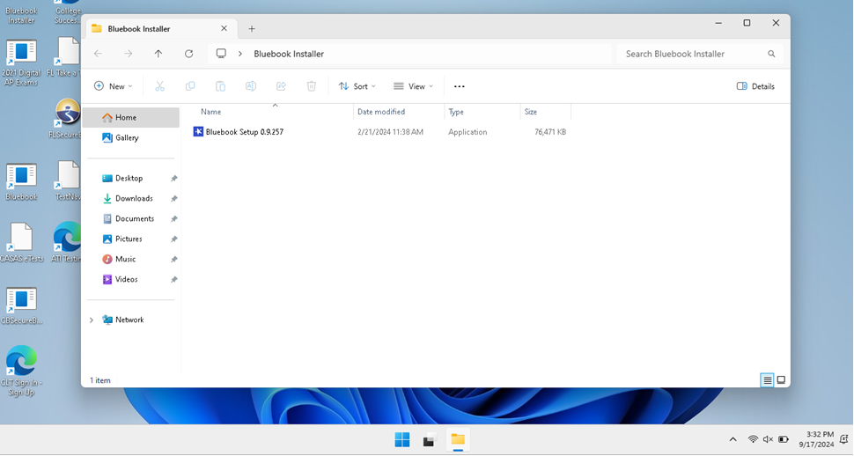
Bluebook App Update
Log in using the testing login 0040cbt
Find the Bluebook Installer icon & select
When the Bluebook Installer files opens double click on Bluebook Setup

Slide 3
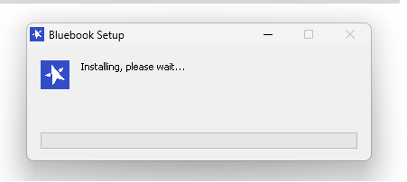
Bluebook App Update Cont
You will see an install window pop up
After installing it launches updates to get the newest version of Bluebook

Slide 4
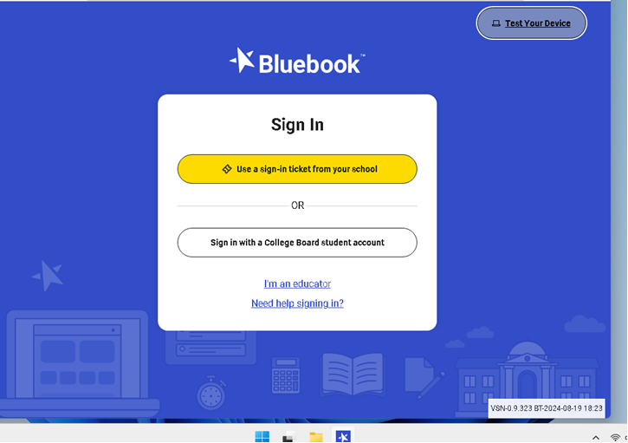
Bluebook App Updates cont.
Once the app updates please select Test Your Device in the upper right-hand corner, all three items should have a green check.
At this time, please have students log-in using their College Board account information
They must know this information from memory there will be no access to any cell phone or password manager app on test day
If you can’t remember your password now would be a good time to change it, maybe your PCS password would be good.
Have students complete a TEST PREVIEW where they can practice with multiple-choice and FRQ questions to get familiar with the app.

Slide 5
Windows Update
Once the Bluebook App is updated, & a quick test preview has happened, have all students shut down their laptops and restart
This may be a lengthy process, keep the laptop open and “awake” and allow it to take it time to update.

Slide 6
Testing Reminders
Charge your laptop NIGHTLY
Bring your FULLY CHARGED laptop and CHARGER to school daily
Know your College Board login information (memorize it, if password is too hard to remember now is the time to change it…maybe your PCS password is a good choice)
Student will NOT have access to your phone or a password manager on test day!!!

