Slide 1
Chapter 25
Geography and the
Settlement of Greece

Slide 2
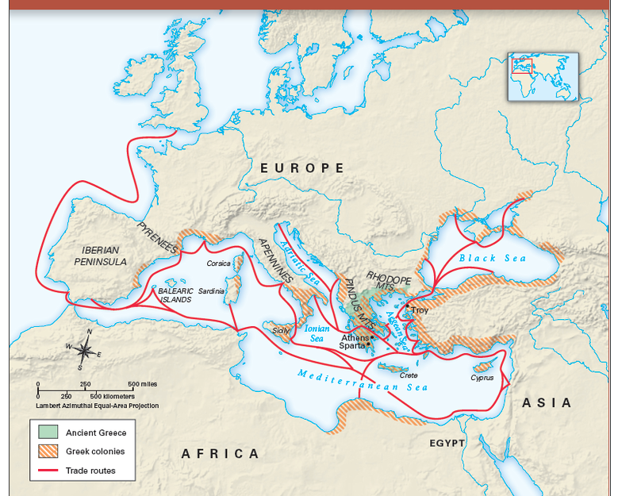
World of the Ancient Greeks

Slide 3
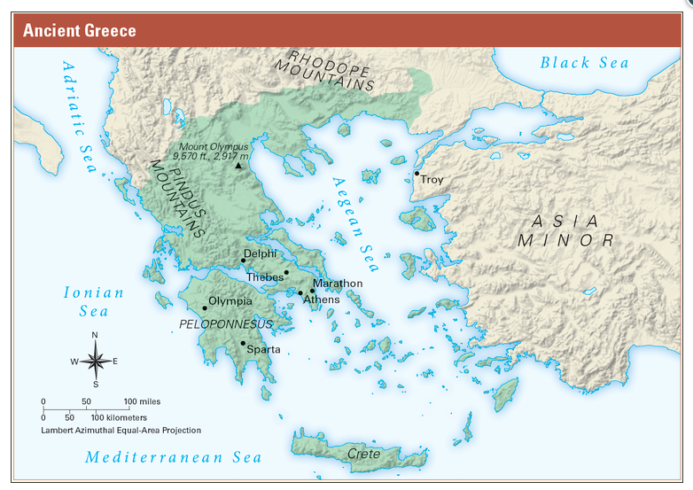
Ancient Greece Geography

Slide 4
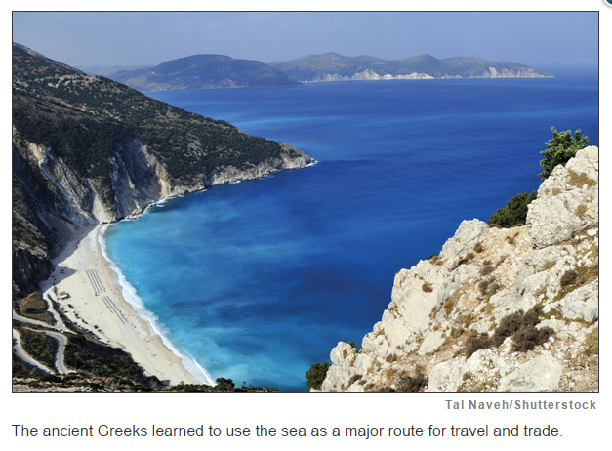
How did geography influence settlement and way of life in ancient Greece?

Slide 5
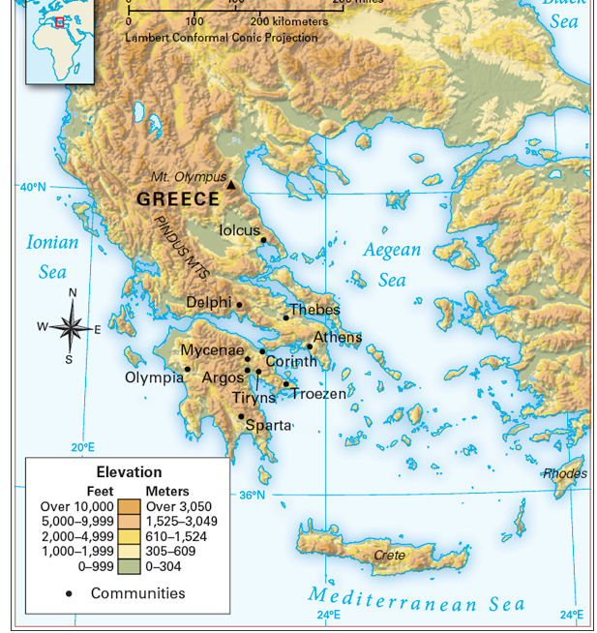
Isolated Communities and the Difficulties of Travel

Slide 6
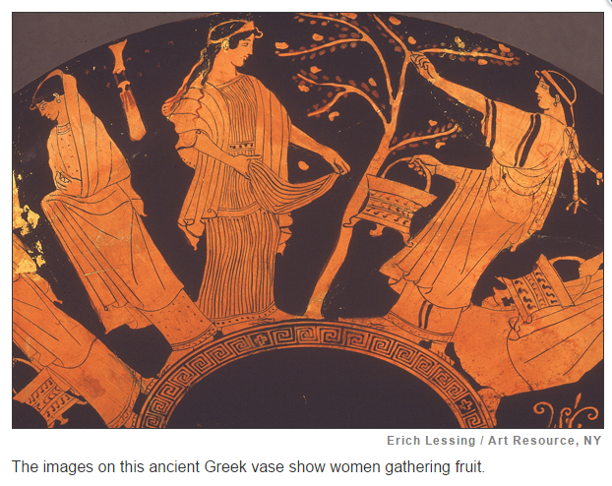
Farming in Ancient Greece

Slide 7
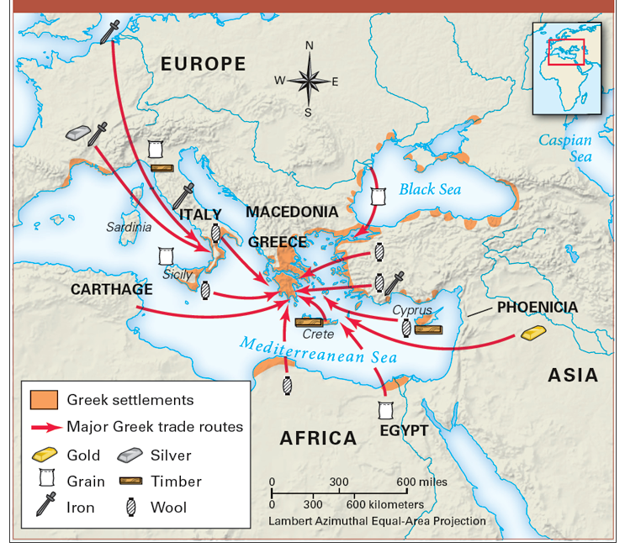
Ancient Greek Colonies and Trade Routes

Slide 8
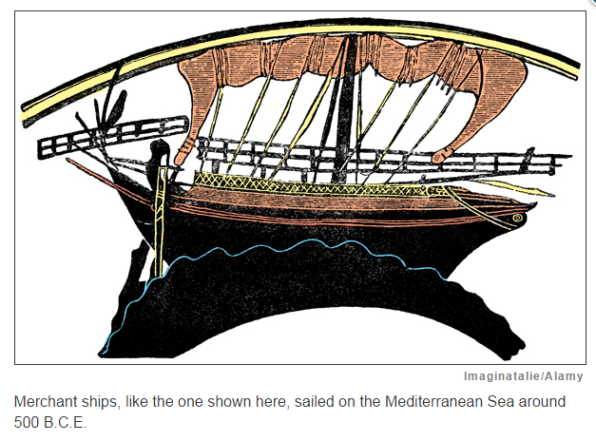
Trading for Needed Goods

Slide 9
How did geography influence settlement and way of life in ancient Greece?
Greece’s steep mountains and surrounding seas forced Greeks to settle in isolated communities. Travel by land was hard, and sea voyages were hazardous.
Most ancient Greeks farmed, but good land and water were scarce. They grew grapes and olives, and raised sheep, goats, pigs, and chickens.
Many ancient Greeks sailed across the sea to found colonies that helped spread Greek culture. Colonists settled in lands that include parts of present-day Turkey, Spain, France, Italy, and northern Africa.
To meet their needs, the ancient Greeks traded with other city-states, their colonies, and with other peoples in the Mediterranean region. They exchanged olive oil and pottery for such goods as grain, timber, and metal.

