Slide 1
Chapter 33 The Rise of the Roman Republic

Slide 2
Ancient Roman Social Classes Before Plebeians Rebel

Slide 3
Patrician (Rich) Life

Slide 4
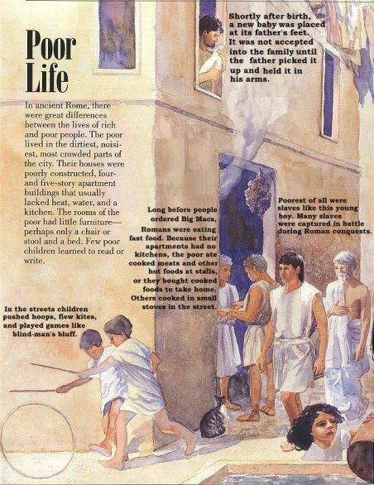

Slide 5
What were the characteristics of the Roman Republic and how did they change over time?

Slide 6
Patricians and Plebeians Under Etruscan Rule

Slide 7
The Patricians Create a Republic

Slide 8
The Plebeians Rebel

Slide 9
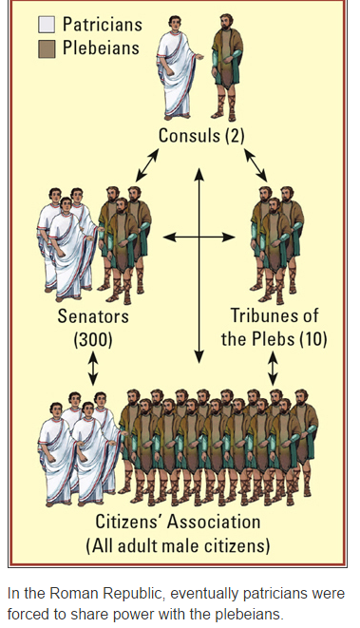
The Plebeians Gain Political Equality
Plebeians gained rights. Laws were written down, so the patricians couldn’t change them at will. The laws were published on tablets called the Twelve Tables. Eventually, the patricians were forced to share power with the plebeians.

Slide 10
Comparing Republican Governments Rome vs. United States of America

Slide 11
What were the characteristics of the Roman Republic and how did they change over time?
Romans overthrew the Etruscans and created a republic. Romans were proud of their republic, which lasted for about 500 years. Under the Etruscans, Roman society was divided into two classes, patricians and plebeians. Plebeians made up about 95 percent of Rome’s population, but had little voice in the government.
In 509 B.C.E., patricians drove out the last of the Etruscan kings and created a republic. Most of the power was held by the patrician Senate and the consuls. Only patricians could participate in the new government.

Slide 12
What were the characteristics of the Roman Republic and how did they change over time?
The plebeians began to demand more political rights in a struggle with the patricians known as the Conflict of the Orders. In 494 B.C.E., angry over the lack of power, the plebeians rebelled.
The patricians agreed to let the plebeians elect Tribunes of the Plebs and the Council of Plebs. Around 451 B.C.E., the Twelve Tables were published. By 287 B.C.E., assemblies of all citizens could pass laws. Plebeians governed with patricians. The plebeians had won their fight for equality.

