Slide 1
Chapters 36 & 37
The Origins and
Spread of Christianity
&
The Learning about the
World Religions: Christianity

Slide 2
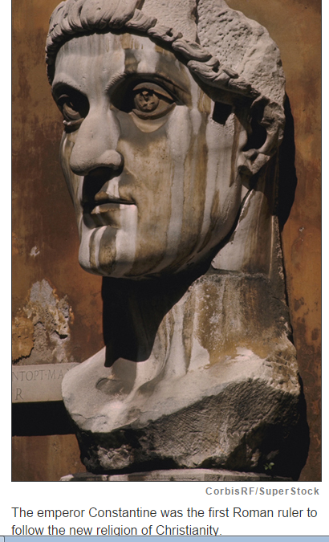
How did Christianity originate and spread?

Slide 3
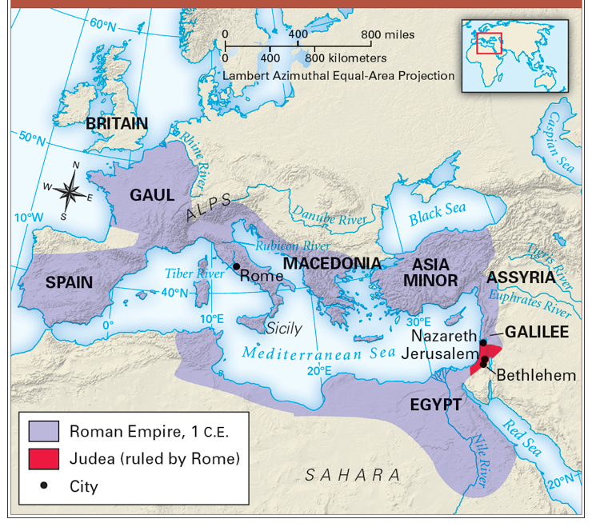
Judea: The Birthplace of Christianity

Slide 4
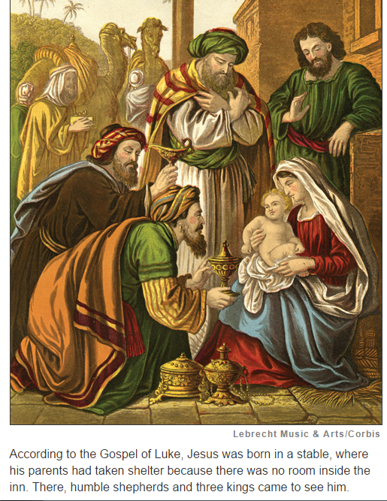
The Birth of Jesus

Slide 5
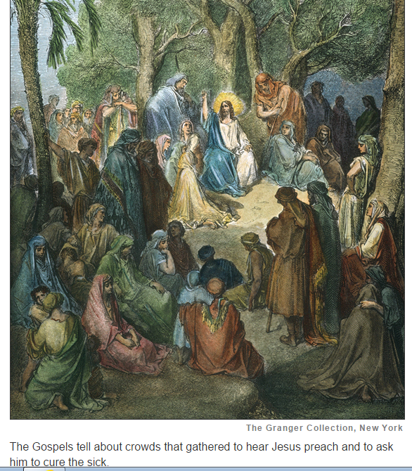
The Life and Death of Jesus

Slide 6
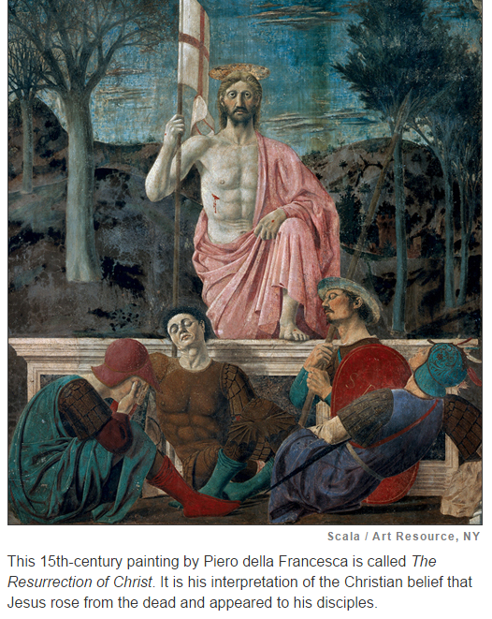
The Crucifixion and Resurrection of Jesus

Slide 7
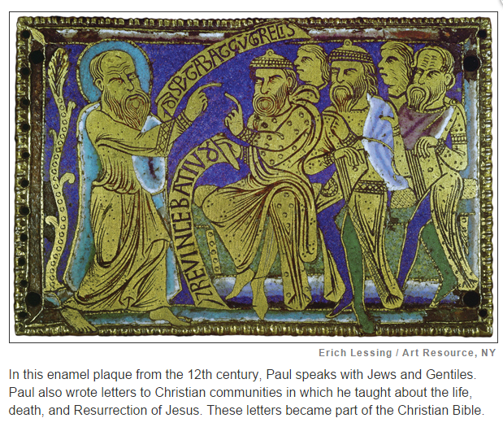
The Missionary Work of Paul

Slide 8
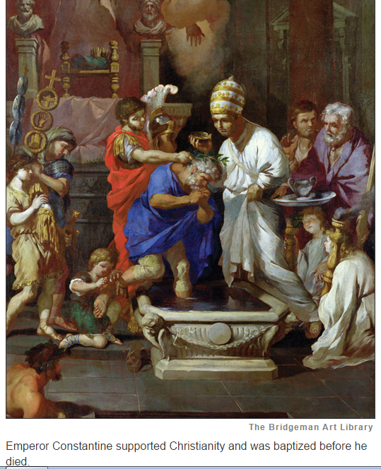
Spread of Christianity

Slide 9
How did Christianity originate and spread?
Christianity began in Judea in the present-day Middle East. Jews there told prophecies about a Messiah who would remove the Romans and restore the kingdom of David.
What we know about Jesus’s life and his birth around 6 B.C.E., comes from the four Gospels. Not much is known about his childhood, but when Jesus was about 30, John the Baptist identified him as the Messiah.

Slide 10
How did Christianity originate and spread?
Jesus preached with his disciples in present-day Israel. He emphasized love and mercy, and often taught in parables. His teachings angered some. In his early 30s, the Romans executed Jesus by crucifixion. According to the Christian Bible, three days later, he arose from the dead and appeared to his disciples. His disciples began to spread his teachings.

Slide 11
How did Christianity originate and spread?
Paul of Tarsus was a Jew. He persecuted Christians. But after a vision, he became an important Christian missionary, spreading the religion around the empire. His letters to early churches are part of the Christian Bible.
The new religion survived harsh persecution and spread across the Roman Empire. In 313 C.E., the emperor Constantine gave Christians freedom of religion in the Edict of Milan. It was the official Roman religion by 380.

Slide 12
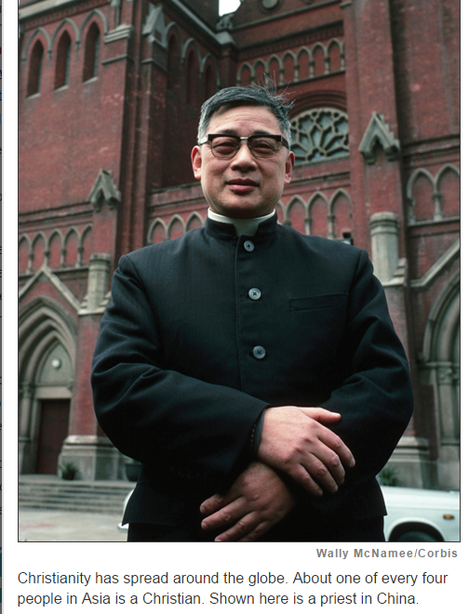
How are Christians’ lives shaped by the beliefs and practices of Christianity?

Slide 13
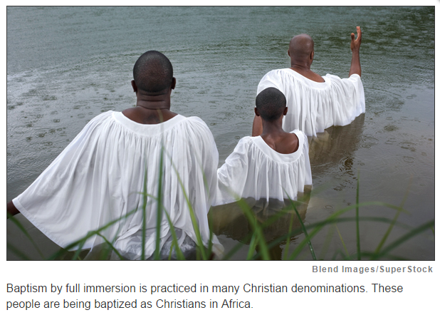
The Central Beliefs of Christianity

Slide 14
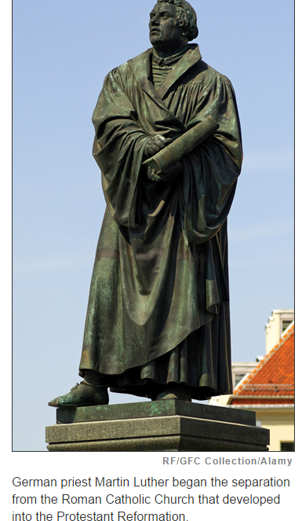
The Reformation

Slide 15
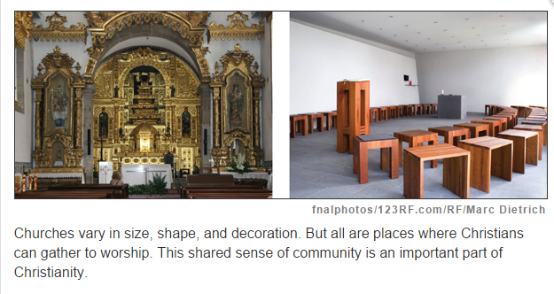
Christian Sacraments and Worship

Slide 16
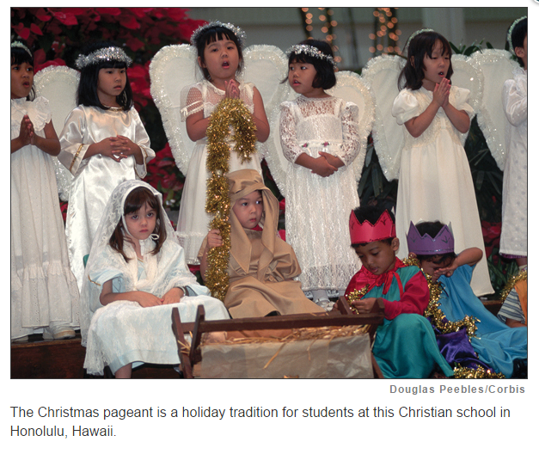
The Christian Year

Slide 17
How are Christians’ lives shaped by the beliefs and practices of Christianity?
Christianity has grown into the world’s largest religion. It has also become a diverse faith with many denominations.
Christians believe in one God with three parts—Father, Son, and Holy Spirit—known as the Trinity. Christians believe in the Resurrection of Jesus. They also believe in salvation from sin and in eternal life.
In 1054, Eastern Orthodox Christianity split from Roman Catholic Christianity in the Great Schism. Beginning in the 1500s, Martin Luther and others began the Reformation that separated Protestants from the Roman Catholic Church and led to the creation of thousands of Protestant denominations.

Slide 18
How are Christians’ lives shaped by the beliefs and practices of Christianity?
Most Christians practice the sacraments of baptism and Holy Communion. Baptism brings a person into the Christian Church. In Holy Communion, Christians share bread and wine or grape juice as Jesus did in his Last Supper.
Many Christians make group worship at church services part of their lives. The most important Christian holidays of the Christian year are Christmas and Easter.

